Slide 1
What’s in your Watershed?
A. Write the definition: A watershed is the land area that drains rain and melted snow into a creek, river, lake, or ocean.

Slide 2
B. (Write this slide):
Watershed Characteristics are based on -
Area
Length
Slope
Soil
Vegetation Types
Divides with adjoining watersheds

Slide 3
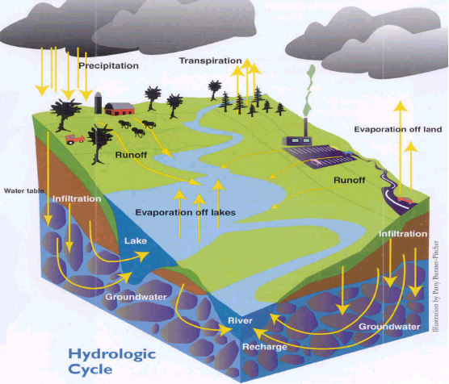

Slide 4
Model a Watershed
1. Crumple up your piece of paper into a loose ball.
2. Slightly un-crumple your paper (Don’t smooth it out). The high points are mountains and the low points are valleys.
3. Use your blue marker to trace the ridgelines of the mountains (tops of fold lines).
  C. Write a prediction of where the rain would go if it rained on your mountains.

Slide 5
4. Gently spray 3-4 squirts of water over your model.
  D. Describe what happened. Where did your water collect etc.?
  E. Answer: What might be living in those areas?
5. With your finger, trace the different watersheds on your model.
  F. How many watersheds can you find?

Slide 6
Model a polluted watershed
6. Crumple up a new piece of paper and repeat steps one and two (Use your blue marker to trace mountain ridgelines and predict where the rainwater would travel).
7. Next, imagine a pollutant that you would not want in your watershed. For example, maybe someone changed their car oil and spills it on the ground. Use your black marker and make a few dots of areas representing this pollutant in different areas of your model.

Slide 7
  G. Answer: Why should we be concerned about pollution?
  H. Answer: How might organisms be affected?
  I. Answer: What can you do to prevent pollution in your watershed?
8. Spray 3-4 squirts of water on your new model and see what happens.
  J. Answer: What watershed do you live in? Go to Surf Your Watershed http://cfpub.epa.gov/surf/locate/index.cfm.
  K. Write the definition: Runoff (surface runoff a.k.a. overland flow): is the flow of water that occurs when excess stormwater, meltwater, or other sources flows over the earth's surface.

