Slide 1
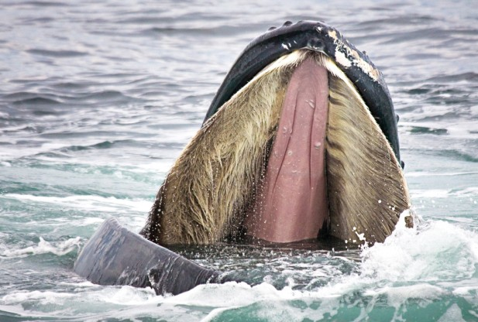
A Whale of a Find
1. Number the paragraphs
2. Read the article
3. Circle confusing words or points
4. Underline/highlight information related to genetics
5. Discuss your assigned paragraph(s) with your group
6. Share out the main idea of your paragraph(s)
{Spokesperson with the highest # of pets}
7. Write a summary (individually) that includes information about how genetics and evolution are related.

Slide 2
Lizard and Whale Article Comparison
8. In your groups, create a “T” chart and list
specific examples/ideas from each article that support (or are related to) genetics and evolution.

Slide 3
9. Write a claim about how the information in the articles provide evidence for evolution. Support your claim with specific examples from each article.
Example: The information in the articles both provided evidence for evolution. For example, in the lizard article scientists found that ___________________________. This indicates that ____________________. Similarly, in the “whale” article ___________________________ which provides support because ____________________________________.

