Slide 1
Taxonomy
The Classification of Life
Essential Question: How are organisms classified into different groups?

Slide 2
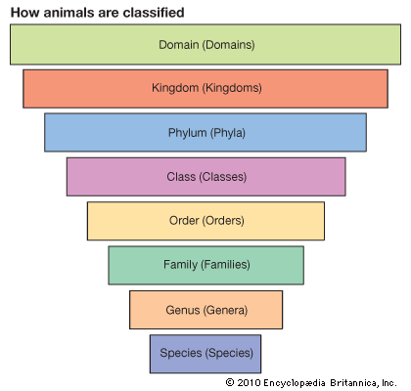
Taxonomy
Taxonomy = Biological classification:
Each organism is placed into 8 taxa according to its characteristics with other organisms.
With each level, the amount of organisms in each taxa shrinks because what they have in common becomes more specific.

Slide 3
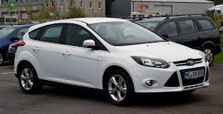
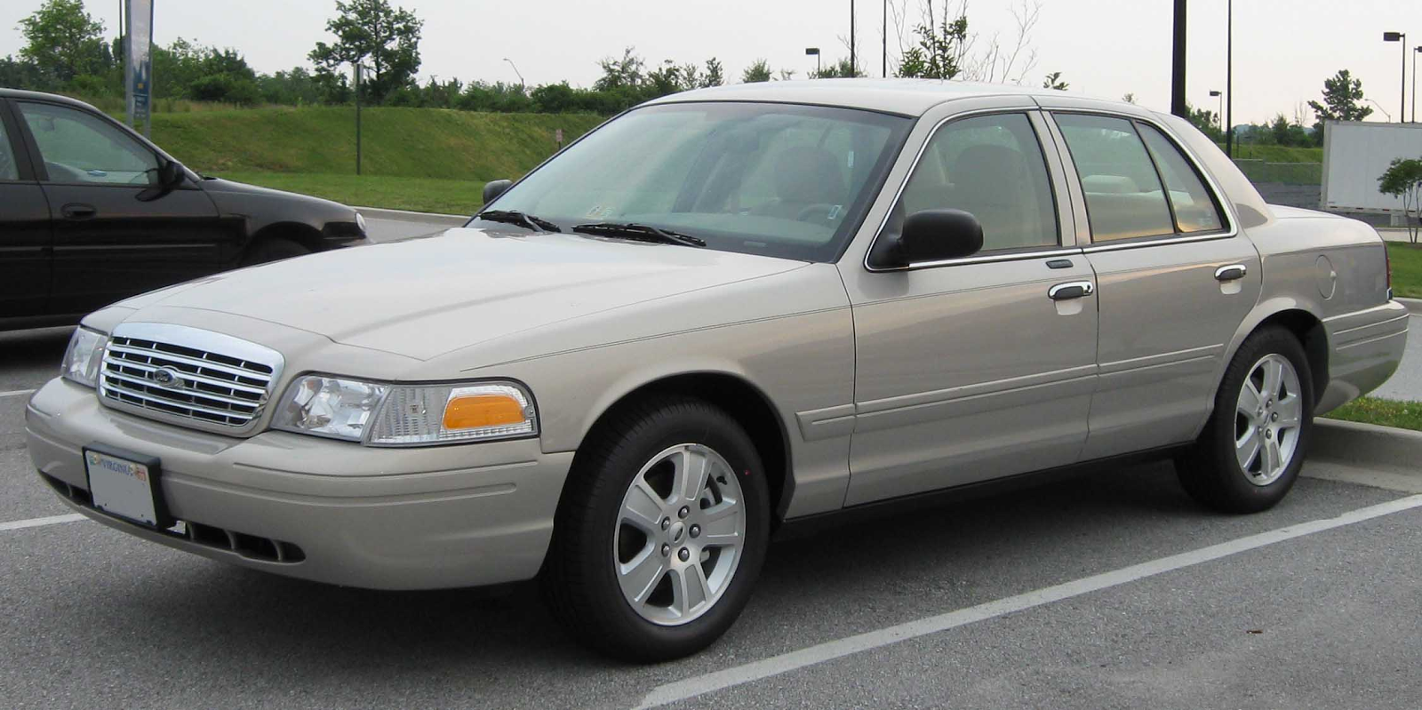
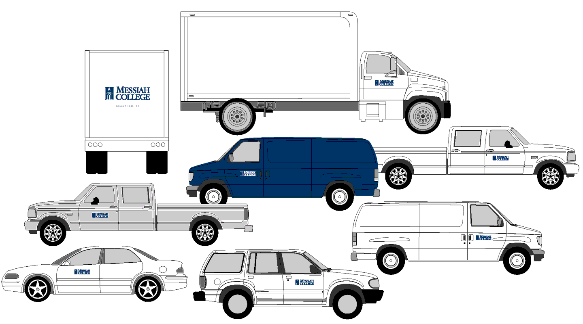
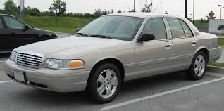
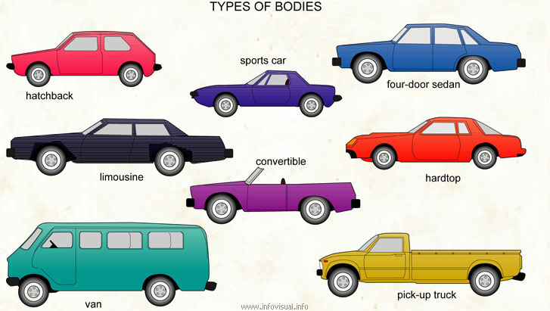
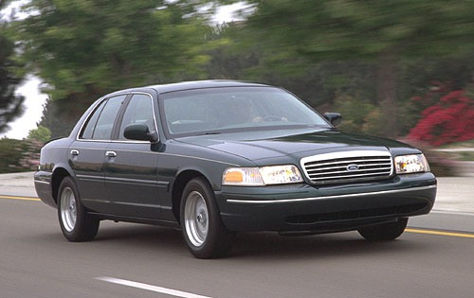
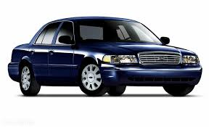
Domain
Order
Vehicles
Anything that’s used for transportation
Automatic vs
Stick?
Kingdom
Family
Energy Source?
Fuel or Electric?
Automobile
Uses 4 or more wheels
Automatic Gas Crown Victoria
Phylum
Genus
Different brands of automobiles
Class
Species
2014
Body Type
2000

Slide 4
Taxonomy

Slide 5
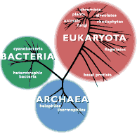
Domains
Eukaryota: (Fungi, Protists, plants, animals..) Made of Eukaryotic cells, which have a “true” nucleus and organelles. More complex.
Bacteria: (Heterotrophic), (Made of prokaryotic cells. Less complex, more primitive, no nucleus etc.) Many beneficial, some harmful.
Archaea: Halophiles and thermophiles. Made of prokaryotic cells.
Notes:
Source: http://www.ucmp.berkeley.edu

Slide 6
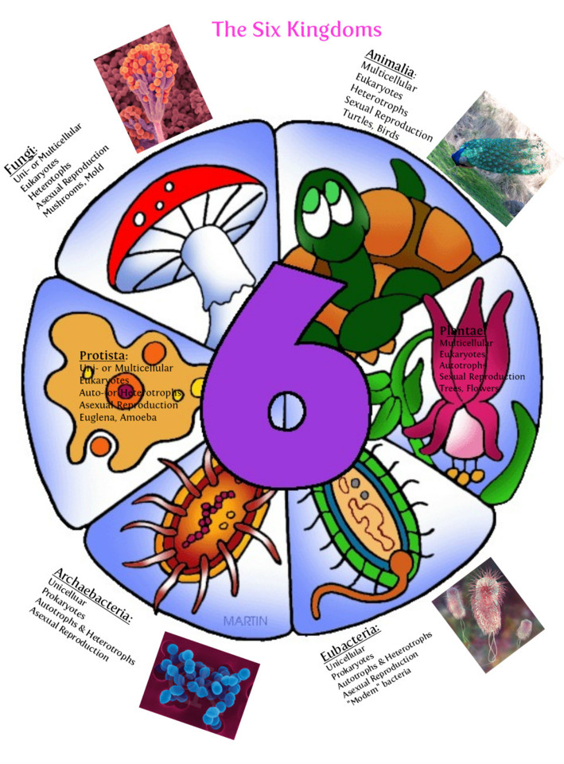
Kingdoms

Slide 7
Six Kingdoms

Slide 8
Taxonomy Poster
You will work with a partner to become familiar with taxonomy and scientific naming.
1. Use a Chromebook to research information about the 6 kingdoms.
2. Choose 3 organisms (1 from each of 3 of the kingdoms) and write their scientific names, draw each of them and describe them.
3. For the remaining 3 kingdoms, create 3 “made-up” creatures that would fit into these kingdoms, draw them, name them using scientific names and describe them.

Slide 9
Phylum Project:
You and a partner will be doing research on a specific phylum of organisms and making a poster (on a white board).
Your poster needs to have the following information on it:
The scientific phylum name
What kingdom and domain is it a part of?
4-5 characteristics that define that group
A drawing and name of a unique organism within that group
An interesting fact about this group of organisms

