Slide 1
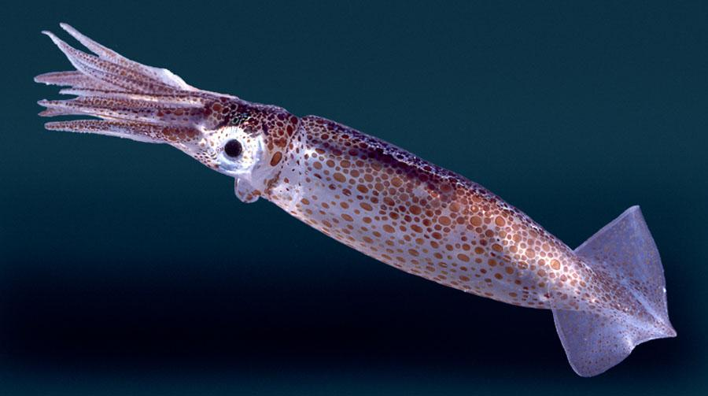
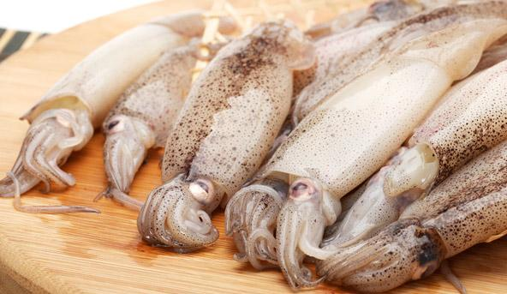
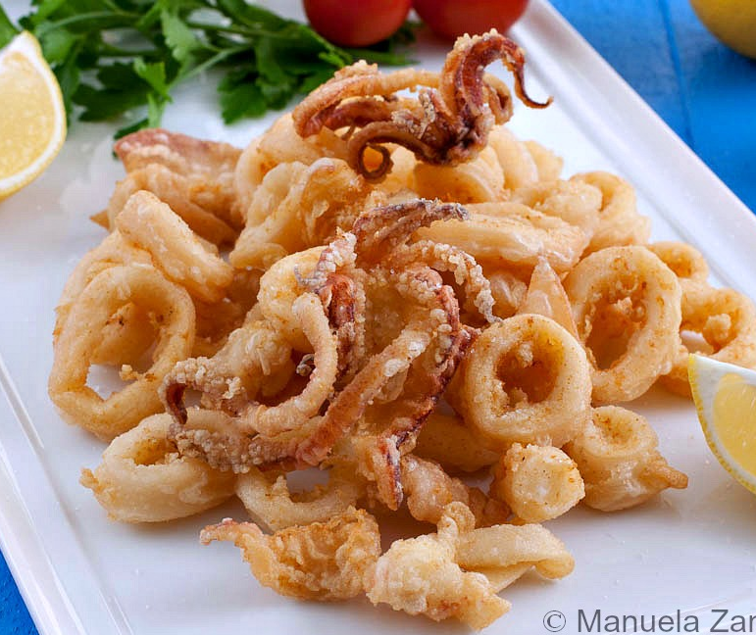
Squid Dissection

Slide 2
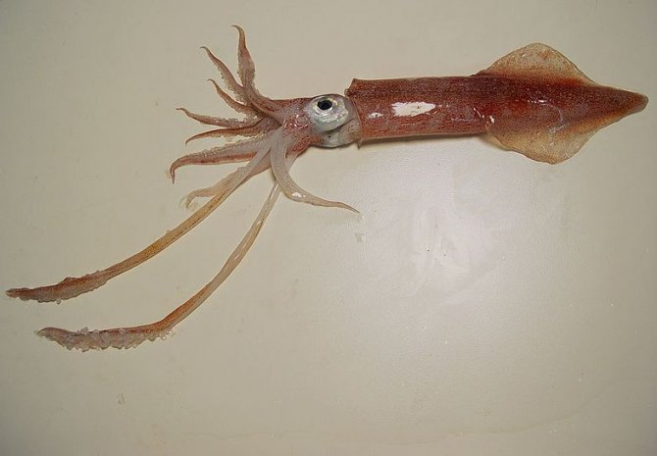
Warm-up:
Read the descriptions of the anatomy of the squid and think about how the physical structures are adaptations that aid in survival

Slide 3
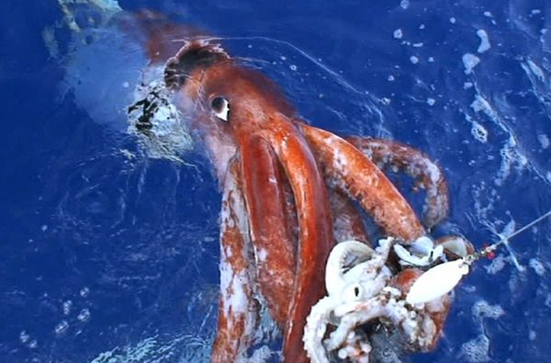
Today’s Goal: Explore the squid!

Slide 4
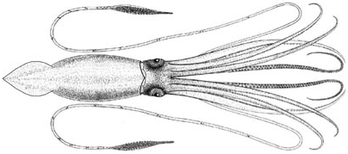
Squid Facts
An ocean predator.
Catches prey using its tentacles and suckers.

Slide 5
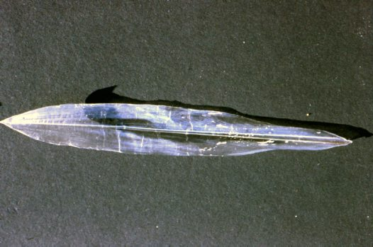
Squid Pen

Slide 6
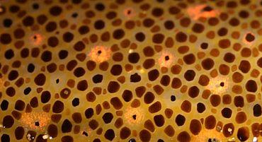
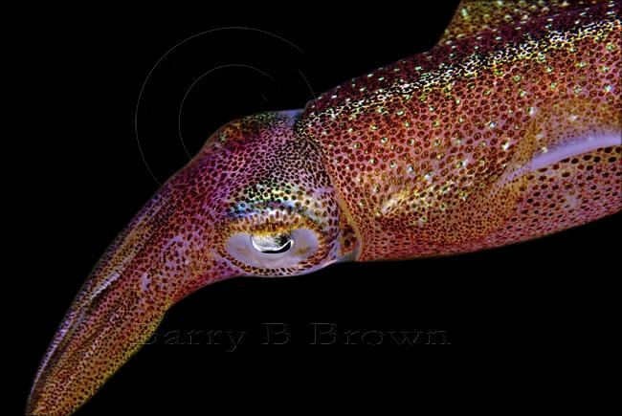
Chromatophores

