Slide 1
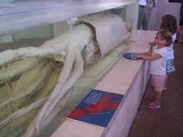
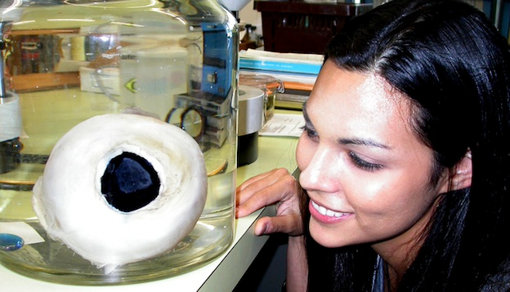
Squid Article
Number the paragraphs
Read through one time without making any marks (“Popcorn” Read).
Read a second time and circle
any confusing words or ideas

Slide 2
Analysis (p. 36)
Why do they think the giant squid evolved such large eyes?
What is meant by the “law of diminishing returns?” (Paragraph 5)
How do they know that sperm whales eat giant squid?
What exactly are the squids’ eyes adapted to see (not just the whale).
What is meant by “arms race” (Paragraph 13).

Slide 3
Videos
Natgeo Sperm whale looking for squid (6:32)
Sperm Whale vs. Giant Squid (2:35)
Discovery Channel Video - giant squid (2:31)

