Slide 1
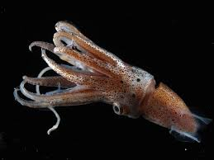
Squid Analysis P.28 (back of PPT)
Cephalopods, the group containing squid have been on earth for more than 500 million years.
Why do you think fossil cephalopods are rare?
There are over 500 species of squid, what are some adaptations you think might play a role in the success of the group?
If there are present day organisms that are very similar to their ancient ancestors, what might that tell you about their environment. Give an example.

