Slide 1
Speciation and Population Genetics

Slide 2
Objective
All students will compare and contrast allopatric and sympatric speciation and understand the evidence for speciation seen in patterns of evolution.

Slide 3
What is a species?
A species is interbreeding populations of organisms that can produce healthy, fertile offspring.
Add two examples of different species on the lines of your paper

Slide 4
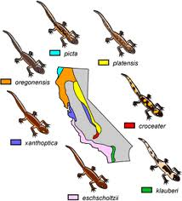
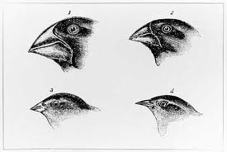
What is speciation?
Speciation is the evolution of one or more species from a single ancestor species.

Slide 5
There are two types of speciation, they are :
Allopatric speciation
Sympatric speciation

Slide 6
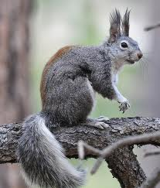
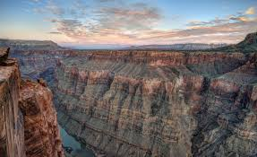
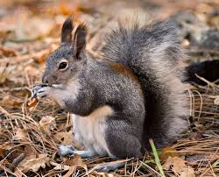
Allopatric Speciation
In allopatric speciation, a physical barrier divides one population into two or more populations. The separate populations eventually will no longer be able to breed successfully with one another.
Notes:
Abert squirrel on left – Kaibab squirrel on right (separated by Grand Canyon)

Slide 7
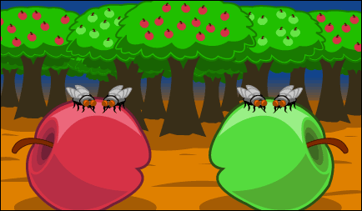
Sympatric Speciation
A species evolves into a new species without a physical barrier. The ancestor species and the new species live side by side during the speciation process.
(Most commonly seen in insect and plant species).
Apple Maggot Flies: Appear to be diverging based on type of fruit they eat.

Slide 8
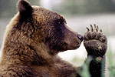
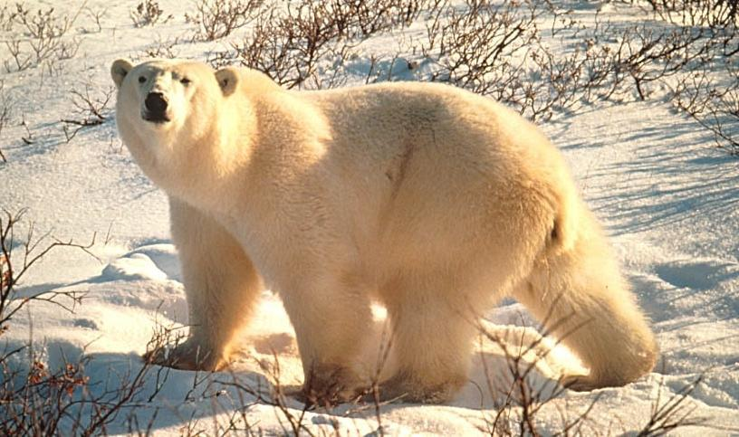
What are the patterns of evolution making evidence of speciation visible?
Adaptive radiation (also called divergent evolution): When one species gives rise to many species in response to the creation of a new habitat or another ecological opportunity.

Slide 9
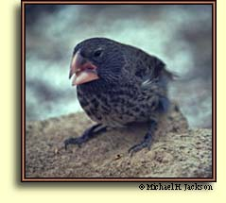
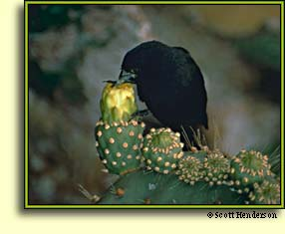
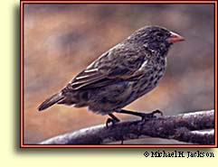
Adaptive radiation (another example): evolution of many diversely adapted species from one common ancestor.

Slide 10
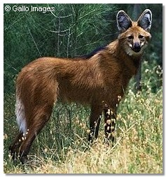
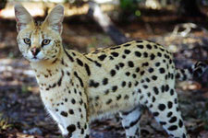
2) Convergent evolution: Natural selection has produced analogous (similar) adaptations in response to similar environments.
Notes:
Maned wolf and Serval cat both have very long ears, an adaptation that enables them to hear their prey move in tall grasslands. Both eat rodents and lizards. Both have long legs for chasing prey.

Slide 11
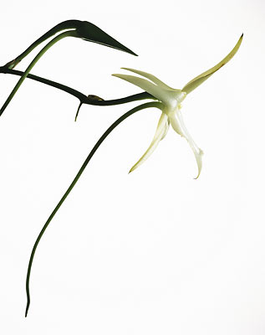
3) Coevolution: Over millions of years, species that interact closely often adapt to one another.
Notes:
The Madagascar orchid has an 11-inch long nectar receptacle. Darwin predicted that somewhere in Madagascar there would be an insect with a proboscis 11 inches long, adapted to harvest the orchid’s nectar.

Slide 12
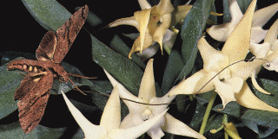
Notes:
Forty years later, the Madagascan sphinx moth was found.

Slide 13
Gene pool
Combined genetic material of all the members of a given population.
(All mechanisms of evolution involve changes in the gene pool).

Slide 14
Allele Frequency
In any gene pool, the number of each allele is a fraction of all the genes for a particular trait.
(Remember that genes often have two or more different forms, called alleles).

Slide 15
Hardy-Weinberg Principle
Under specific conditions, allele frequencies in a population remain constant from generation to generation.
Notes:
If these conditions aren’t met – can result in evolution.

Slide 16
Conditions of Hardy Weinberg
1. no natural selection
2. random mating
3. no migration
4. no mutation
5. very large populations

Slide 17
Genetic Drift
Random change in allele frequencies in a population due to chance events.
Notes:
Can be caused by natural disasters such as fires and floods.

Slide 18
In Summary:
New species can develop when populations become separated and isolated

Slide 19
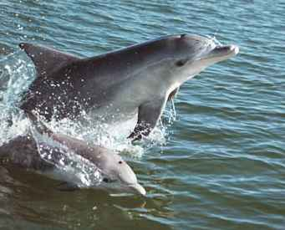
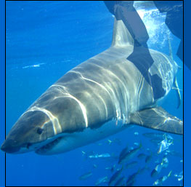
Similar traits can develop in unrelated species occupying comparable niches

Slide 20
Interactions with other organisms affect evolution

Slide 21
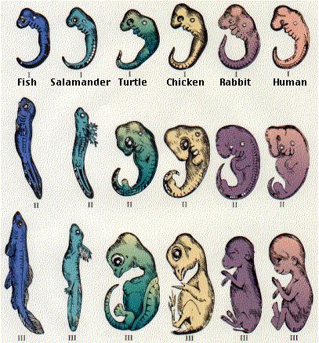
Many diverse species can evolve from one ancestral species
Notes:
What do you think? Can the similarities seen indicate a common ancestor?

Slide 22
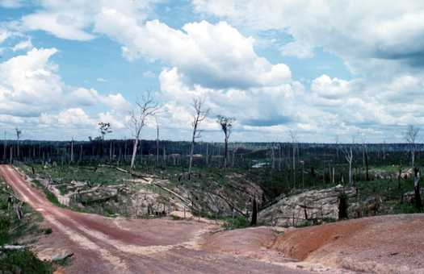
Evolution results from disruptions in genetic equilibrium
Notes:
Deforestation (Human effects)

Slide 23
The normal distribution of variations in a population can be changed by natural selection

