Slide 1
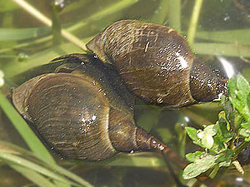
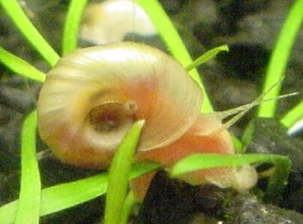
A lab set-up contains an aquatic snail and a live plant in a closed system. A UV light is used to simulate the sun
In a well written paragraph and using your knowledge of photosynthesis and cell respiration, explain how the snail and the plant are able to survive.

