Slide 1
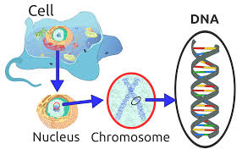
“See Your Own DNA”
Set up your Paper:
1. Title your page (“See your own DNA”).
2. PROCEDURES: (write)
1. Add soap to test tube
2. Swish with Gatorade for (at least) a minute
3. Spit back into cup
4. Pour “spit” into test tube
5. Add pinch of meat tenderizer
6. Cover and gently mix by tipping (about 5x)
7. Add cold alcohol with the pipette (gently – aim toward side of cylinder)
- Add until you have at least a centimeter of alcohol on top of your Gatorade layer.
Notes:
Only used 2 for 2 classes!! Did half blue and half red to keep separated in the jars

Slide 2
Add to your Lab Paper
3. RESULTS: (Did you see your DNA? – sketch and write about what you saw)
Write the following questions and answer:
A. What kind of cells do you think the DNA came from?
B. What was the purpose of the soap?
C. What was the purpose of the meat tenderizer?
D. How do you think it was possible to see your own DNA?
E. Is there anything you would change in your procedure to get better results?
F. Instead of a summary, write a paragraph answering the following prompt: “If you could change any of your DNA, what would you change and why? If you wouldn’t, explain why you wouldn’t.”
Notes:
Meat tenderizer breaks the histones to unwrap the DNA
Soap breaks open the cell membranes
D. 6 feet per cell times 1000’s of cells = clumped together is enough to see

