Slide 1
Scientific notation
APES Math Topics 1 and 2

Slide 2
Scientific notation
When the number is 10 or greater, the decimal point has to move to the left, and the power of 10 is positive.
When the number is smaller than 1, the decimal point has to move to the right, so the power of 10 is negative.
To figure out the power of 10, think “How many places do I move the decimal point?”
Examples:
0.0045 = 4.5 x 10 ⁻³ (in scientific notation)
500 = 5 x 10² (in scientific notation)
4, 800,000,000 = 4.8 x 10⁹ (in scientific notation)

Slide 3
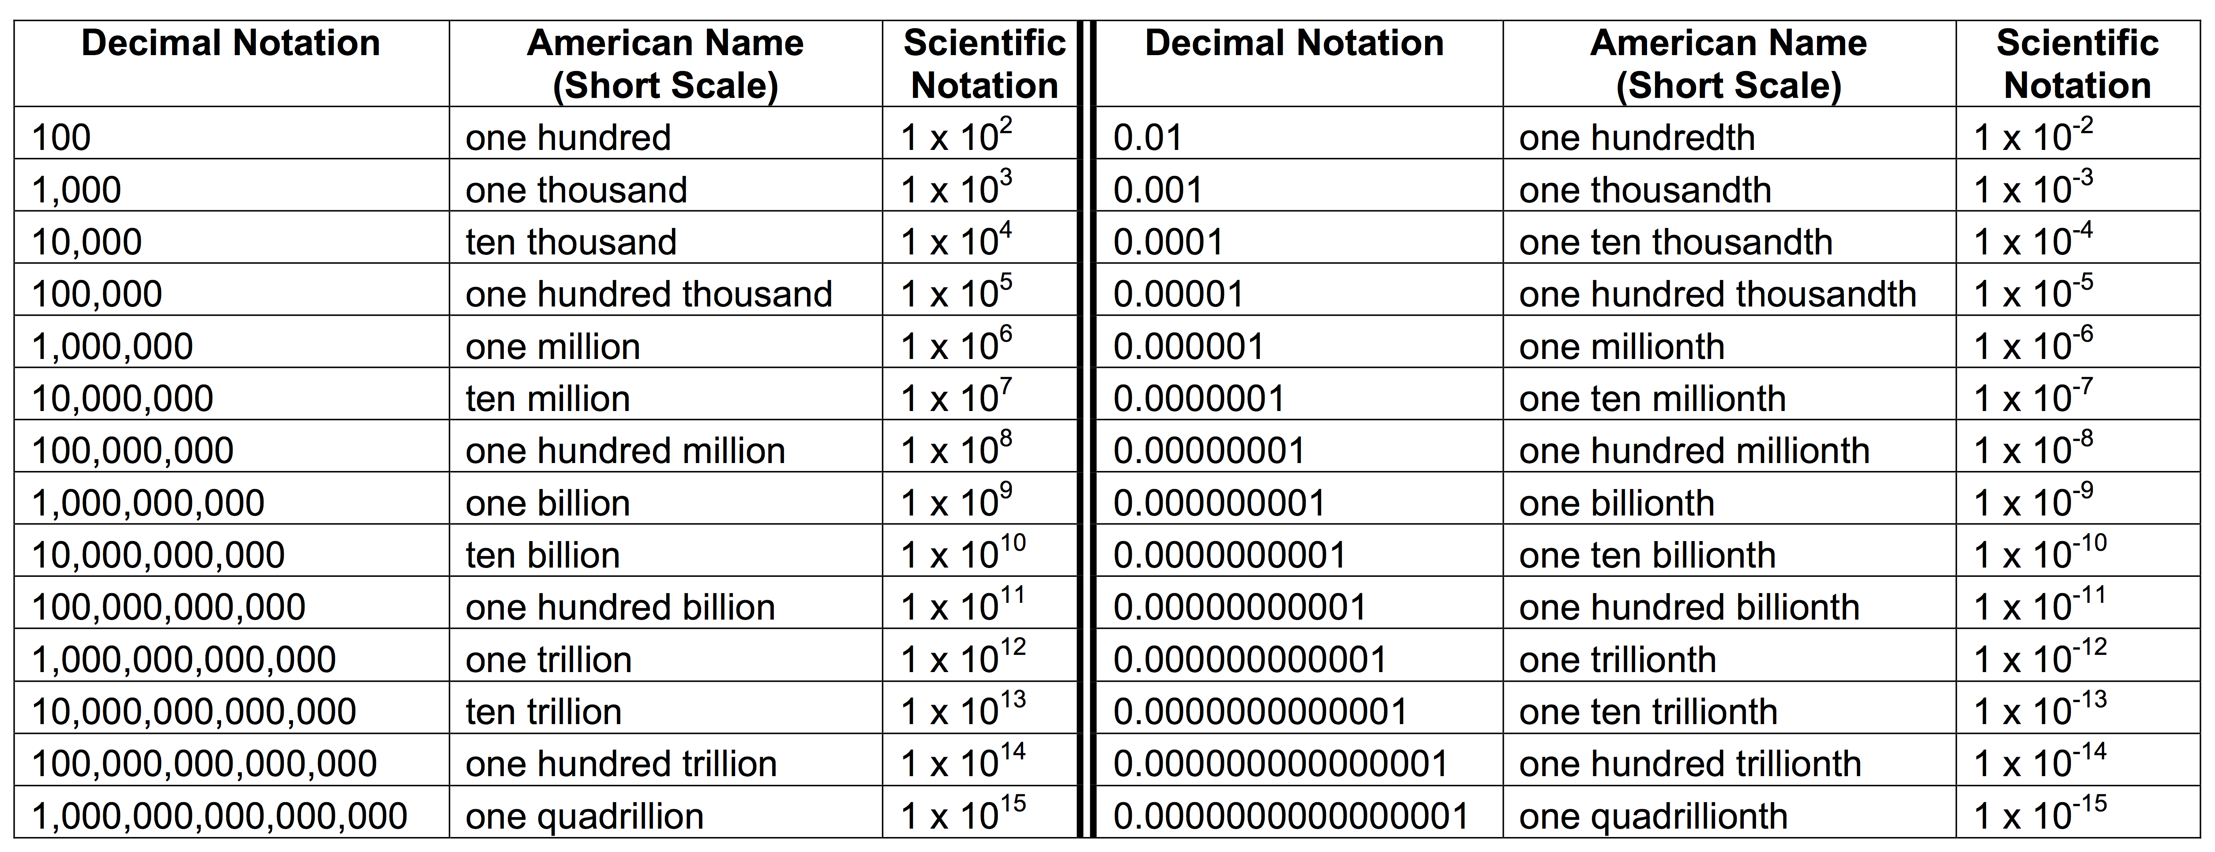
Powers of 10

Slide 4
Place the Following into scientific notation:
1. one billion
2. twenty three thousand
3. 70 trillion
4. three hundred
5. 0.00000483

Slide 5
Multiplying and dividing in scientific notation:
1. Five hundred billion times thirty five thousand
2. six thousand divided by 300 billion
3. one ten thousandth of three million
4. 6 billion divided by 35 trillion

