Slide 1
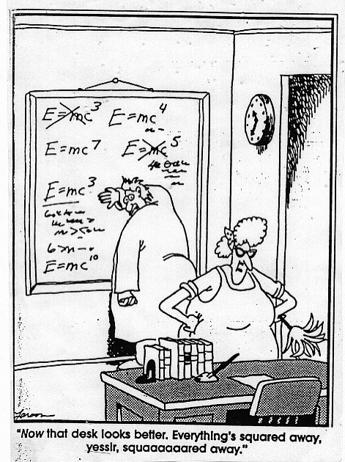
Science and the Scientific Method

Slide 2
Deals
with the natural world
A process
to gain knowledge
What is science?
Collects & organizes (data/evidence)
Gives
testable
explanations

Slide 3
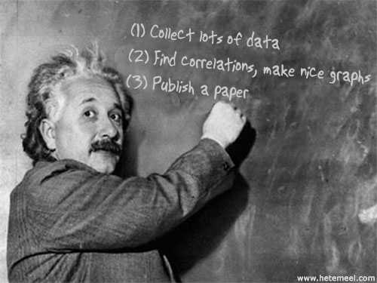
What is Science?
Science is an organized way of using evidence to learn about the natural world.

Slide 4
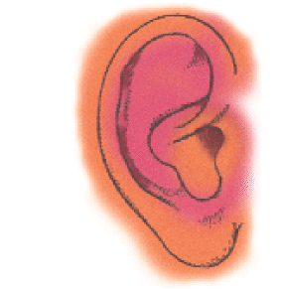
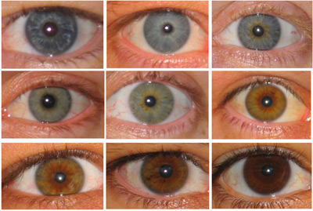
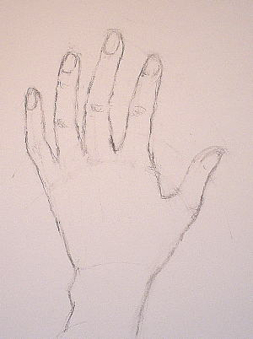
Scientific Method
Science starts with observation (using 5 senses).
Hearing
Taste
Sight
Touch
Smell
Can your senses be fooled?

Slide 5
What do you see in this picture?

Slide 6
Can you count the black dots at the intersections of the boxes?

Slide 8
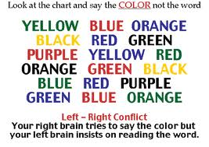

Slide 9
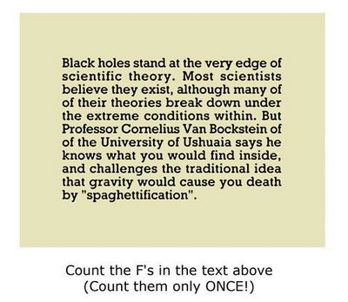

Slide 10
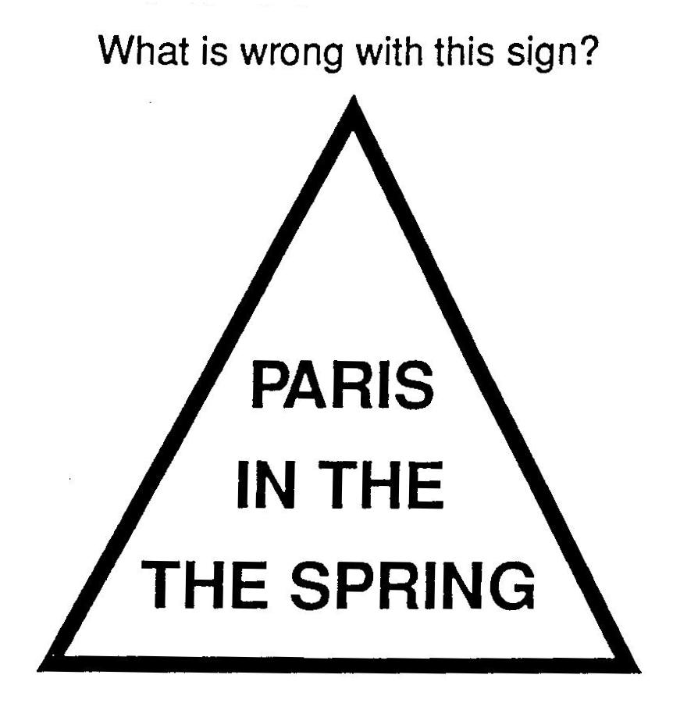

Slide 11
Aoccdrnig to a rscheearch at Cmabrigde Uinervtisy, it deosn't mttaer in waht oredr the ltteers in a wrod are, the olny iprmoatnt tihng is taht the frist and lsat ltteer be in the rghit pclae. The rset can be a taotl mses and you can sitll raed it wouthit a porbelm. Tihs is bcuseae the huamn mnid deos not raed ervey lteter by istlef, but the wrod as a wlohe. Amzanig huh? Yaeh and I awlyas thought slpeling was ipmorantt! The phaonmneal pweor of the hmuan mnid.

Slide 12
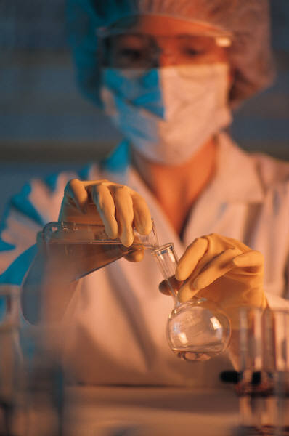
Scientific Method
1) Observation
Collect Data/Evidence
2) Ask a Question
- Why is the sky blue?
- Where do maggots come from?

Slide 13
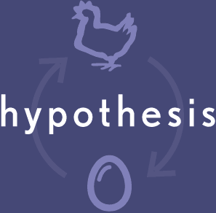
Scientific Method
3. Form a Hypothesis
A hypothesis explains both the
observations/evidence and can be
tested.

Slide 14
Scientific Method
4. Experiment
An experiment is the process of testing the hypothesis.
-Control group
-Experimental group
Only 1 variable should be tested.
5. Analyze Results
Do the results support your hypothesis?

Slide 15
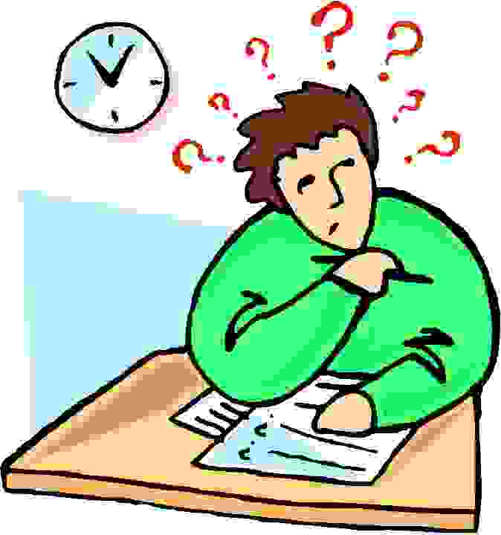
Scientific Method
6. Draw Conclusions
Make a complete statement of what is thought to be true

Slide 16
1
Observation
Start
2
Ask a question
3
Hypothesis
Scientific Method
4
Experiment
5
Analyze
Results
6
Conclusions

Slide 17
So…how do we design an experiment?
If you wanted to test if a new pill made students do their homework better, how would you test it?
Take 2 minutes to come up with one answer as a group, then we will share out.

Slide 18
Some definitions to know (and write down ☺)
Variable: An object or any other category that you are trying to measure. There are two types, dependent and independent.
Independent Variable: Something that DOES NOT change.
Dependent Variable: Something that DOES change.

Slide 19
In an experiment you need at least two groups
Control Group: The group that is not changed. For example they are not given the pill, or are given a placebo.
Placebo: An ineffective treatment (ex: A pill with no actual medicine)
Experimental Group: The group that is being tested/ given the actual pill.

Slide 20
An Example
The Science team wants to see if a new drink will make their students get to class early. They give group A, 100 students the actual drink and group B, 100 students a drink that looks the same but has none of the medication inside.
Who is the control group?
Who is the experimental group?
What is the independent variable?
What is the dependent variable?

Slide 21
Its good to remember this trick…..
The independent variable causes a change in the dependent variable.
Fill in the blanks and see if it makes sense
The amount of students that get to class early causes a change in the new drink?
Or
The new drink causes a change in the amount of students who get to class early?

