Slide 1
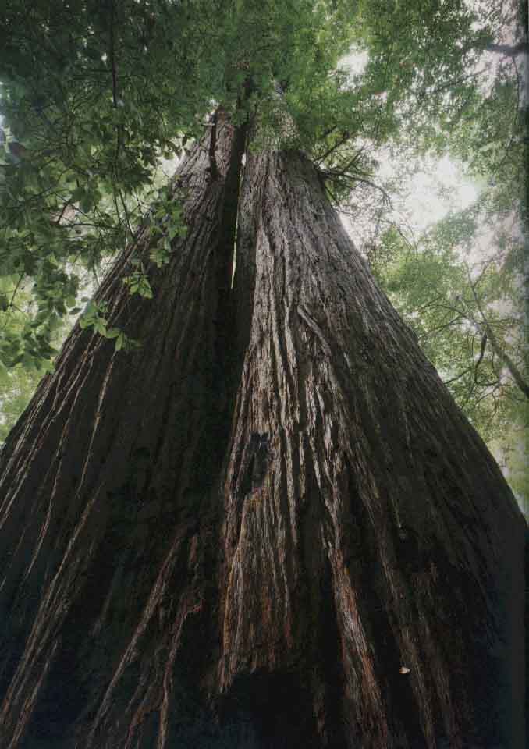
Climate change
and Redwoods
(Page 22: Quickwrite)
What have you heard about
global climate change/global warming?
(Write 3-4 sentences describing your prior knowledge).

Slide 2
Climate change and Redwoods: Annotations
Read the article
Read the article a second time
Number the paragraphs
Mark “?” for any confusing words or ideas
Mark “!” for anything new or interesting

Slide 3
Redwoods: Analysis
Why were scientists surprised to discover that Redwood growth rates have not slowed and in some cases have increased?
What are two concerns that scientists still have about the future of the redwoods?
Explain (in 2-3 sentences) how this article relates to photosynthesis.
Do humans have any impact on the future of redwoods? Explain in complete sentences.

