Slide 1
Rats (p. 21)
How are their external structures related to their functions?

Slide 2
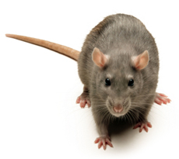
Create a “T” chart (10 total)
Example:
Short legs can fit in small spaces

Slide 3
Warm-up (Day 1 - add to page 21)
1. What is the function of blood?
2. What structures do you think would need a greater blood supply? WHY?

Slide 4
Skin the leg and find the blood supply

Slide 5
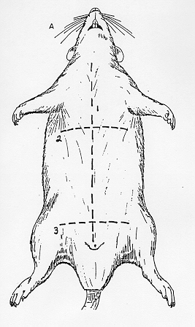

Slide 6
Locate the Intestines
Carefully remove the intestines
Measure the length of your rat’s intestines and record your results

Slide 7
Warm-up (Day 2) Add to p. 21
3. What is homeostasis?
4. Give an example of homeostasis as it pertains to the rat.

Slide 8
Microscopes:
HEART - look at it under the microscope (then cut it in half and see if you can locate the chambers
STOMACH - look at the outside and then bissect, rinse out the food and look at the ridges inside
TESTES - look at the blood supply on the outer part of one testis and cut the second one open to see the tissue on the inside
TAIL – make a cross section of the tail (like a disc or cookie)
What else do you want to see??? Tell us if you found something interesting to share with the class.

Slide 9
Conclusion (Add to p.21)
5.What advantage is there to having the lungs located near the heart?
6. Name one difference that you noticed between your rat and another groups.
7. Describe one of the organs you looked at closely and explain how the structure is related to its function

