Slide 1
Protein Synthesis Review
How much do you know?

Slide 2
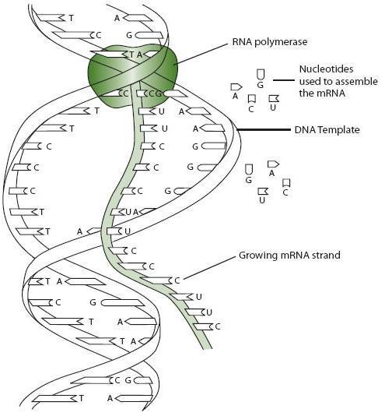
Which step of protein synthesis?
Notes:
Transcription

Slide 3
Where does transcription occur?
Notes:
In the nucleus

Slide 4
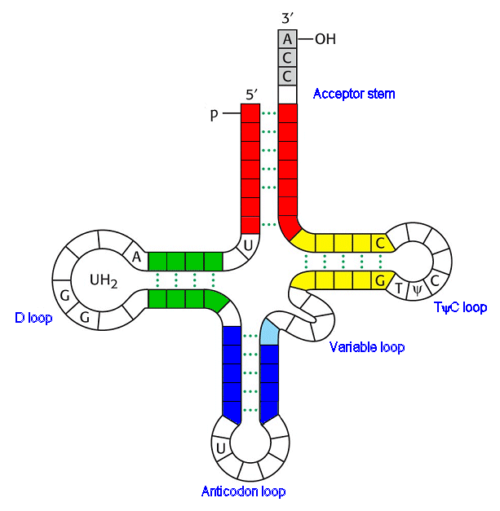
What is this?
Notes:
tRNA

Slide 5
What does tRNA transfer?
Notes:
Amino Acids

Slide 6
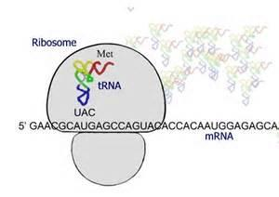
Which stage of Protein Synthesis?
How do you know?
Notes:
Translation (It’s at the ribosome and there is tRNA)

Slide 7
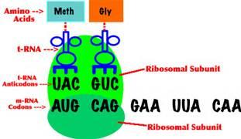
What would the next anticodon be?
How do you know?
Notes:
CUU

Slide 8
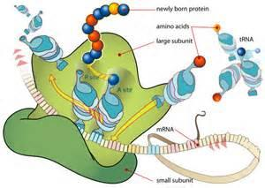
Where does translation occur?
Notes:
At the ribosome (cytoplasm)

Slide 9
Why are proteins important?
Notes:
Cell communication, structure, enzymes etc.

