Slide 1
Protein Synthesis
Transcription
and
Translation

Slide 2
Protein Synthesis
Process by which an organism’s genotype is translated into its phenotype.
Genes code for amino acids that make up proteins
DNA is the template or pattern for making proteins.

Slide 3
DNA and RNA work together!
They have to work together to make proteins.
DNA (Deoxyribonucleic acid)
RNA (Ribonucleic acid)
3 Kinds of RNA
mRNA (messenger)
tRNA (transfer)
rRNA (ribosomal)

Slide 4
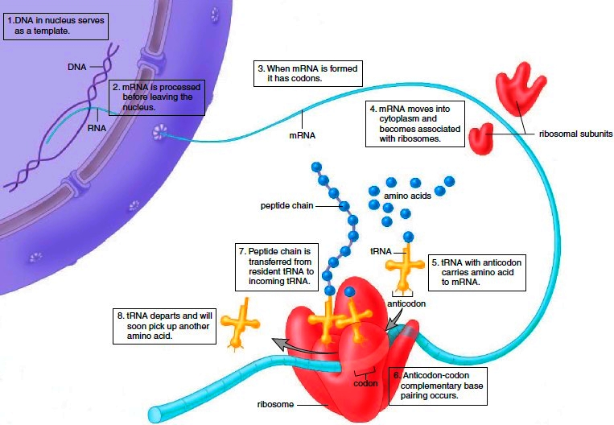

Slide 5
Protein Synthesis: 2 Stages
First Stage:
Transcription: genetic information from a strand of DNA is copied into a strand of mRNA.
“Transcribe” means to copy

Slide 7
Transcription
Begins with DNA Helicase that unzips the DNA so that now unattached RNA can pair up to the open strand of DNA. RNA polymerase builds the mRNA.
RNA Bases:
Uracil to Adenine
Guanine to Cytosine
DNA Bases:
Thymine to Adenine
Guanine to Cytosine

Slide 8
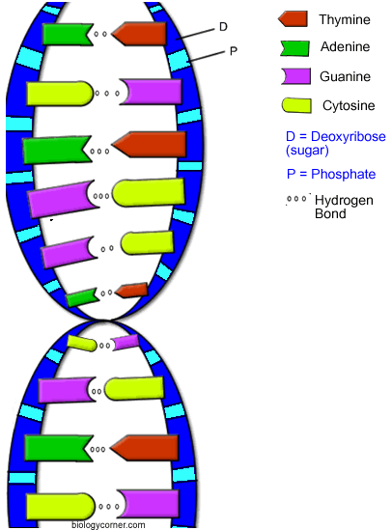

Slide 9
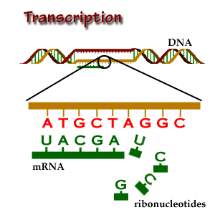

Slide 10
Second Stage: Translation
Translation: “language” of nucleic acid (bases) is changed into the “language of protein (amino acids).

Slide 11
Building Proteins Translation (2nd Stage)
mRNA carries genetic information and then the information gets translated to form proteins. Process involves linking amino acids together.
tRNA transfers amino acids to the ribosomes. (Main JOB is to transport amino acids).

Slide 12
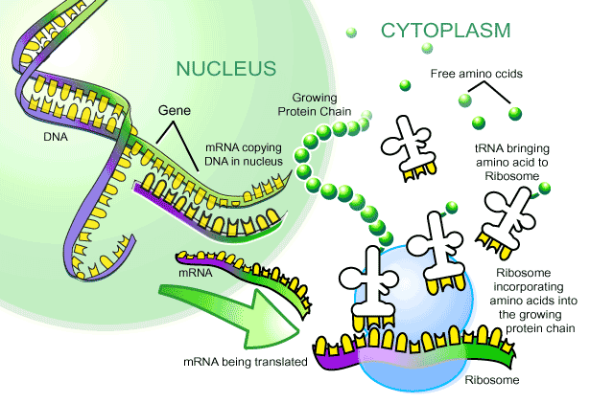

Slide 13
Introns and Exons
Introns: Regions on DNA that do NOT code for proteins.
Exons: Regions on DNA that do code for proteins.
RNA splicing: introns are removed and the exons join before mRNA leaves the nucleus. Now may leave the nucleus and go to the ribosome.

Slide 14
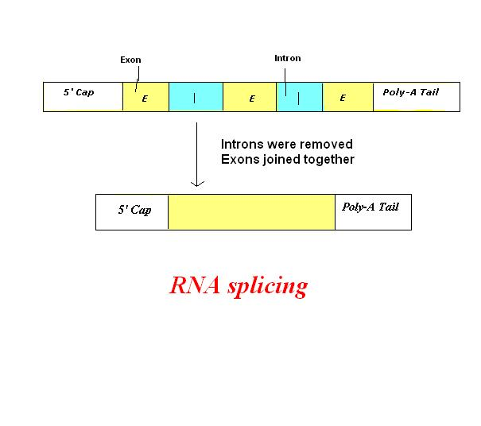

Slide 15
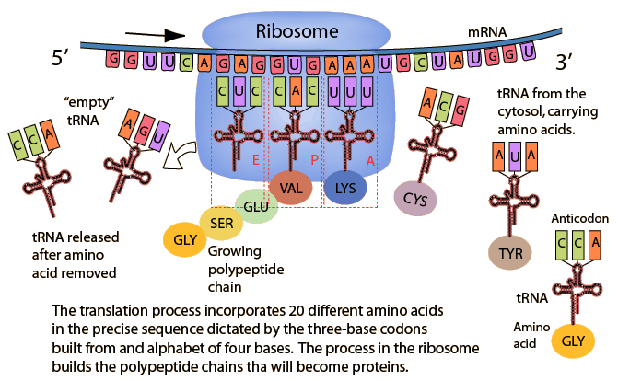

Slide 17
Codons
Codons are a 3 base section of mRNA. They carry for a specific amino acid.
GCU codes for the amino acid Alanine
mRNA carries many codons
Anticodons are 3 bases found on tRNA.
tRNA carries only one anticodon.
tRNA anticodon complements a specific mRNA codon.
tRNA = AGU
mRNA = UCA
They fit like puzzle pieces.

Slide 18
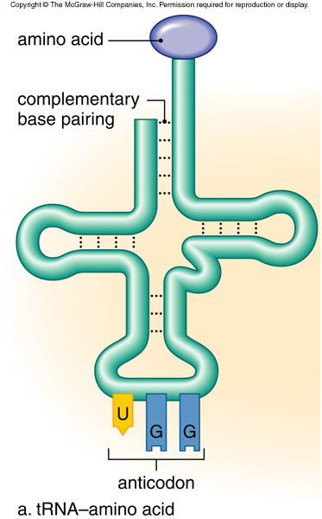

Slide 20
Start and Stop Codons
Signal a ribosome to start and stop translation.
They are found at the beginning and end of a mRNA code.
Universal Start Codon = AUG (methionine)
Universal Stop Codons = UAA, UAG, and UGA

Slide 21
