Slide 1
If the population is growing at a rate of 1.4 percent annually, the population will double in how many years?
A) 20 D) 100
B) 50 E) 140
C) 65
Notes:
B) 50: Rule of 70 (70/1.4)

Slide 2
K-selected species often are regulated by density-dependent factors. A population of K-selected elephants is experiencing a recent rapid decline in numbers. Which of the following is the most likely cause?
A) DECLINING PREDATOR POPULATIONS
B) Lack of food and water
C) Climate change
D) Increase in vegetation
E) Inbreeding
Notes:
B

Slide 3
Which of the following best describes the process of photosynthesis?
A) Oxygen, water, and solar energy are used to produce carbon dioxide and sugar.
B) Oxygen, sugar, and solar energy are used to produce carbon dioxide and water.
C) Carbon dioxide, water, and solar energy are used to produce oxygen and sugar.
D) Carbon dioxide and oxygen combine to form water and sugar.
E) Carbon dioxide and water are used to produce oxygen, sugar, and more carbon dioxide.
Notes:
C

Slide 4
What is the main source of energy for Earth’s organisms?
A) Wind
B) The sun
C) Fossil fuels
D) Geothermal activity
E) Biomass
Notes:
B

Slide 5
In a country with an inverted population pyramid, there is a
A) Growing population
B) High rate of disease affecting the working-age population
C) Smaller labor market as well as more stress on social systems to support the elderly
D) Strong military and labor market
E) High rate of death among older ages in the population
Notes:
C

Slide 6
China’s one-child policy has been successful in reducing population growth but has had negative consequences as well. All of the following are potential problems with the declining population due to this policy EXCEPT:
A) Increased pressure on social systems such as Social Security and healthcare.
B) A decrease in the number of individuals in the labor market
C) Increased abortion rates of female fetuses
D) An uneven sex ratio
E) More people entering the military
Notes:
E

Slide 7
A population of mule deer was growing very quickly until starvation reduced the number of individuals. The mule deer passed the condition or point of:
A) Overcrowding
B) Exponential growth
C) Carrying capacity
D) Limited growth
E) Extirpation
Notes:
C

Slide 8
The next two questions refer to the following info: A country has a crude birth rate of 32/1000, a crude death rate of 9/1000, an immigration rate of 2/1000 and an emigration rate of 4/1000. What is the growth rate of this country?
A) 1.8 %
B) 2.9 %
C) 2.6 %
D) 2.1 %
E) 3.4 %
Notes:
D) 2.1 %: (32/1000 + 2/1000) – (9/1000 + 4/1000) = 21/1000 = 0.021 x 100 = 2.1%

Slide 9
What do these numbers tell you about the population?
It is declining slowly
It is stabilizing
There are a large number of individuals in the older age groups
There are high death rates at y0ung ages
The population is still growing.
Notes:
E) The population is growing and will double in about 33 years. Will continue to grow

Slide 10
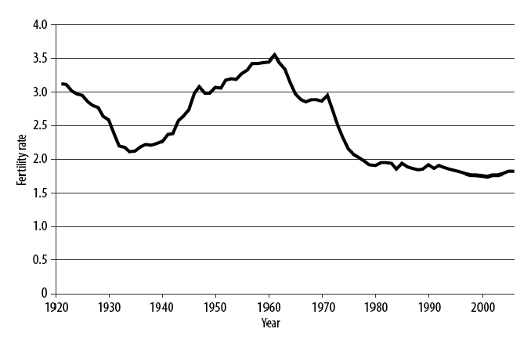
What lead to the total fertility rate in Australia in the 1920s and 1930s?
War
Economic Depression
Widespread disease
An increase in the use of contraception
An aging population
Notes:
B Economic Depression: Couldn’t afford to have kids

Slide 11
What contributed to the increase in fertility in Australia in the 1940s and 1950s?
Immigration
Economic growth
High infant mortality rates
Lack of contraception
Lack of female empowerment
Notes:
B) Economic boom after World War II

Slide 12
In developing countries, the largest use of energy is for:
A) Transportation
B) Manufacturing
C) Preparing food
D) Technology
E) Recreational activities
Notes:
C domestic

Slide 13
Nitrogen fixation is a necessary part of the nitrogen cycle because:
A) Atmospheric nitrogen cannot be used directly by organisms
B) There is not enough nitrogen in the atmosphere
C) Nitrogen needs to be combined with phosphorus
D) Bacteria needs to be combined with phosphorus
E) Nitrogen in the soil needs to be fixed to go back to the atmosphere
Notes:
A

