Slide 1
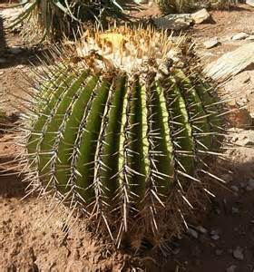
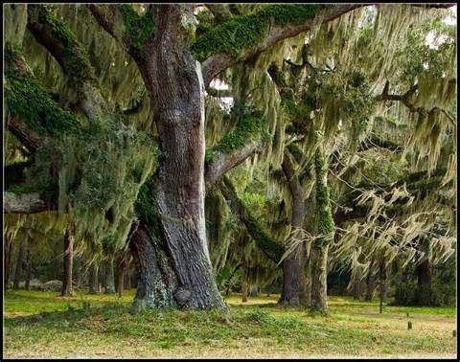
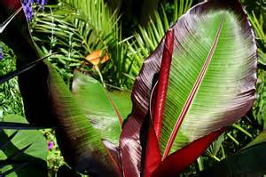
What can you predict about the habitat these plants live in?
B.
B.
A.
C.
Defend your answers in complete sentences.
Notes:
Spanish Moss (Georgia)

Slide 2
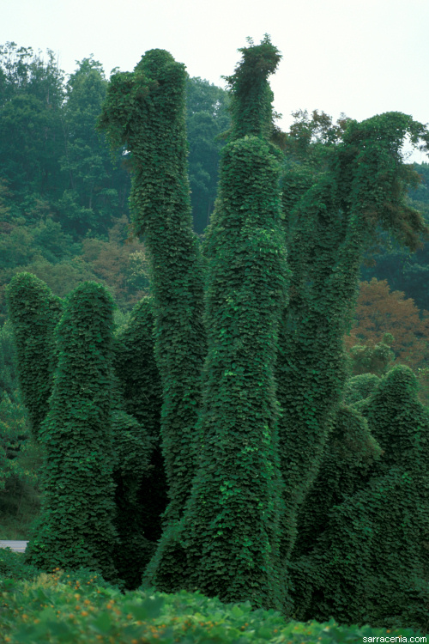
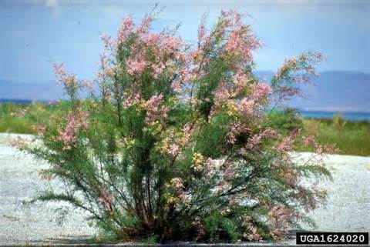
Notes:
Tamarisk Kudzu

