Slide 1
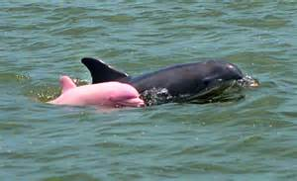
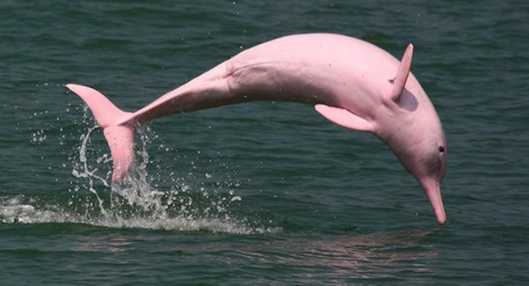
Pinky
Brainstorm: What are some possible explanations for Pinky’s unusual coloration?

Slide 2
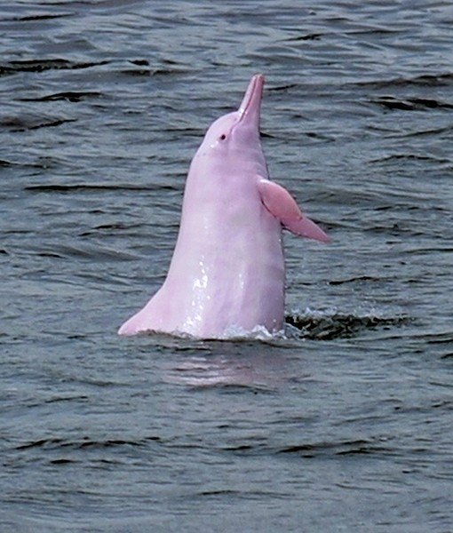
Article
1. Number the paragraphs
2. Read the article once

Slide 3
Annotations:
3. Read the article a second time
4. Mark a “!” for anything new or interesting.
5. Mark a “?” for anything confusing.
6. Highlight or underline any information that helps explain how Pinky got her pink coloration.

Slide 4
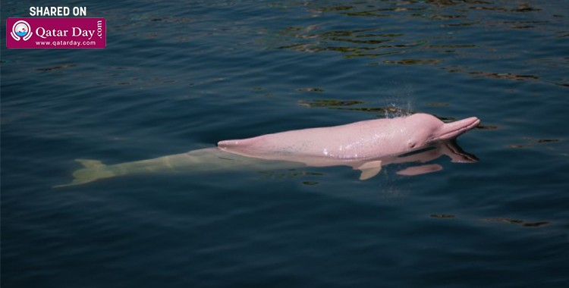
ANalysis:
1. In your own words, explain the proposed reasoning for Pinky’s coloration.
2. What are some potential negative effects of Pinky’s condition?

Slide 5
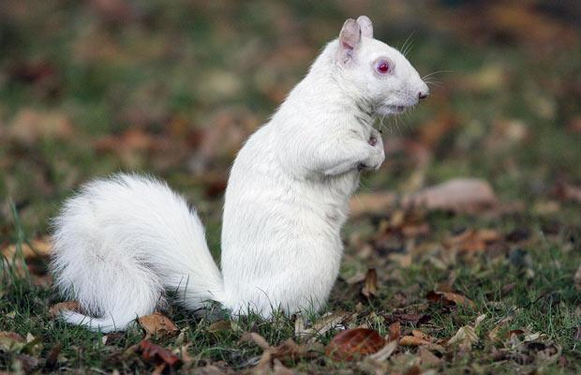

Slide 6
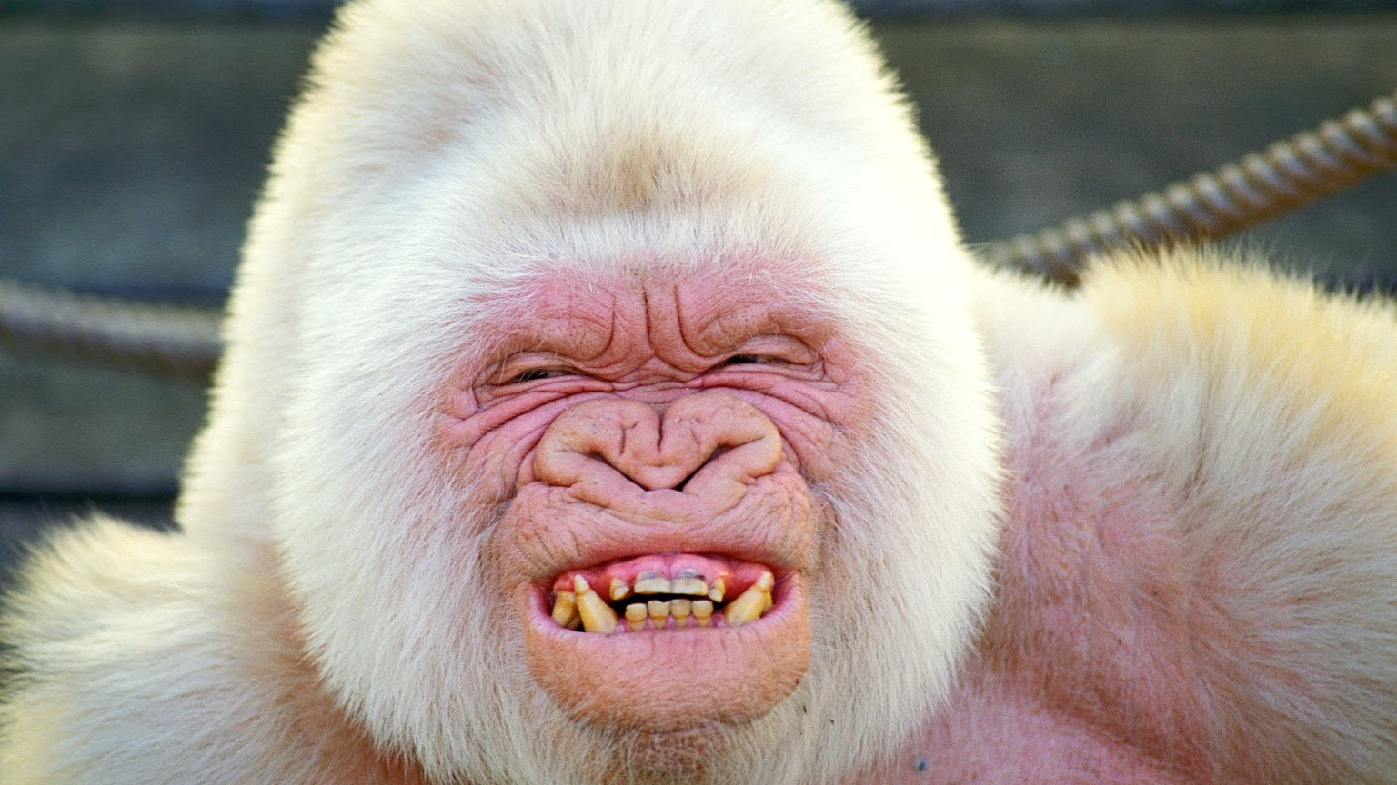
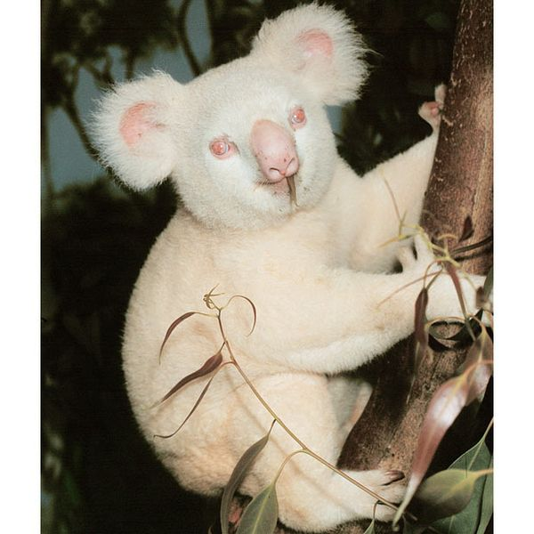

Slide 7
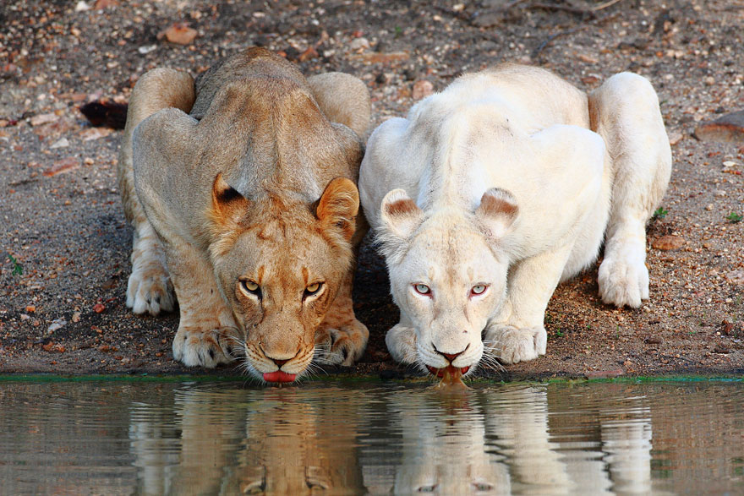

Slide 8
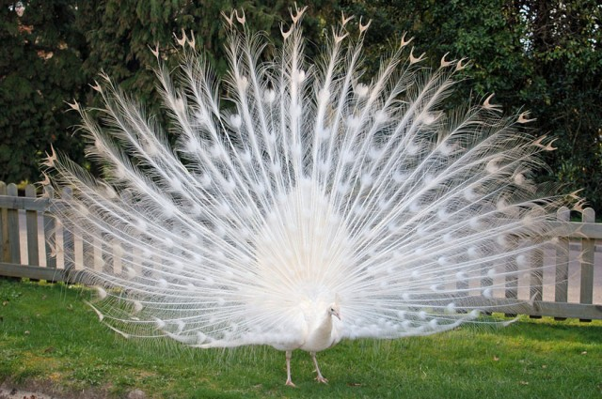

Slide 9
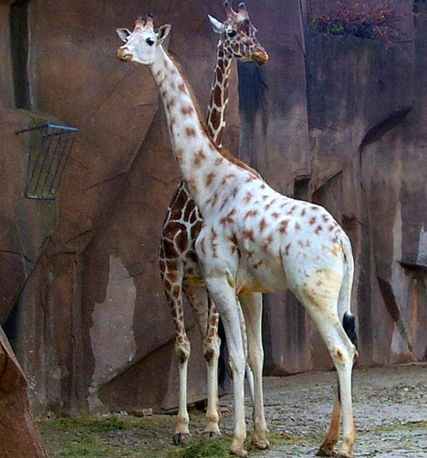
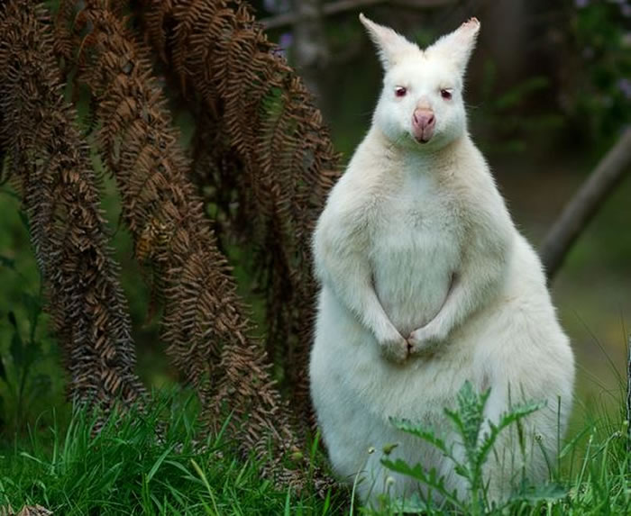

Slide 10
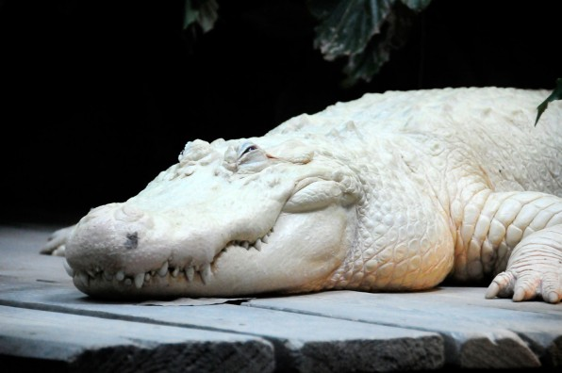
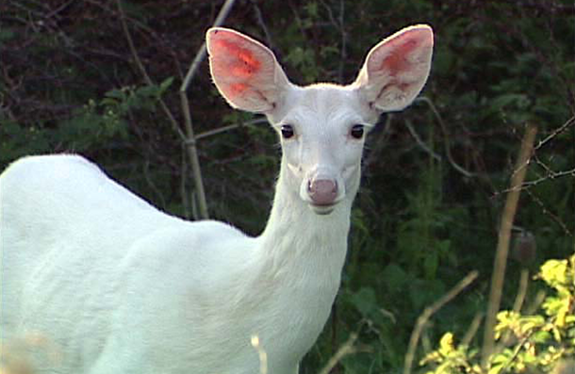

Slide 11
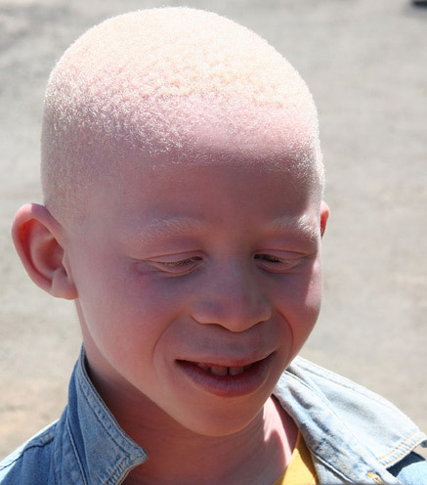
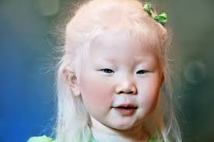
video 1: take notes and summarize
Video 2:Write a reflectioN

