Slide 1
Oil!
What are the issues surrounding environmental cleanup?

Slide 2
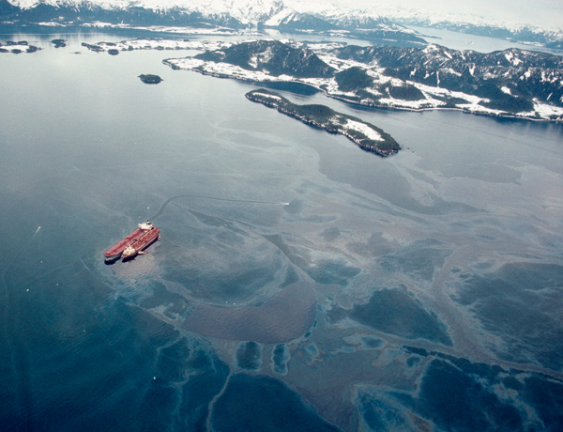
Exxon Valdez Oil Spill 1989

Slide 3
Deepwater Horizon 2010

Slide 4
Gulf of Mexico

Slide 5
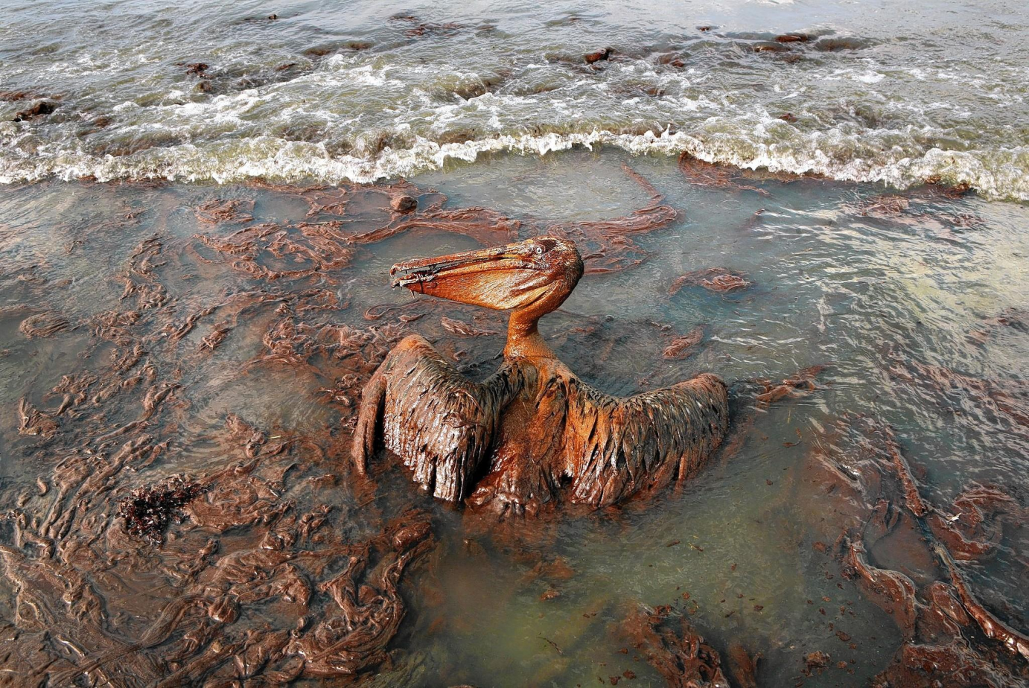
“BP Oil Spill”

Slide 6
Largest oil spill in history
Oil Rig Exploded and sank
Oil gusher flowed for 87 days until it was capped
Largest accidental marine oil spill in petroleum industry history
11 rig workers never found
Estimated 210 million gallons
Reports in early 2012 indicated the well site was still leaking.
In July 2015, BP agreed to pay $18.7 billion in fines, the largest corporate settlement in U.S. history

Slide 7
Environmental Engineers
Environmental engineering is the integration of sciences and engineering principles to improve the natural environment, to provide healthy water, air, and land for human habitation and for other organisms, and to clean up pollution sites.

Slide 8
Cost of clean-up
The Deepwater Horizon accident cost BP an estimated $32 billion to date, including $14 billion in cleanup costs. It's also paid out nearly $8 billion in compensation to Gulf Coast residents, pleaded guilty to manslaughter charges and paid a $4 billion fine for the deaths on the rig.

Slide 9
Brainstorm clean-up ideas:
How expensive do you think your ideas would be?

Slide 10
4 main methods of oil-spill clean-up
1. Dispersal by natural means (usually when far from coastline).
2. Containment: Booms and Skimmers
3. Dispersants: break up the oil and speed natural biodegradation
4. Introduce biological agents to the spill to hasten biodegradation.
Notes:
No two oil spills are the same due to variation in oil types, locations, and weather conditions involved. However, broadly speaking, there are four main methods of response.
Dispersal will break apart and evaporate – light oil evaporates faster than heavy oil
Successful dispersion of oil through the water column can affect marine organisms like deep-water corals and sea grass. It can also cause oil to be temporarily accumulated by subtidal seafood.
Most of the components of oil washed up along a shoreline can be broken down by bacteria and other microorganisms into harmless substances such as fatty acids and carbon dioxide. This action is called biodegradation. The natural process can be speeded up by the addition of fertilizing nutrients like nitrogen and phosphorous, which stimulate growth of the microorganisms concerned.

Slide 11
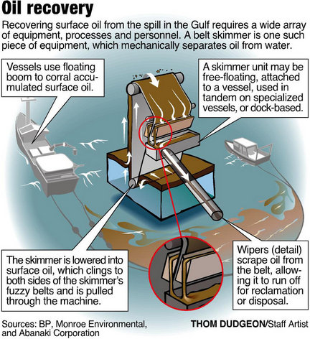
Booms and skimmers

Slide 12
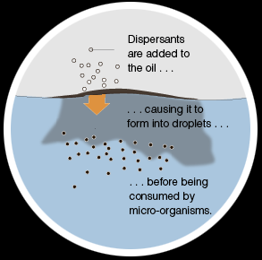
Dispersants
Notes:
The decision to use dispersants—which have been commercially available for oil spill response since the mid-1960s—always involves environmental tradeoffs, says Mahlon Kennicutt, a professor of chemical oceanography at Texas A&M University. Whereas undispersed oil floats on water, smothering birds and marine mammals and fouling coastal resources, dispersed oil is transported throughout the water column, where it's more available to marine life. "Dispersants don't make the oil go away," Kennicutt emphasizes.
New research from investigators at the University of Alabama at Birmingham suggests that Corexit EC9500A, an oil-dispersal agent widely used in the Gulf of Mexico following the Deepwater Horizon oil spill, contributes to damage to epithelium cells within the lungs of humans and gills of marine creatures.

Slide 13
Oil Spill Lab
Create your own oil spill, test different remediation methods and discuss the merits of each method in terms of effectiveness and cost.

Slide 14
Learning objectives
Identify some causes and effects of oil spills on a water source and the organisms that use that water.
Describe the different methods that environmental engineers use to clean up water pollution.
Use volume to describe the amount of oil and water removed during the model clean up.
Organize oil removal data and analyze using bar graphs

