Slide 1
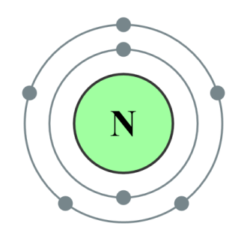
NITROGEN
What do you know about nitrogen? (think about the article you read on Tuesday)
Essential Questions (Leave space):
1. How does nitrogen flow through an ecosystem?
2. How is nitrogen relevant to living organisms?

Slide 2
Model the nitrogen cycle:
Pretend that you are a nitrogen molecule. Roll the die at your table and follow the instructions to continue traveling through the nitrogen cycle.
Document your travels and collect your passport stamps.

Slide 3
Compare and contrast:
Find a partner.
Compare the nitrogen pathways that each of you followed. How are they similar? How are they different?

Slide 4
Evaluate the activity:
How did this model accurately depict the cycling of nitrogen?
How was this model inaccurate?

Slide 5
Draw Conclusions
Look at your nitrogen passport paper. Label parts of your travel involving abiotic factors and those involving biotic factors.
What conclusions can you draw about nitrogen in the environment based on the reading you did yesterday and the activity today?
(For example: Nitrogen is important in the environment as evidenced by ____________________________)

Slide 6
Essential Questions
1. How does nitrogen flow through an ecosystem?
2. How is nitrogen relevant to living organisms?

Slide 7
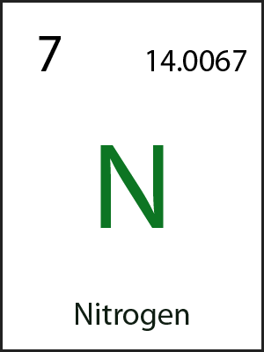
Ticket out the door:
What is one new fact that you learned about nitrogen today?

