Slide 1
The Nervous System: EQ: What is the structure and function of the nervous system?
Nervous System
Central
Nervous System
Peripheral Nervous System
Brain
Spinal Cord
Sensory Nerves
Motor Nerves
Autonomic Nervous
System
Somatic Nervous
System

Slide 2
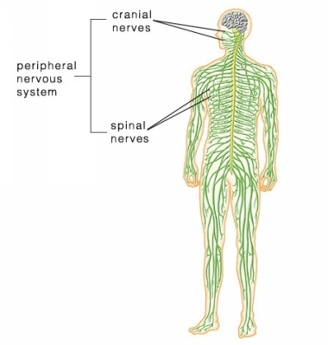
Peripheral Nervous System (PNS):
Main goal of the PNS is to connect the CNS to the limbs and organs.

Slide 3
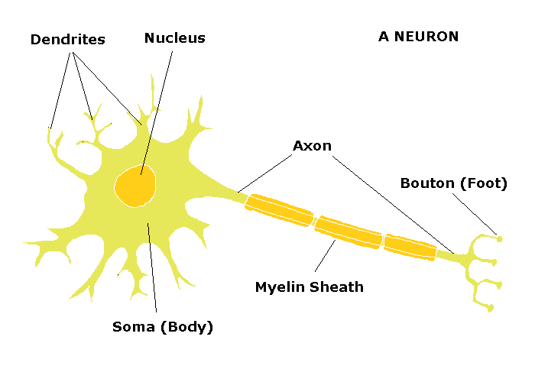
Peripheral Nervous System (PNS):
Sensory Nerves = carry commands from sensory organs (such as skin) to the CNS

Slide 4
Peripheral Nervous System (PNS):
Stimulus → Sensory Nerve → CNS → Motor Nerves → Response
Motor Nerves = carry commands from CNS to muscles, other organs (such as glands)
Autonomic Nervous System- Not in our conscious control (Digestion, breathing)
Somatic Nervous System – In our conscious control (Walking)

Slide 5
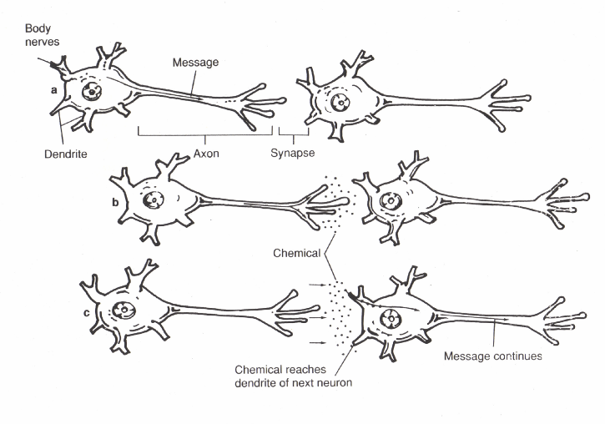

Slide 6
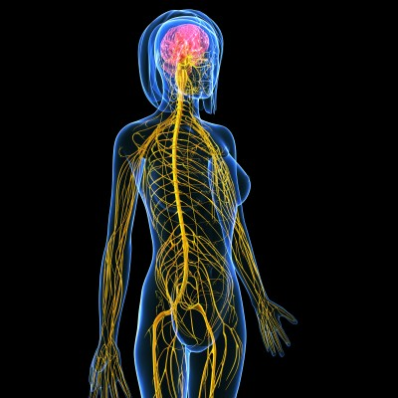
Central Nervous System (CNS)
Interprets information from your senses (peripheral nervous system).

Slide 7
Problems with the Nervous System
Alzheimer’s-Deterioration of memory, personality, ability to function
Causes: Genetic Mutations, Abnormal clumps and tangled bundles of fibers in brain
Symptoms/Effects: Forgetfulness, loss of concentration, poor judgment, confusion
Treatment: No cure or way to slow down. Can take some meds if caught early enough to help with cognition.

Slide 8
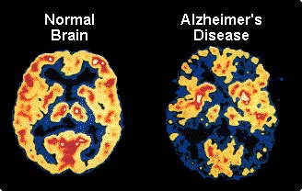

Slide 9
Problems with the Nervous System
Multiple Sclerosis- nerve signals are slowed down or blocked
Causes: destruction of myelin sheath
Symptoms/Effects: depends on which nerves are affected- weakness on one side of the body, slurred speech, blurred vision, confusion
Treatment: sometimes the symptoms disappear, usually come back; use meds and therapy to ease symptoms

Slide 10
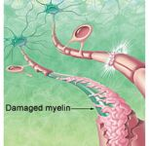

Slide 11
Problems with the Nervous System
Meningitis- inflammation of the membrane surrounding the brain and spinal cord
Causes: bacterial or viral infection that gets into the brain
Symptoms/Effects: high fever, severe headache, nausea, sudden changes in behavior/ can result in deafness, paralysis, mental retardation
Treatment: depends on type- antiviral meds, antibiotics, other meds to treat symptoms, hospitalization

Slide 12
