Slide 1
MUTATIONS
Essential Question:
What can happen if there are
mistakes in the DNA?

Slide 2
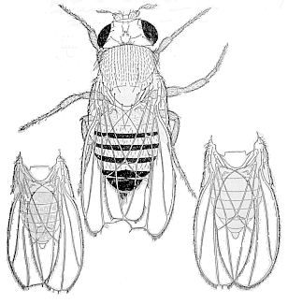
Chromosomal Mutations (Changes in the structure of the chromosome)
Deletion: A piece of the chromosome breaks off.
Notes:
Deletion: Like a delete key on a computer
Like a bad connection on a cell phone
*Most deletions are lethal

Slide 3
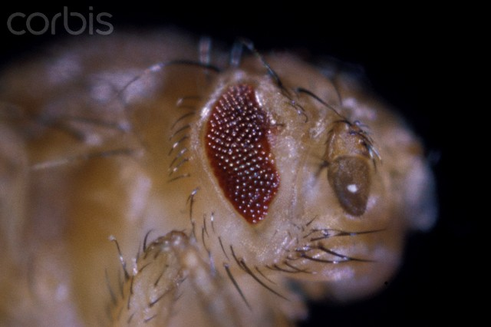
Duplication
A piece of the chromosome breaks off and gets stuck in its homologue.
(example: bar-eyed fly)
Duplications of oncogenes
are a common cause of
many types of cancer (In such cases the genetic duplication occurs in a somatic cell and affects only the genome of the cancer cells themselves, not the entire organism).

Slide 4
Translocation
Piece of a chromosome breaks and ends up in a different (non-homologous) chromosome.
Can affect in several ways
Not usually harmful
Example: Evening primrose (limited ability to reproduce)

Slide 5
Inversion
Part of chromosome breaks off, turns around and gets stuck back in.
Not usually harmful
Original The fat cat ate the wee rat.
Inversion The fat tar eew eht eta tac.

Slide 6
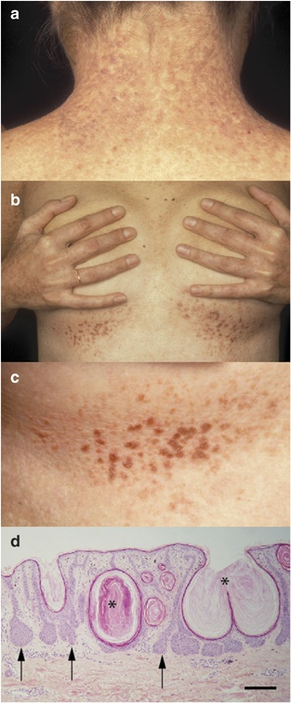
Gene Mutations (DNA errors in a single gene)
Frameshift mutation: Addition or subTraction of Nucleotides that changes codons
Pat the bad cat
Ptt heb adc at
Notes:
Deletion: Like a delete key on a computer
Like a bad connection on a cell phone
*Most deletions are lethal

Slide 7
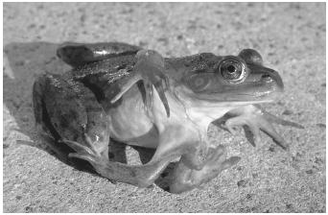
Point Mutation
Affects only one nucleotide.
Less chance of harm but can cause sickle-cell anemia and can create a stop codon.
Original The fat cat ate the wee rat.
Point Mutation The fat hat ate the wee rat.

Slide 8
Mutation Review
Greatpacificmedia
Amoeba Sisters

