Slide 1
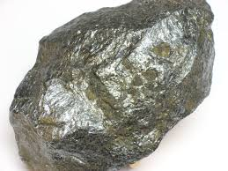
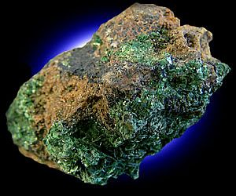
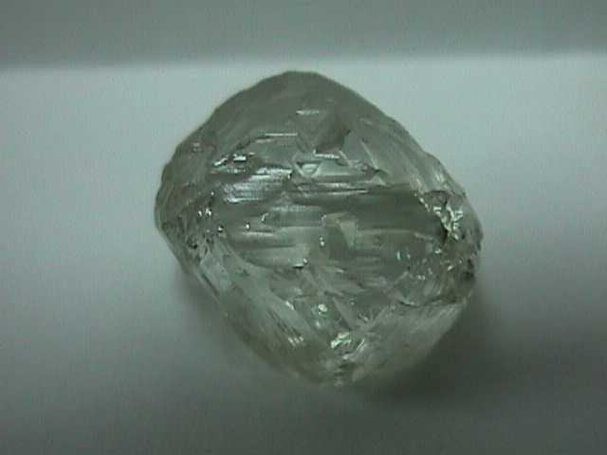
Mineral Resources and mining
Notes:
Silver, diamond, uranium

Slide 2
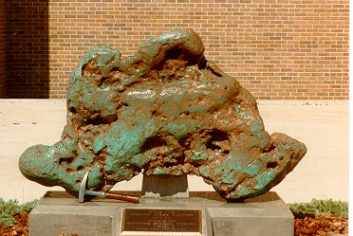
Mineral Resource
A concentration of naturally occurring material in or on the earth’s crust that can be extracted and processed into useful materials at an affordable cost.

Slide 3
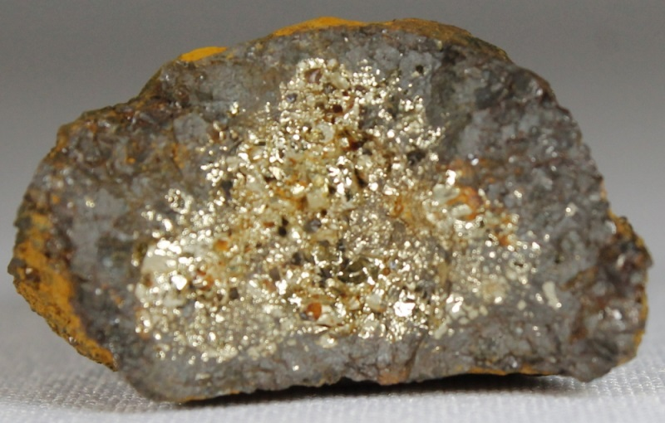
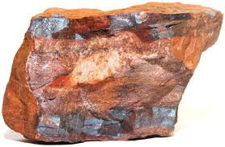
Types of mineral resources
Metallic
Nonmetallic
Energy
Ore is rock containing enough of one or more metallic minerals to be mined profitably. About 40 metals are extracted from ore.

Slide 4
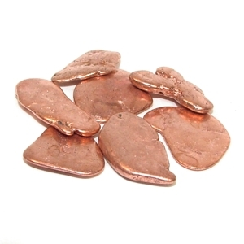
Identified resources
Known location

Slide 5
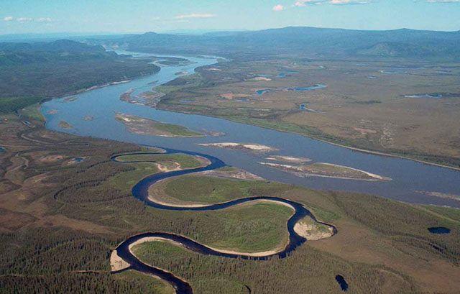
Undiscovered resources
Potential supplies of a nonrenewable resources assumed to exist on the basis of geologic knowledge but with location unknown

Slide 6
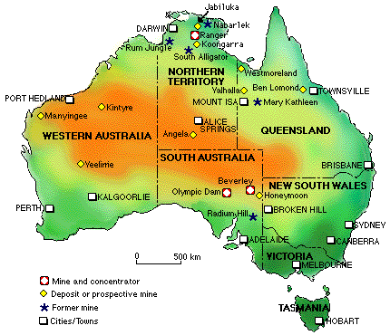
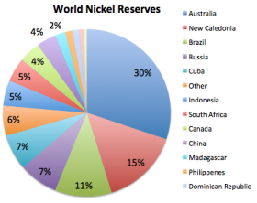
Reserves
Identified resources from which a usable nonrenewable mineral can be extracted profitably at current prices
Notes:
Nickel and Uranium

Slide 7
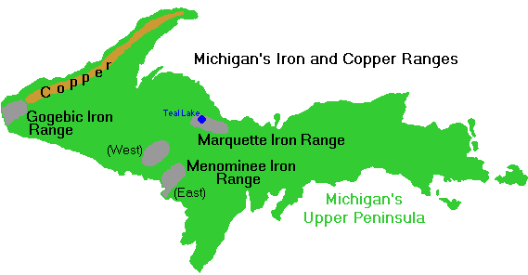
Other resources
Identified or undiscovered resources not classified as reserves (usually too expensive or difficult to extract)

Slide 8
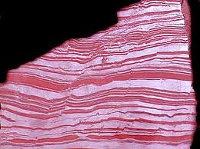
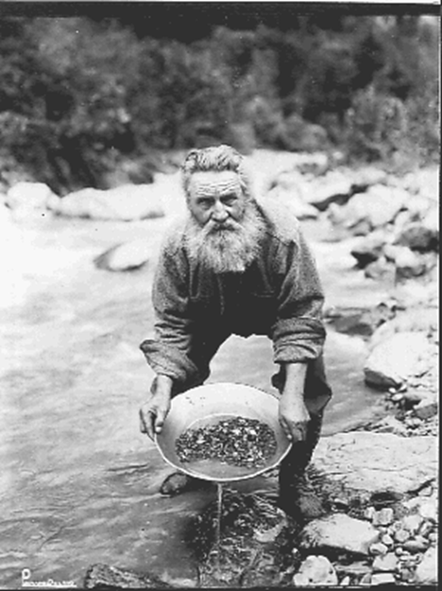
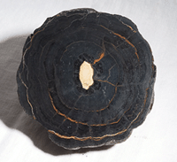
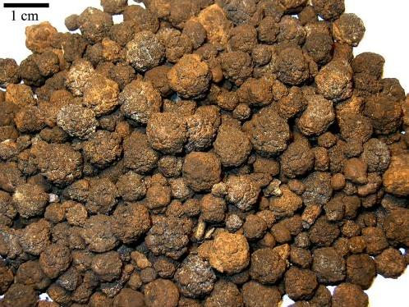
Ore formation
Magma pockets
Hydrothermal deposits
Chemosynthesis
Underwater volcanoes
Deposition
Notes:
Deposition from saturated solution like gold in stream beds

Slide 9
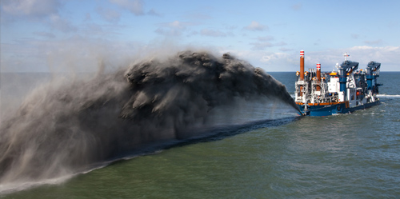
Mining (surface)
Open Pit Mining
Dredging
Area strip mining
Contour strip mining

Slide 10
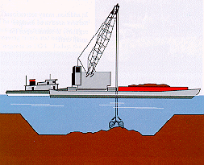
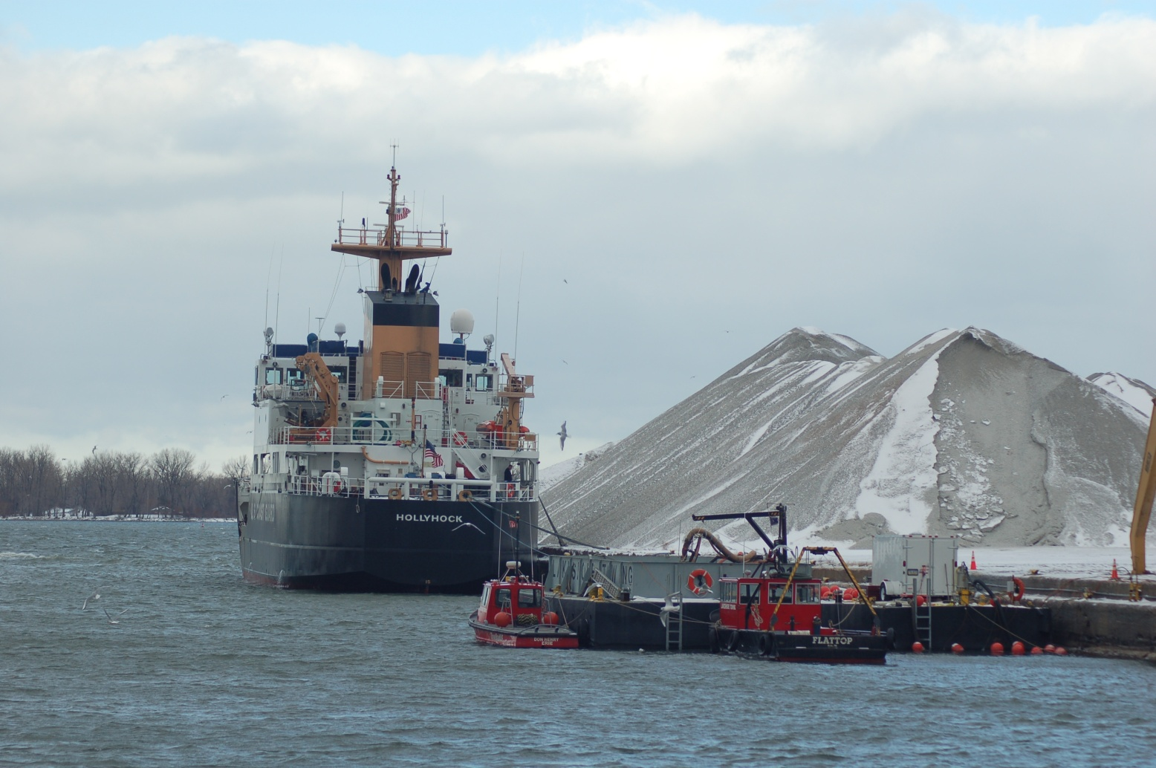
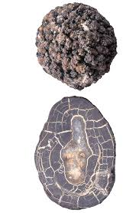
Dredging
For things on the sea floor, like manganese nodules

Slide 11
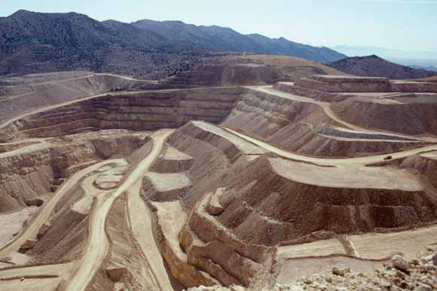
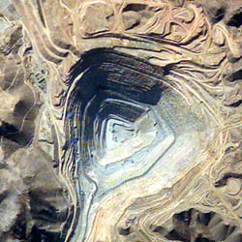
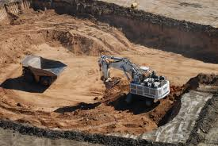
Open Pit Mining
Not much OVERBURDEN (unwanted surface rock)

Slide 12
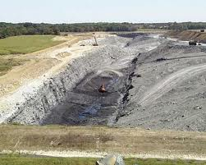
Area Strip Mining
Remove overburden
Expose ore
Remove ore
Replace overburden

Slide 13
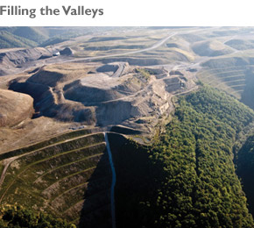
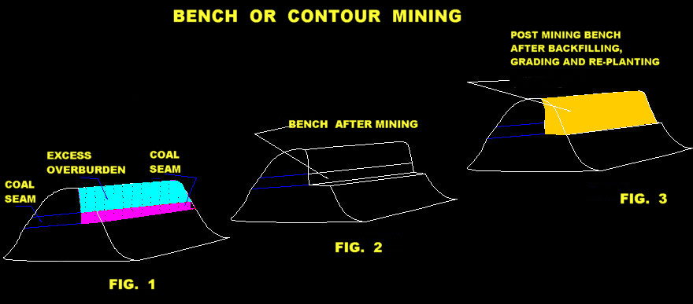
Contour strip mining
Same thing but works along contour lines, minimizing erosion

Slide 14
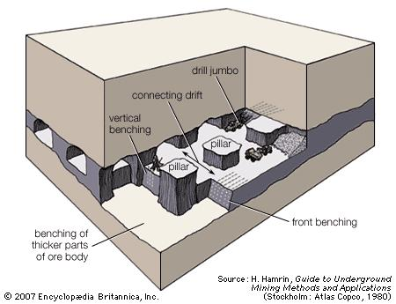
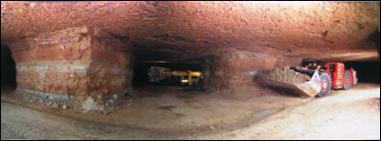
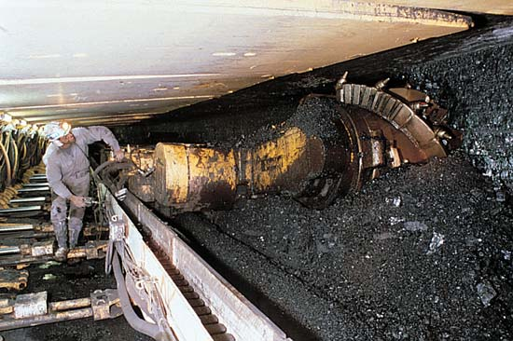
Subsurface mining
Tunnel mining (coal mining)
Room and pillar mining
Long-wall mining
Reduce disturbance at surface, but more dangerous to miners

Slide 15
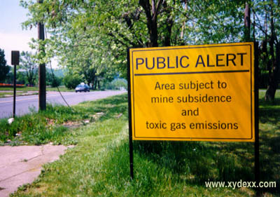
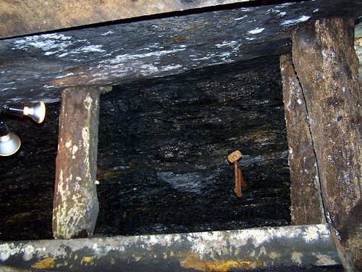
Tunnel Mining
Centralia, Pennsylvania

Slide 16
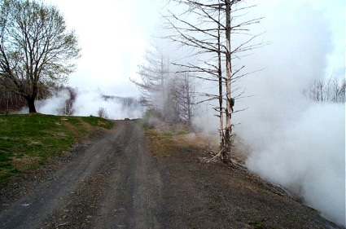
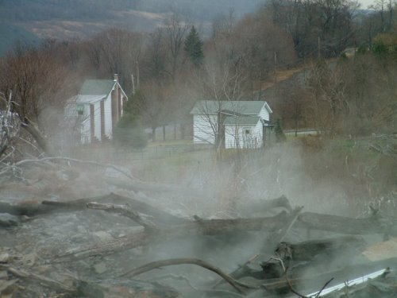
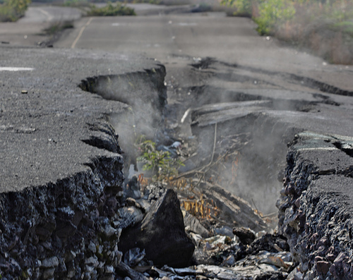

Slide 17
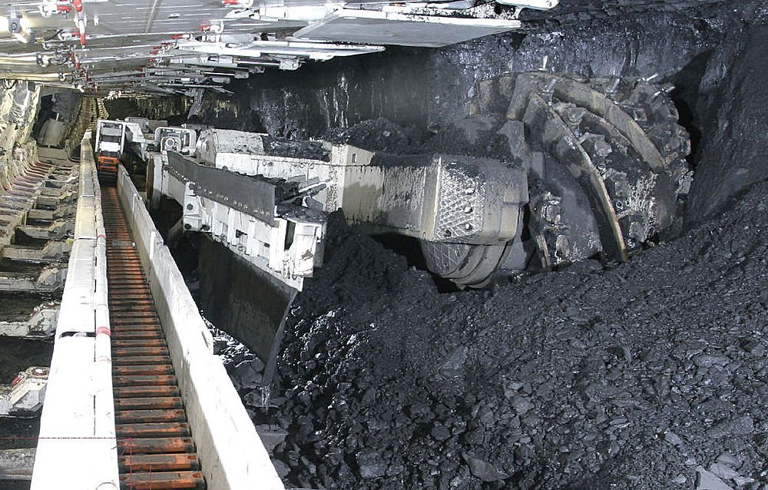
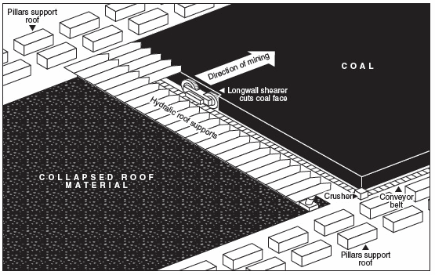
Long Wall Mining
Collapses mine as it progresses, on purpose

Slide 18
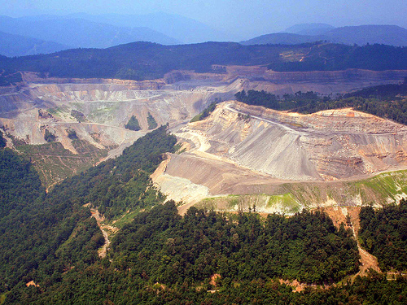
Mountain top removal

Slide 19
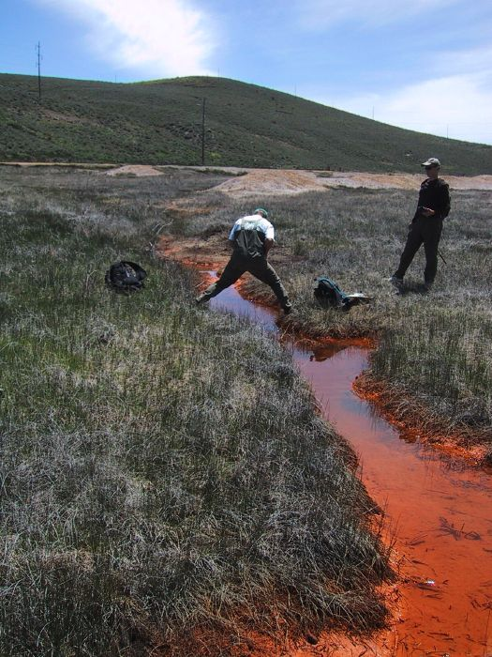
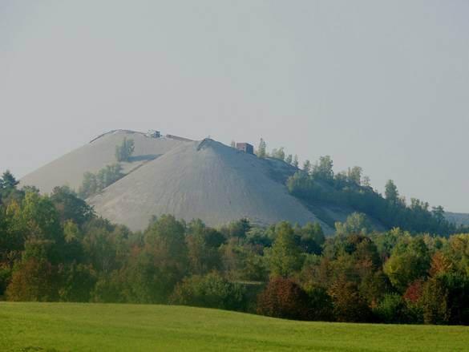
Processing
Tailings piles
Waste water ponds
Acid Mine Drainage

Slide 20
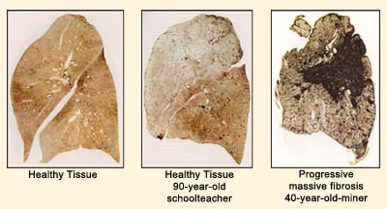
Humanitarian concerns
Diamonds
Amazonian Gold
Amazonian Silver

Slide 21
Solutions
Reduce – energy demands, mineral demands
Reuse--
Recycle (uses less energy and produces less waste rock than processing new ore)
Buy recycled
Find alternatives
Be an informed consumer

Slide 22
