Slide 1
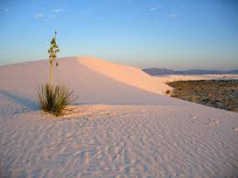
Lizard article
Write your name on your article
and read it to yourself silently.

Slide 2
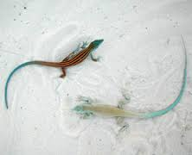
Circle formation
Number off: 1’s and 2’s. If there’s an odd number, two 2’s will travel together.
1’s: Form inner circle
2’s: Outer circle

Slide 3
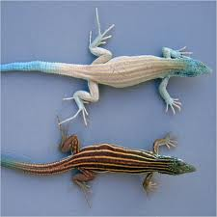
Article Activity
Step 1:
1’s: Read paragraph
2’s: Summarize
Step 2: 1’s and 2’s interpret. Discuss the meaning of the paragraph.
Step 3: Outside circle rotates one to the right. Repeat process for each paragraph.

Slide 4
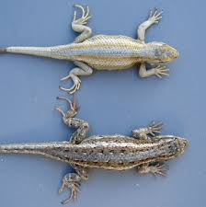
Share out:
-Return to your seats
-Call on students to share out paragraph analysis.

Slide 5
Notebook Page 32
Title “Lizard” Article:
Write a paragraph summarizing the main ideas of the article.

