Slide 1
LD50
Toxicity

Slide 2
LD50
Dose that is lethal to 50% of a test population (usually mice or rats)
Measured in mg/kg (toxin mass to body mass)
Mass of individual x LD50 = lethal dose
The smaller the LD50, the more toxic the chemical

Slide 3
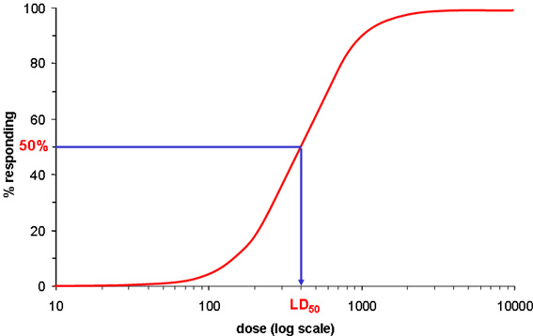

Slide 4
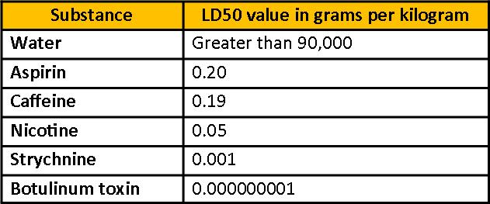

Slide 5
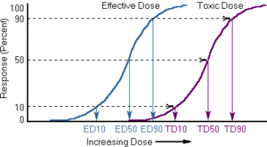
ED50
Effective Dose: Dose of a pharmacologic agent which will have a therapeutic effect in 50% of the population
Threshold: Maximum dose that does not show an effect

