Slide 1
Keystone Species Concept in Ecology and Conservation
Will the extinction of a single species cause the loss of many other species?
Can we identify a set of species that are so important in determining the ecological functioning of a community that they warrant special conservation efforts?

Slide 2
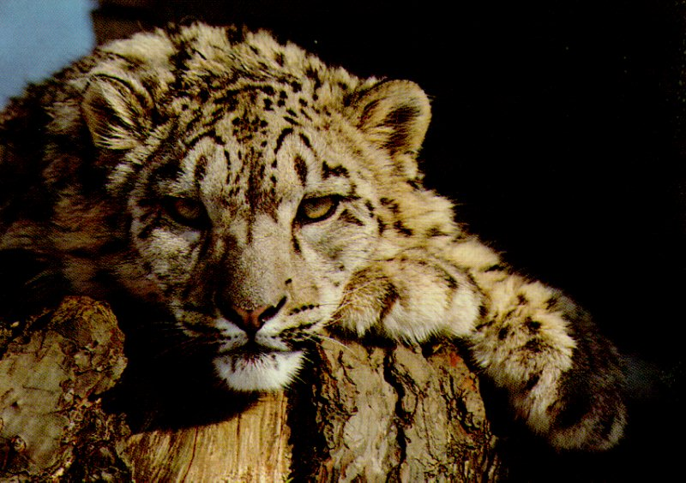
Keystone Species = limited number of species whose loss would precipitate many further extinctions
This is known as an extinction cascade or extinction vortex
Snow Leopard

Slide 3
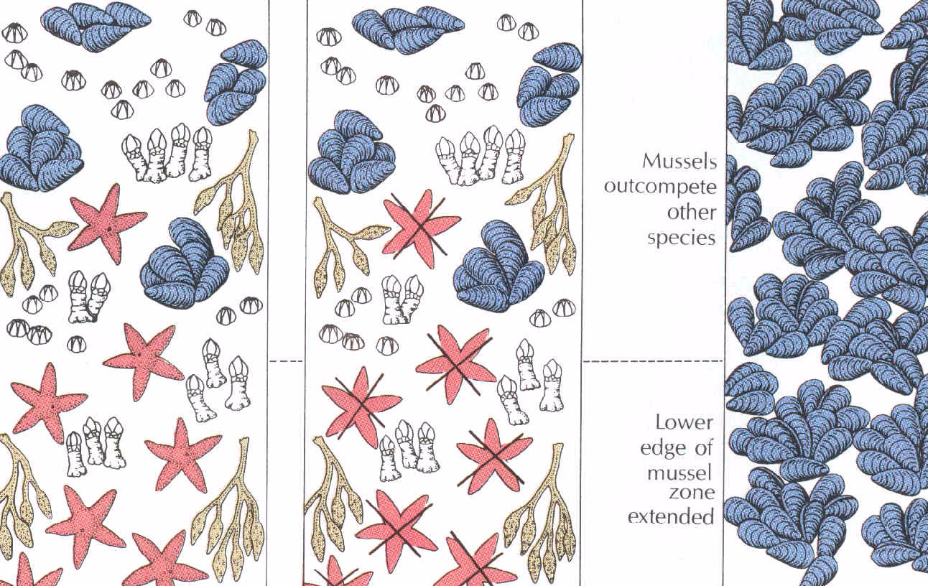
Natural
State
Sea Stars
Removed
Result
Middle
inter-tidal
Lower
inter-
tidal
Scene One

Slide 4
Natural
State
Sea Stars
Removed
Result
Middle
inter-tidal
Lower
inter-
tidal
Scene Two

Slide 5
Natural
State
Sea Stars
Removed
Result
Middle
inter-tidal
Lower
inter-
tidal
Scene Three

Slide 6
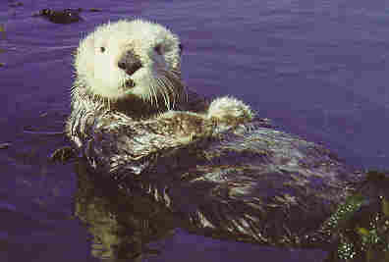
Four types of Keystone Species
1. Predator- considered keystone if they control the density of ecologically significant prey species, or on overall community composition
Sea Otter

Slide 7
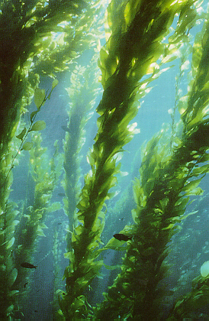
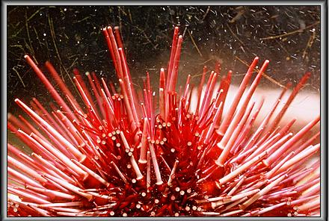
Sea Otters are one component of a very interesting ecosystem, which includes kelp beds, shellfish and sea urchins
Kelp
Red Sea Urchin

Slide 8
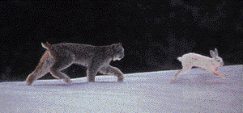
2. Keystone Prey
Lynx, Arctic Hare, Snowshoe Hare System on Newfoundland

Slide 9
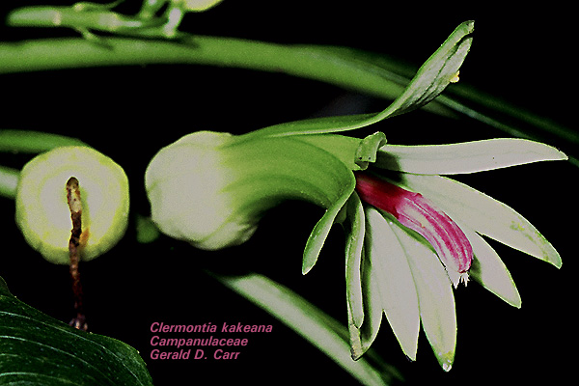
3. Keystone Plant- species of plants upon which certain animals are dependent, may also be referred to as a keystone mutualist
Lobelia plants native to the Hawaiian Islands

Slide 10
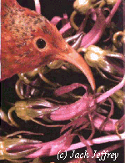
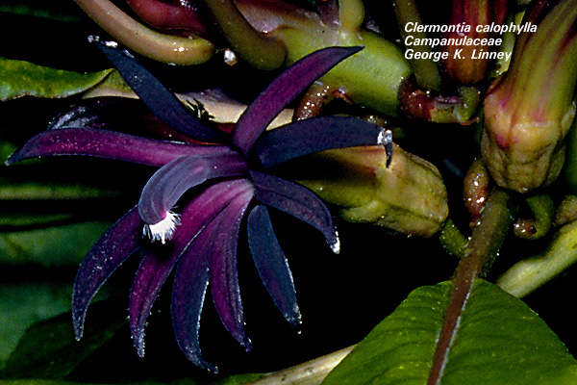
The i'iwi (Vestiaria coccinea) is one
of the Hawaiian honeycreepers
Records from the past century show
that these birds fed primarily on
Hawaiian lobelioids
Decurved bill specifically adapted for
extracting nectar from a flower with a
long fused corolla

Slide 11
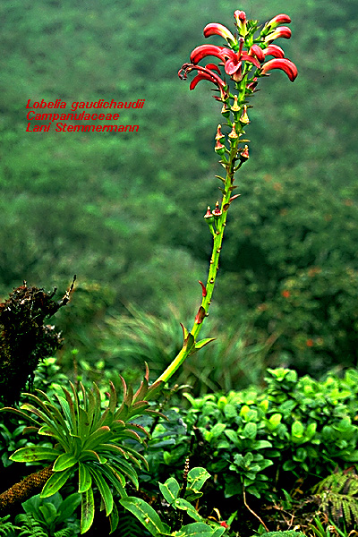
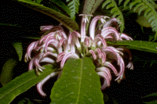
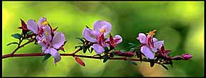
25% of Hawaiian lobelioids, once
common in the understory, and
found only in Hawaii, are now extinct
Most of the remaining species are
threatened or endangered
Over the past 100 years, over-grazing by
non-native herbivores, such as feral
pigs and goats, and competition from
non-native plant species are the cause
of the extinction of many lobelioids

Slide 12
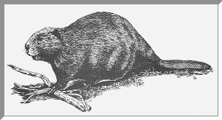
4. Keystone modifier- activities of one species greatly affect the habitat structure which, in turn, affects species composition

Slide 13
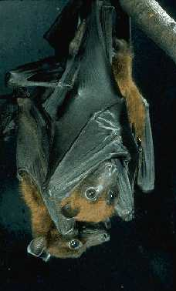
Fruit Bats a.k.a Flying Foxes
Nearly 200 species
Many species confined to islands in the South Pacific and Indian Oceans

Slide 14
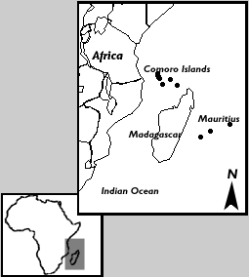

Slide 15
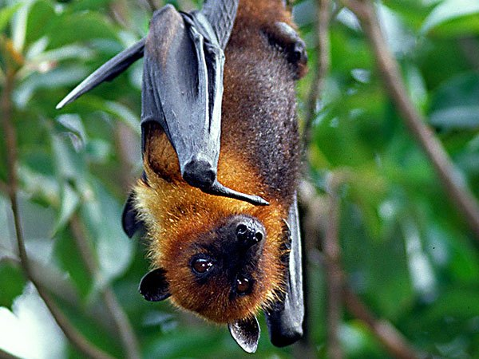
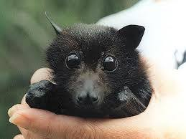
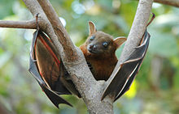
Fruit Bats serve as valuable pollinators and seed dispersers, often the only ones for a particular plant species

Slide 16
In Samoa 80-100% of the seeds found on the forest floor were deposited by Flying Foxes
Many co-evolved features, such as night blooming flowers, prevent other pollinators from taking over in the absence of the flying foxes
On the island of Guam, where two species of endemic Flying Foxes have gone extinct, certain plant species have stopped blooming

Slide 17
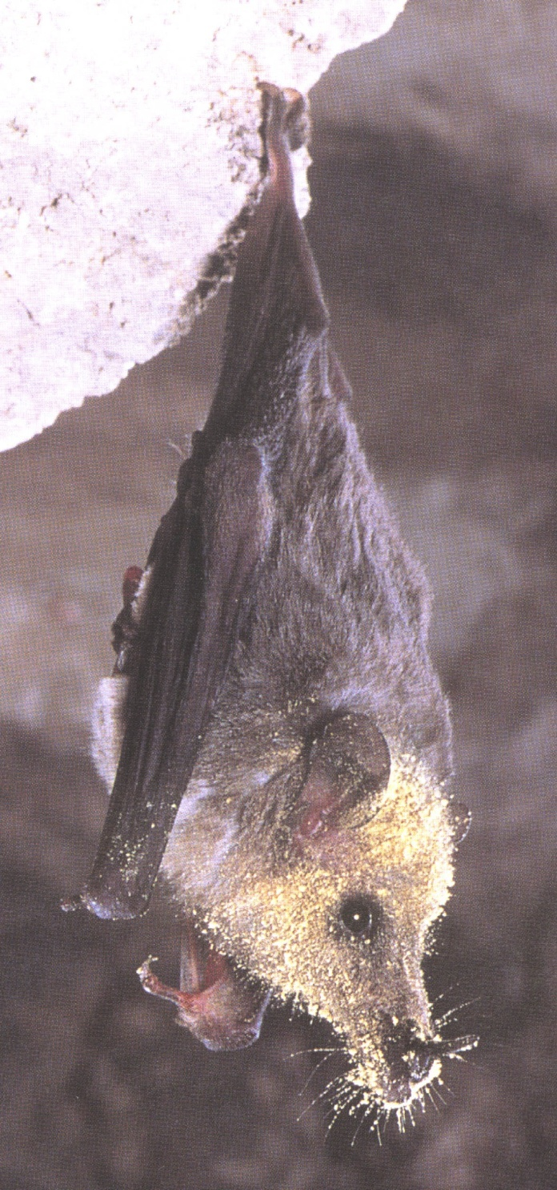
Mexican Long-tongued bat (Cheoronycteris mexicana)
Roosting in a cave, note that the entire head and part of the wing are covered with pollen.

Slide 18
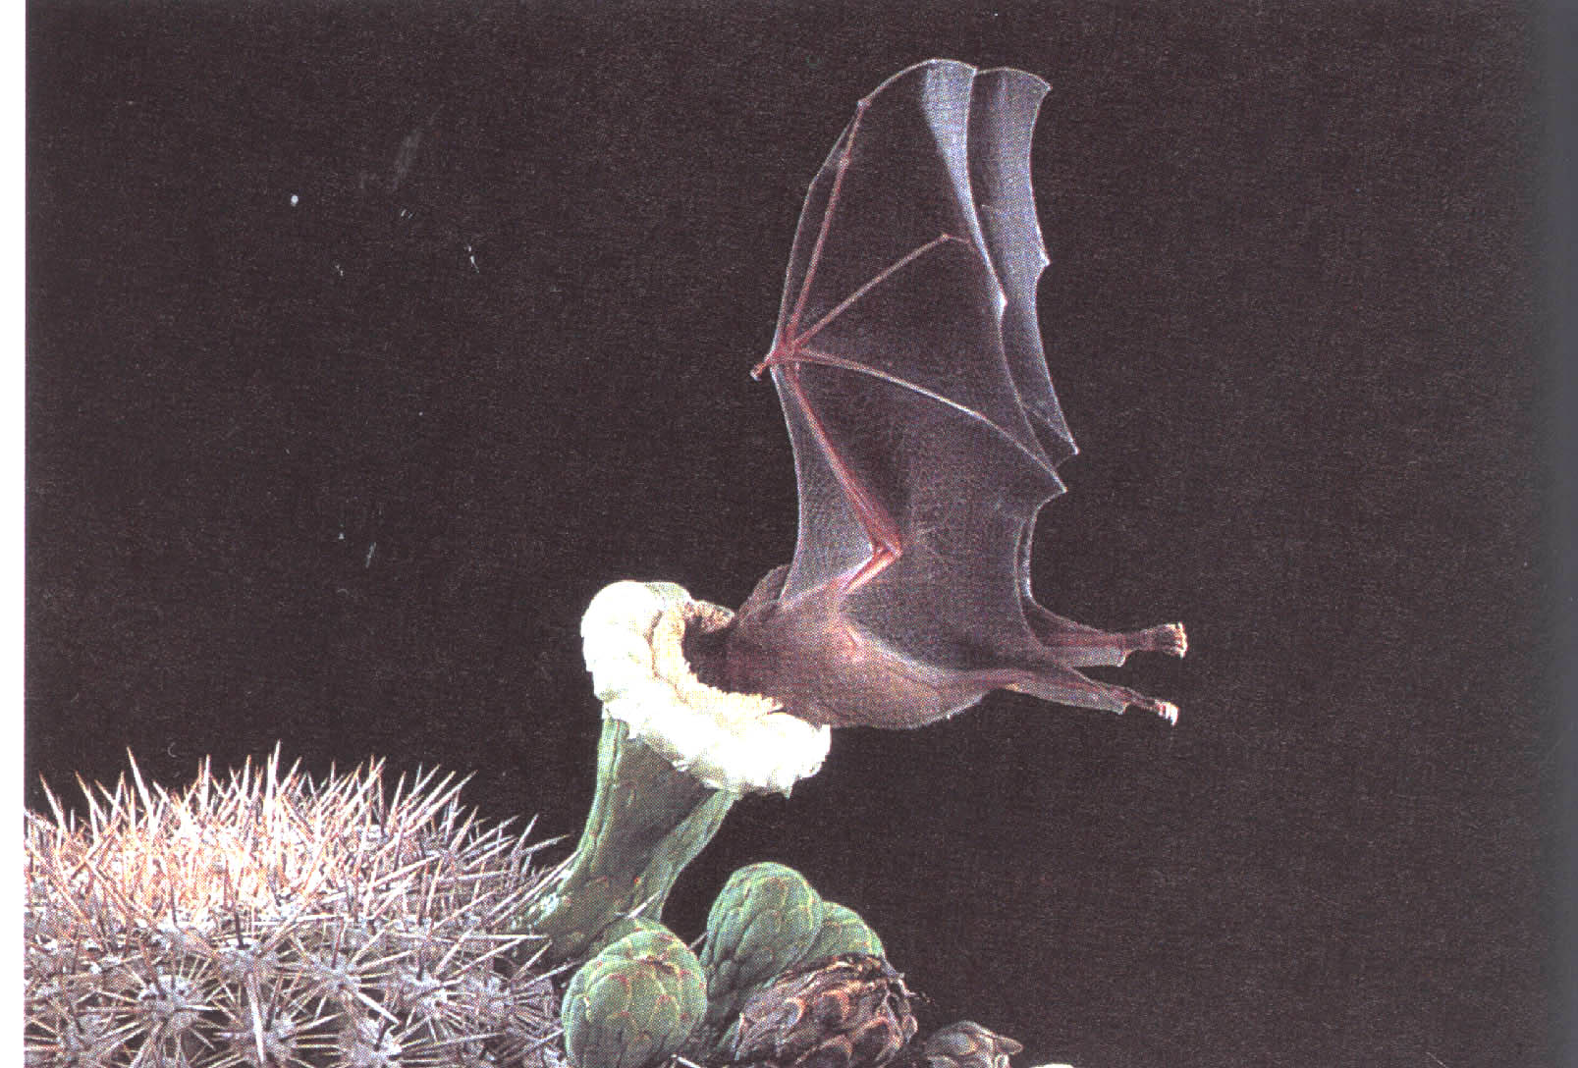
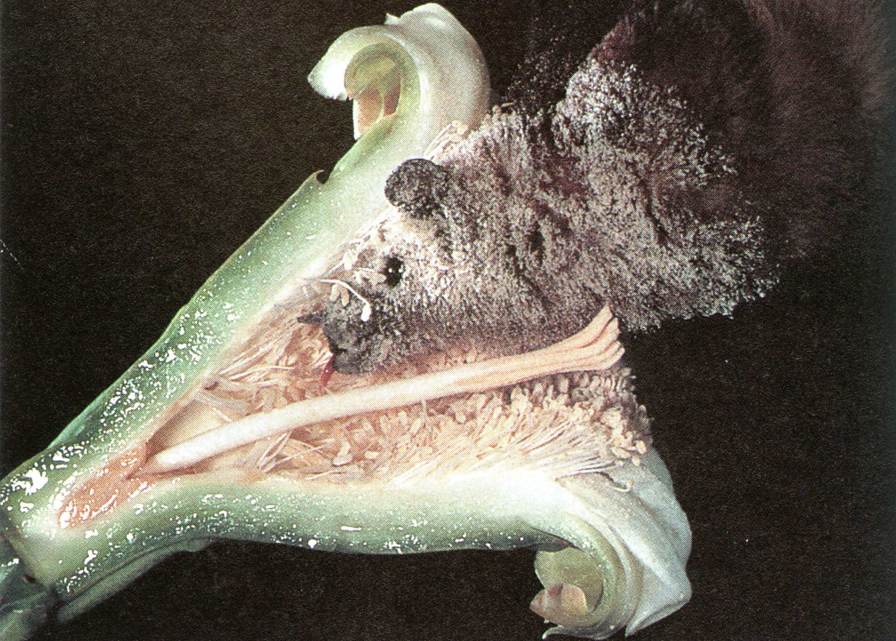
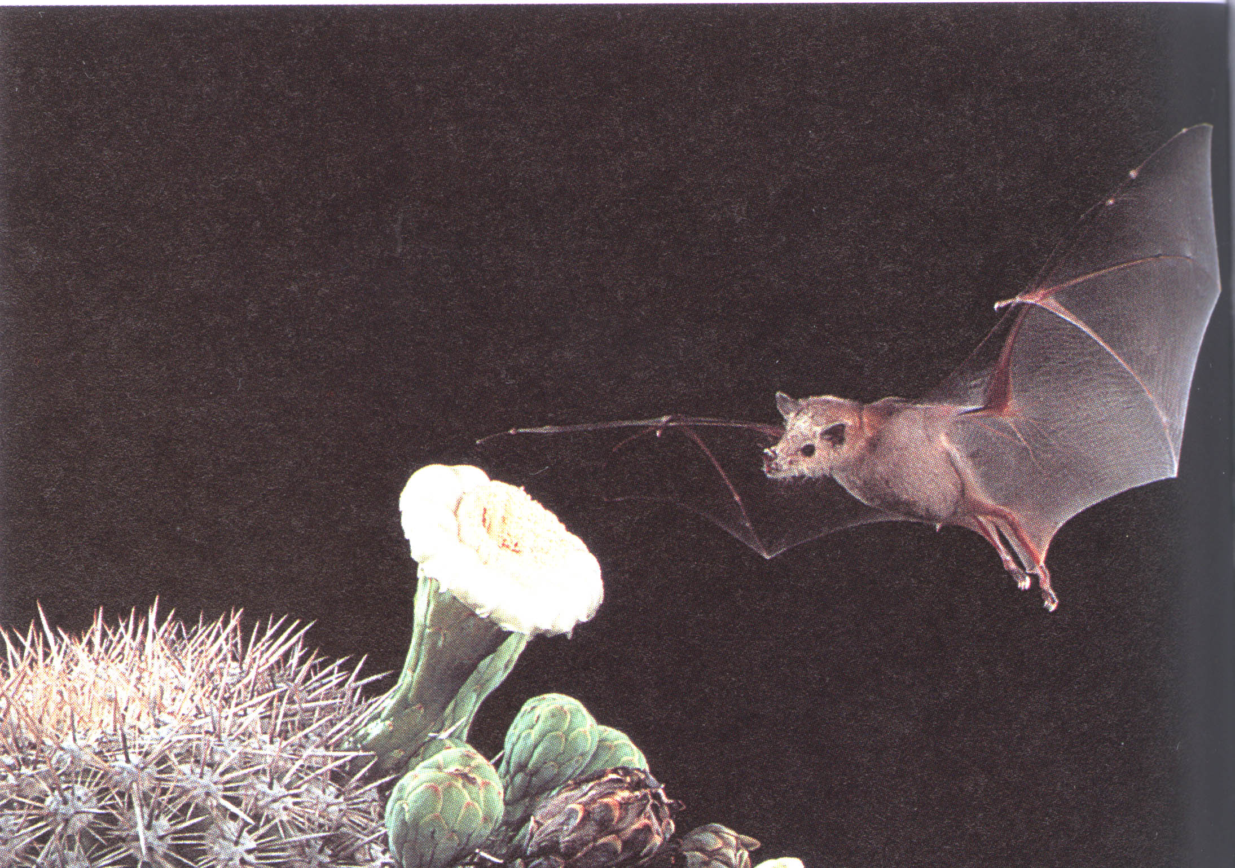

Slide 19
Many of the plants pollinated by bats are of significant economic value both to local and international markets including;
ebony
mahogany
many medicinal species
Flying Foxes are also critical to forest regeneration after man-caused disturbances

Slide 20
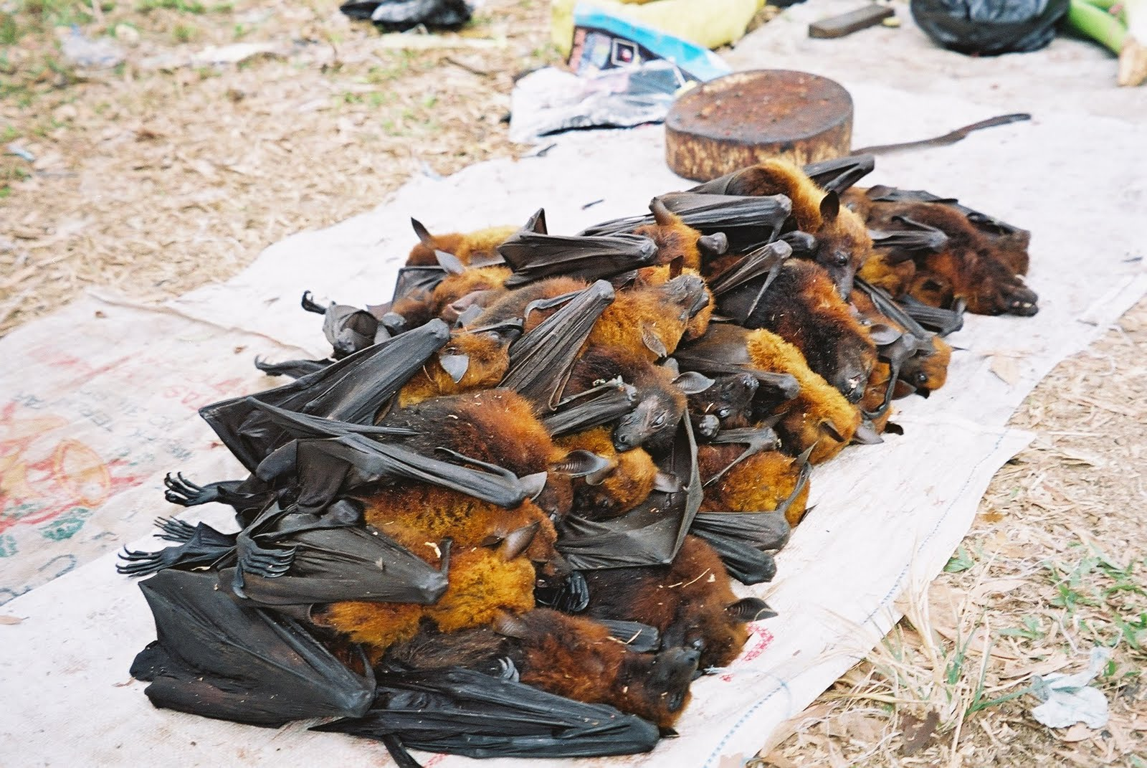
Flying Fox declines are due primarily to
Hunting- since they are colonial, thousands can be “harvested” in a single night
Habitat destruction- due to farming and fuel-wood collection
The decline of Flying Fox species will undoubtedly lead to massive extinction cascades

Slide 21
Summary- Important implications for the identification of keystone species
1. The elimination of a keystone species from a community will precipitate the loss of many other species
2. In order to protect a species of interest, it may be important to protect the keystone species on which it depends
3. If the keystone species in a community can be identified, they should be carefully protected, and even enhanced

Slide 22
