Slide 1
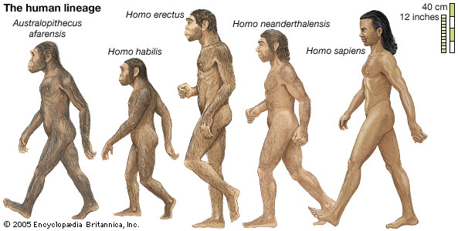
Human Evolution
A bipedal walk through time

Slide 2
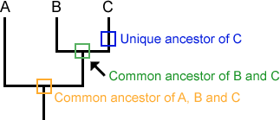
Phylogenetic Tree (evolutionary relationships)
Cut out the phylogenetic tree and glue it near the top of your page 22. Answer the questions based on the following principles:

Slide 3
Human Prehistory I (5 min.)
Watch the video clip and answer the following questions:
5. On which continent did early humans (hominids) originate?
6. Where did a small group of early hominids travel 1st out of Africa?
7. Who did the early humans run into when they reached Europe?

Slide 4
Human Prehistory II (3 min.)
8. What climatic conditions did early humans run into 20,000 years ago?
9. What happened that may have allowed early humans to reach North America?

Slide 5
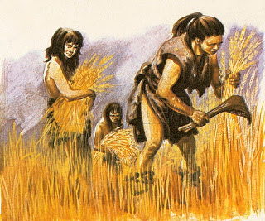
Human Prehistory III (7 min.)
10. What activity allowed the early humans to be able to create more permanent villages instead of migrating for food?
11. Why was there a loss of genetic diversity when people moved around to find fertile soil?

