Slide 1
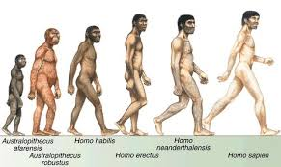
Mapping Hominin Migration
Plot the points from page 468
Use 4 different colors
Create a key for each of the 4 hominid species
Lightly shade in the approximate boundaries

Slide 2
Time in fossil record
Homo habilis: 2.1-1.5 million years ago
Homo erectus: 1.9 mya-143,000 years ago
Homo neanderthalensis: 250,000-28,000 ya
Homo sapiens: 200,000 years ago to present

Slide 3
Human Phylogeny (Family Tree)
Smithsonian Information page and picture

Slide 4
Analysis (questions from p. 468)
According to the map you made and the fossil time record, when was the earliest that hominins could have migrated out of Africa?
Where did they go?
What sets of fossils overlapped in geographic ranges?
What does this suggest?

