Slide 1
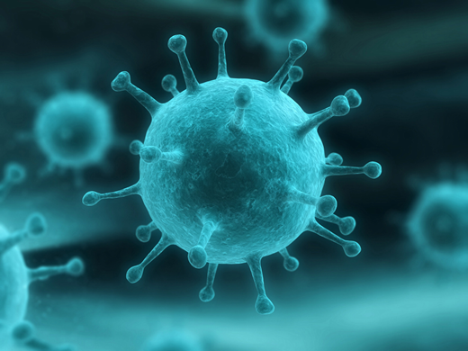
Flu Evolution
1. Number the paragraphs
2. Read the article
3. Highlight/underline:
a. How vaccines work
b. Why we need a different flu vaccine each year
c. Explanation of antigenic drift
d. How natural selection is involved
4. Choose 2 of the discussion questions and answer them in complete sentences.

