Slide 1
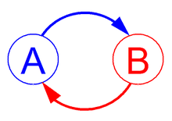
Feedback Loops
EQ: What are positive and negative feedback loops and how do they affect homeostasis?
Feedback occurs when parts of a system affect each other

Slide 2
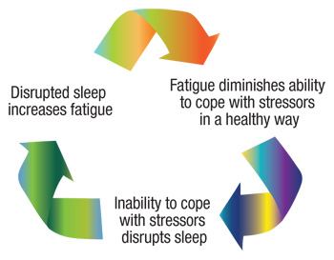
Positive Feedback
The enhancement or amplification of an effect by its own influence on the process that gives rise to it.

Slide 3
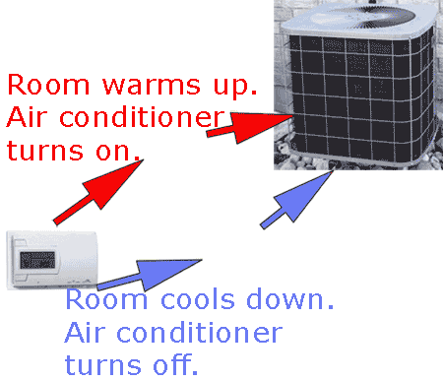
Negative Feedback
Counteraction that: Helps to maintain homeostasis

Slide 4
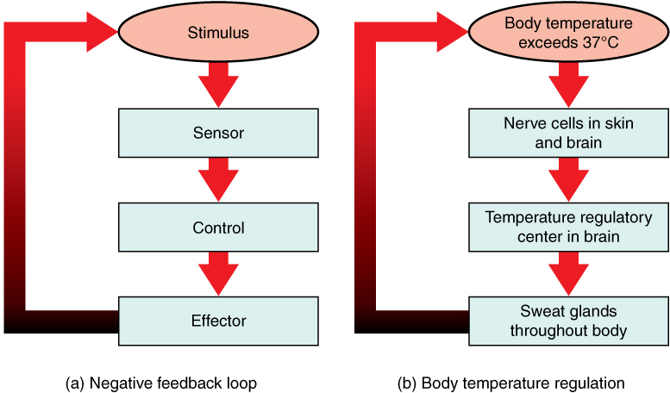

Slide 5
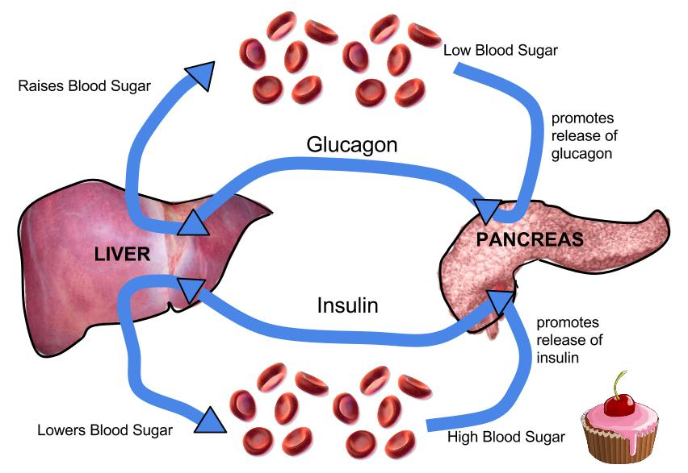
Positive or Negative Feedback?

Slide 6
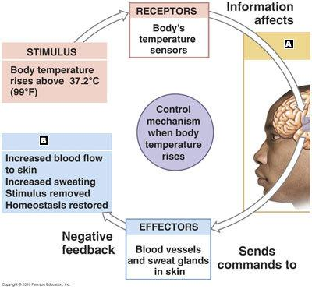
Positive or Negative?

Slide 7
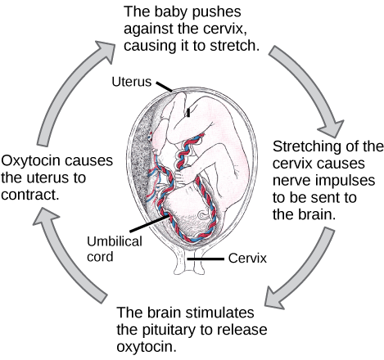

Slide 8
Brainstorm ideas for other examples of feedback loops in humans (2 min.)
Discuss your ideas with your group.
Draw an example of your feedback loop and share it with the class.

Slide 9
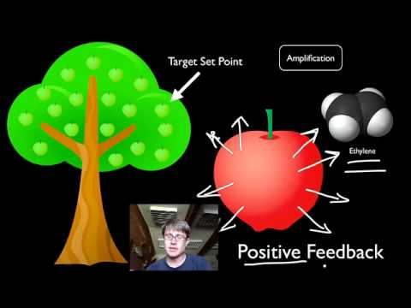
Positive and Negative Feedback Loops “Wrap-up” video:
Watch video
Summarize

Slide 10
Practice Problems:
Look at your practice problems and:
Think
Answer
Discuss
Revise if necessary

