Slide 1
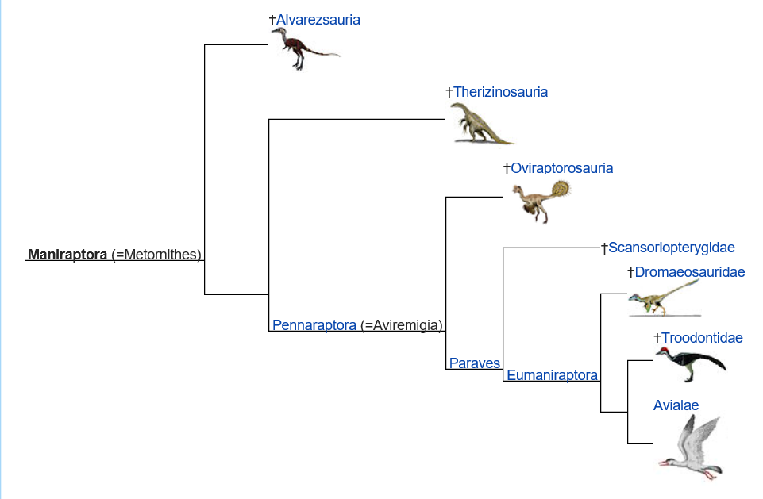
Dinosaurs and Evolution
Notes:
Maniraptorans first appeared in the Jurassic period 201.3 million years ago.

Slide 2
KT Extinction (65 million years ago)
-65 Million years ago marks a mass extinction of 1000’s of different species, most notably all of the non-avian dinosaurs.
-Several environmental factors are thought to have led to the extinction including a large asteroid, volcanic activity and climate change.

Slide 3
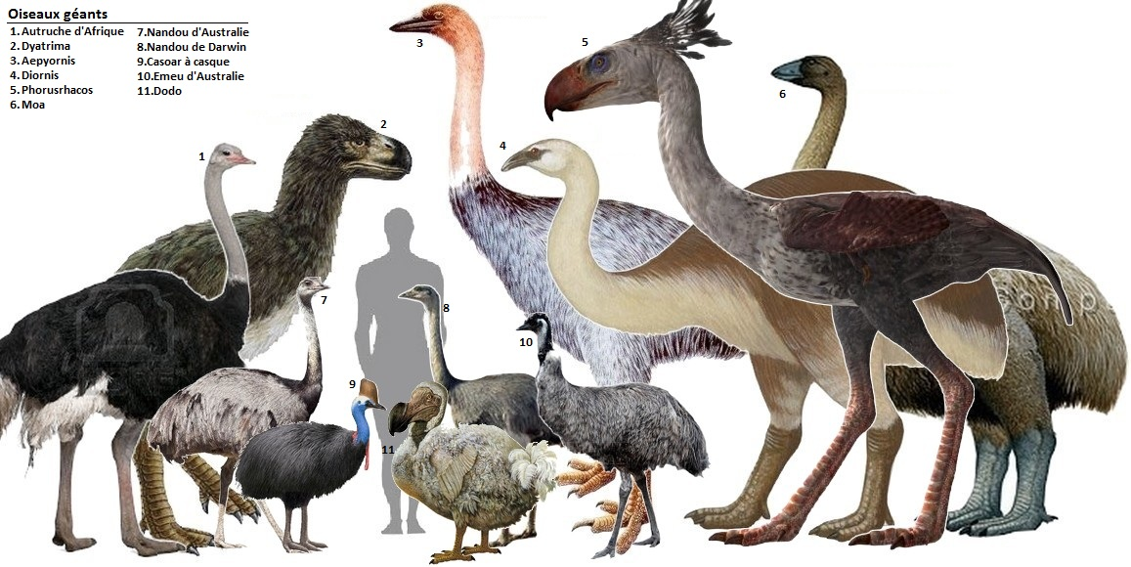
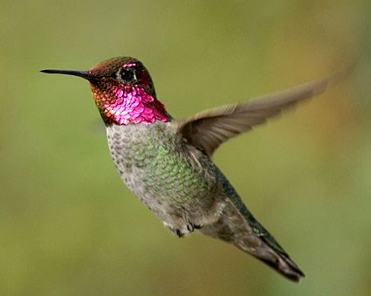
Question 1:
Brainstorm possible factors that could have allowed for the survival of the avian dinosaurs.

Slide 4
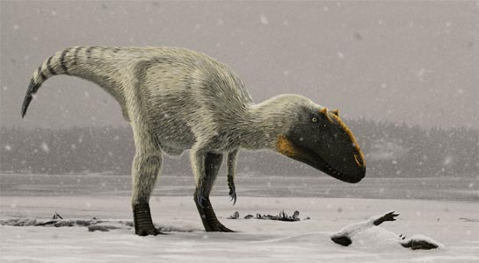
Question 2: What are possible advantages of feathers?
Yutyrannus

Slide 5
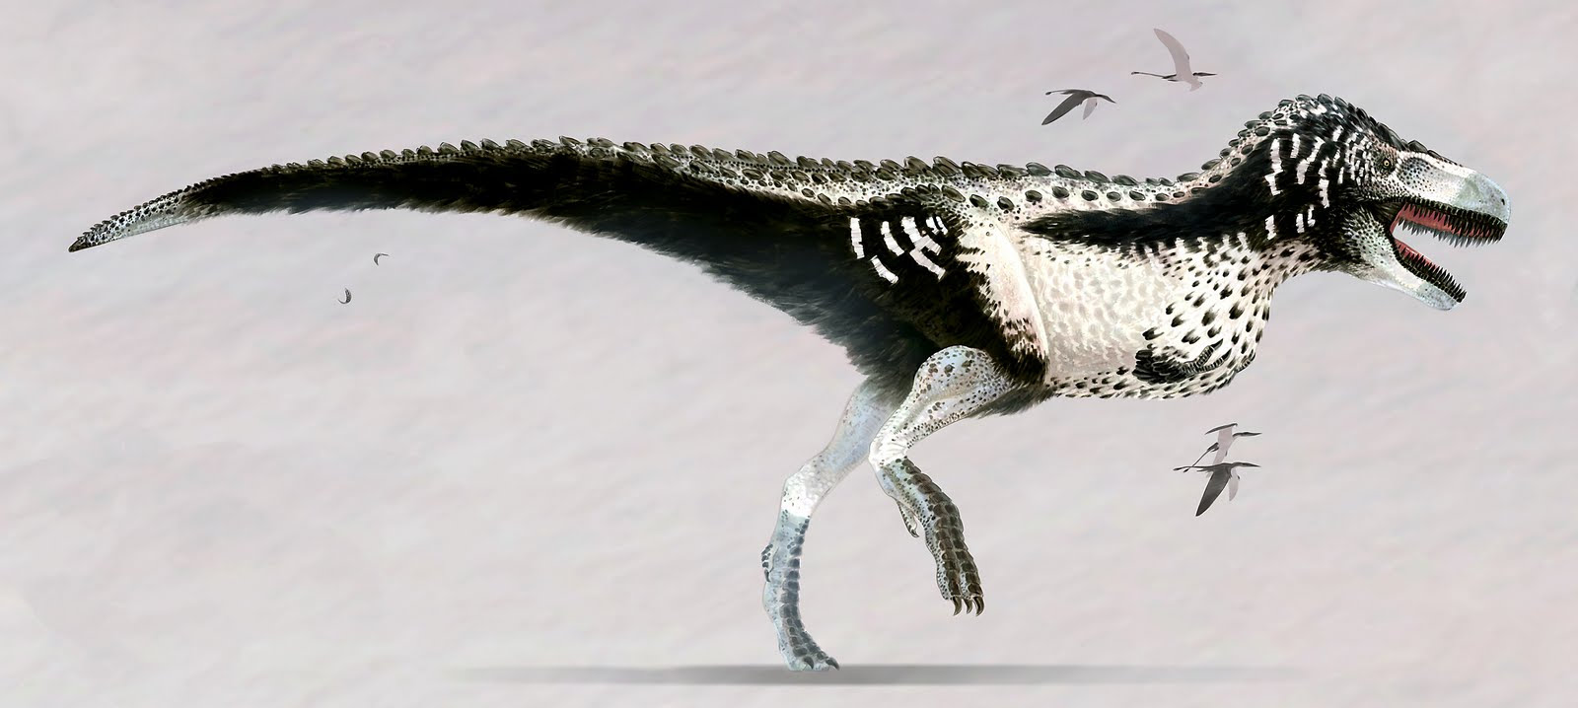
Question 3: How can you infer the color of dinosaurs?

Slide 6
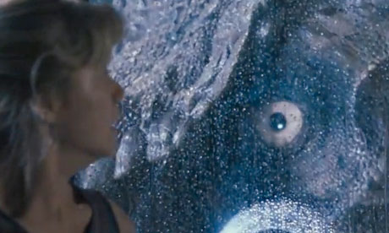
Question 4: Who has better eyesight?
Humans or T Rex?
Eagles or T Rex?

Slide 7
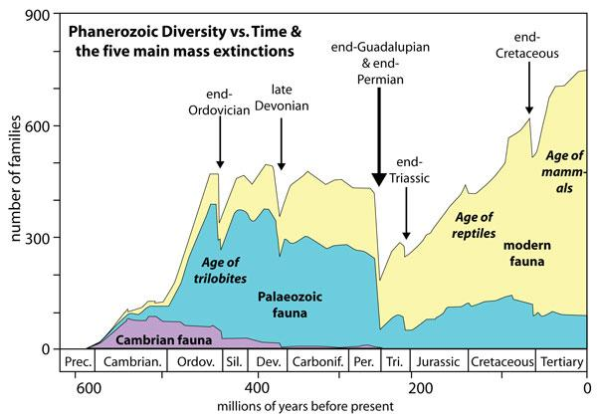
Mass Extinctions can lead to major evolutionary changes

