Slide 1
Enzymes

Slide 2
California Science Standard
1 b. Students know enzymes are proteins that catalyze biochemical reactions without altering the reaction equilibrium and the activities of enzymes depend on the temperature, ionic conditions, and the pH of the surroundings.

Slide 3
Learning Objectives
Students will know that enzymes increase the speed of chemical reactions by lowering the activation energy
Students will be able to identify the substrate, active site and enzyme when given a diagram

Slide 4
Language Objectives
Students will ask and answer questions by using phrases or simple sentences.

Slide 5
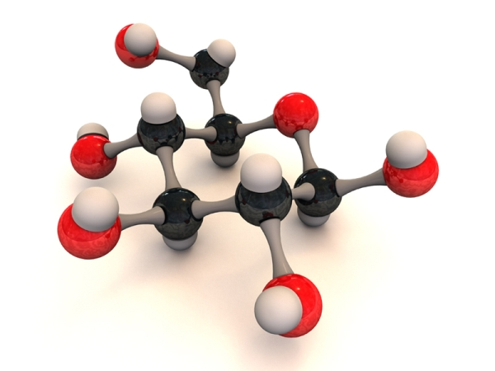
Chemical Reactions
A chemical reaction is the process by which atoms or groups of atoms in substances are reorganized into different substances
Chemical bonds are broken or formed

Slide 6
Traits of Chemical Reactions

Slide 7
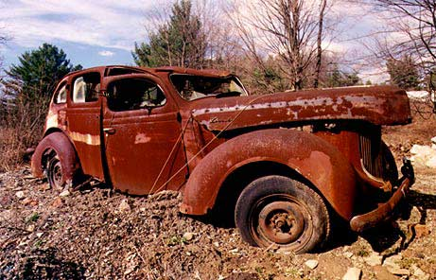
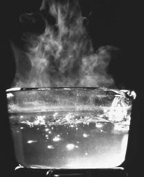
Physical or Chemical
Physical changes occur when a substances appearance is changed, but not its composition – Example water boiling
Chemical change – changes the chemical composition – Example a rusting car
Take one minute and list at least three physical and three chemical changes

Slide 8
Chemical Equations
Reactants Products
In chemical reactions, matter cannot be created or destroyed. This is called the CONSERVATION OF MASS. All chemical equations must show balance of mass.
6CO₂ +6H₂O ^{Light Energy} C₆H₁₂O₆+6O₂
This is the chemical equation for photosynthesis. Take two minutes and write the chemical equation for cellular respiration. Are they balanced?

Slide 9
How Enzymes Work

Slide 10
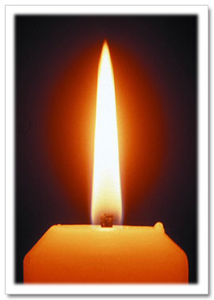
Activation Energy
Activation Energy is the minimum amount of energy needed for reactants to form products in a chemical reaction
Lighting a candle wick provides activation energy for the chemical reaction of the substances in the candle and oxygen

Slide 11
Activation Energy

Slide 12
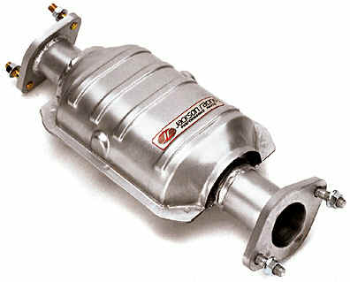
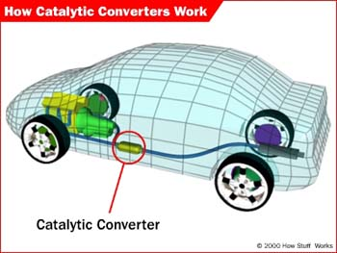
Catalysts
All living things are chemical factories driven by chemical reactions
A catalyst is a substance that lowers the activation energy needed to start the reaction
A catalyst does not increase how much product is made and it does not get used up in the reaction

Slide 13
Catalysts

Slide 14
Enzymes
Special proteins called enzymes are biological catalysts that speed up the rate of chemical reactions in biological processes.

Slide 15
Rates of Chemical Reactions

Slide 16
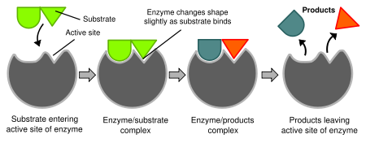
Substrates
The reactants that bind to the enzyme are called substrates.
The specific location where the substrate binds on an enzymes is called the active site
Once the substrates bind to the active site, the active site changes shape and forms the enzyme-substrate complex.

Slide 17
Show me what you know
Create a bridge map showing an analogy of how enzymes work and a lock and key
Relating Factor - Specificity

Slide 18
Factors
Factors such as pH, temperature and other substances affect enzyme activity.
Example, enzymes in human cells are most active at 37°C. However, enzymes in other organisms, such as bacteria can be active at other temperatures

Slide 19
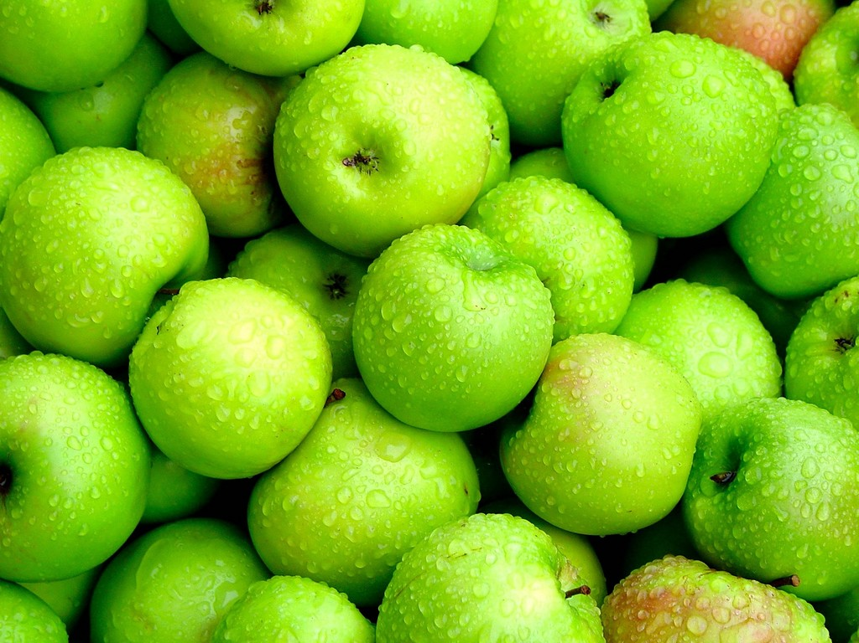
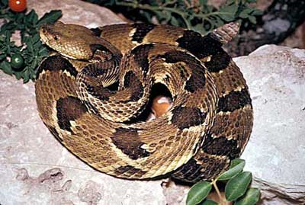
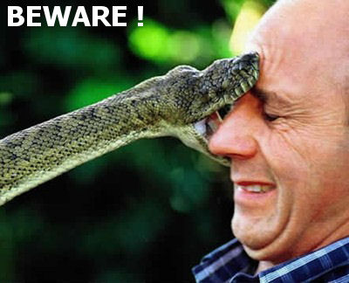
Enzymes and Biological Process
When a person is bitten by a poisonous snake, enzymes in the venom break down membranes of that persons red blood cells.
Hard green apples ripen due to the action of enzymes
Photosynthesis and Cellular Respiration provide energy with the help of enzymes

Slide 20
Worker Bees
Just as worker bees are important for the survival of the beehive, enzymes are the chemical worker bees of the cell

Slide 21
An Enzyme Music Video

Slide 22
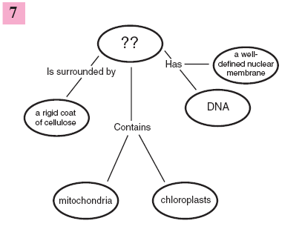
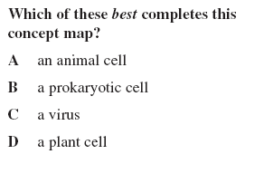
Test Review Warm-up #1 (Add to the end of your Enzyme PowerPoint on p. 36)

