Slide 2
Which form of energy use is most common in developing countries?
A. To develop industrial base
B. Commercial use
C. Industrial
D. Transportation
E. Residential (cooking and heating)

Slide 3
What type of fuel has the highest use worldwide?
A. Petroleum
B. Coal
C. Natural Gas
D. Electricity
E. Renewables

Slide 4
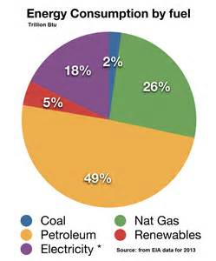
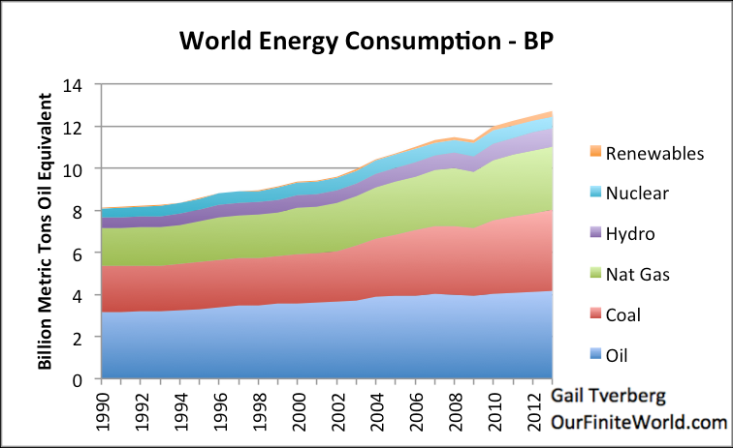
World Energy Use:

Slide 5
Which of the following is the correct order of coal formation? A. Peat – Anthracite – Lignite – Bituminous – sub bituminous B. Anthracite – Lignite – Sub bituminous – Bituminous – Peat C. Peat – Lignite – Sub bituminous – Bituminous – Anthracite D. Sub bituminous – Peat – Lignite – Bituminous – Anthracite E. Bituminous – Sub bituminous – Peat – Anthracite – Lignite

Slide 6
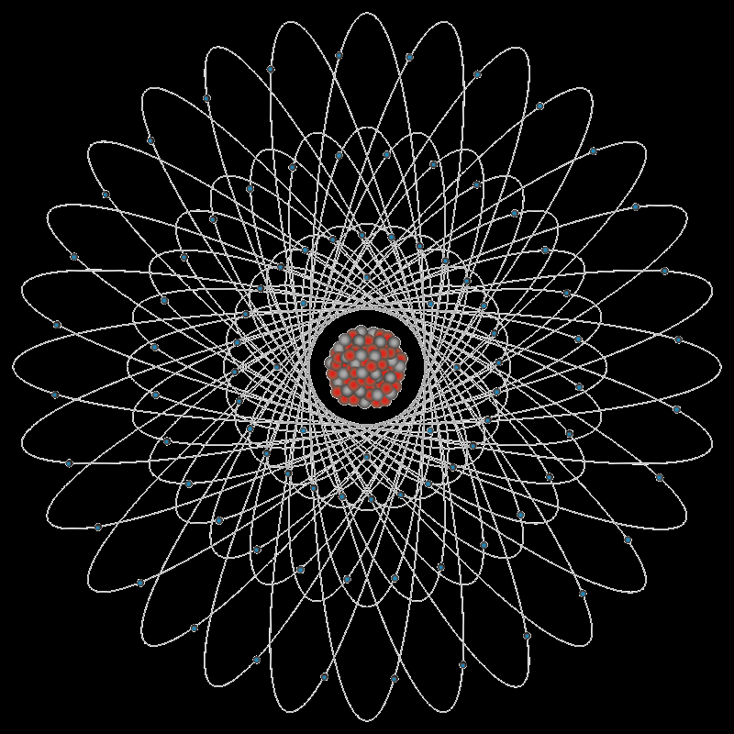
Nuclear power plants produce electricity using energy from the radioactive decay of
A. uranium-235
B. uranium-238
C. uranium-239
D. plutonium-235
E. plutonium-238

Slide 7
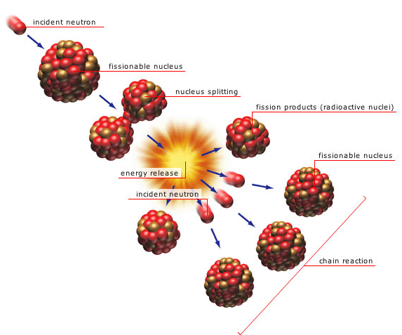
How a Nuclear Power Plant Works
Water is heated and converted to steam, which then turns a turbine and operates a generator (similar to a coal power plant).
NUCLEAR FISSION is used to create heat (instead of combustion).
Heat is released when a neutron strikes a uranium 235 atom and splits it apart. A chain reaction ensues whereby the atom releases more neutrons that strike more U235 atoms. Plutonium isotopes, Barium and Krypton
are some of the radioactive by-products.

Slide 8
A radioactive isotope has a half-life of 50 years and a radioactivity level of 6 curies. How many years will it take for the radioactivity level to become 1.5 curies?
25
50
75
100
150

Slide 9
Which is true about photovoltaic cells?
No need to make steam because it bypasses the steam driven turbine generator
Too difficult to use on houses
Emits mercury that can end up in aquatic food chains
The mirrors attract birds who confuse them with water
They split hydrogen atoms

Slide 10
Which of the following countries is NOT one of the members of OPEC?
A) Iran
B) Iraq
C) Saudi Arabia
D) United Kingdom
E) Venezuela
Notes:
Organization of the Petroleum Exporting Countries As of May 2017, OPEC's members are Algeria, Angola, Ecuador, Equatorial Guinea, Gabon, Iran, Iraq, Kuwait, Libya, Nigeria, Qatar, Saudi Arabia (the de facto leader), United Arab Emirates, and Venezuela, while Indonesia is a former member. Two-thirds of OPEC's oil production and reserves are in its six Middle Eastern countries that surround the oil-rich Persian Gulf. (Iran, Iraq, Kuwait, Saudi Arabia, VenezuelaOPEC was founded specifically as an association of petroleum producing countries that were not major powers or superpowers or part of the European Block. Allowing a major power in the group would have contradicted its purpose, which was to give smaller nations some leverage in the international oil market. Hence, no United States, no Russia, no Norway or United Kingdom.

