Slide 1
Endangered Species
What’s Happening?

Slide 2
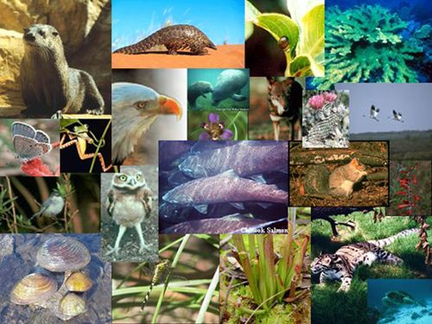
Causes of Extinction
Habitat alteration 40%
Commercial hunting 23%
Competition with introduced species 16%
Pest Control 7%
Subsistence food hunting 6%
Captured to serve as pets 5%
Superstitious beliefs 2%
Pollution 1%

Slide 3
Definitions
Habitat alteration: changes in an organism’s habitat such as logging, landfill, dredging, clearing for development, flooding.
Commercial hunting: hunting of animals for financial gain
Introduced species: organisms that do not naturally live in the area
Subsistence food hunting: hunting of animals for food
Superstitious beliefs: killing of organisms to use in religious ceremonies or for scientifically unsupported superstitions (ex: killing a bear for its spleen or a rhino for its horn).

Slide 4
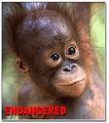
Steps in classifying risk
Step 1: Species of “special concern”
Step 2: Rare
Step 3: Threatened
Step 4: Endangered

Slide 5
Endangered Species Act
Started in 1973
Federal program
Encourages the establishment of state programs
Provides for the conservation of ecosystems upon which threatened and endangered species of fish, wildlife, and plants depend.

Slide 6
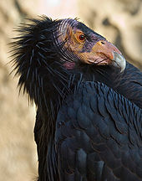
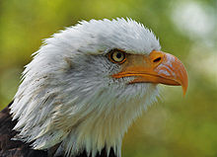
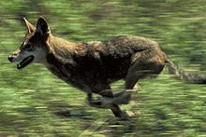
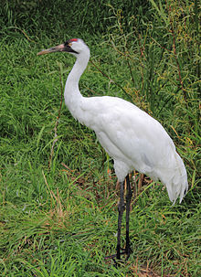
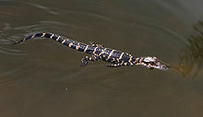
Some species brought back
Bald Eagle California Condor
Red Wolf
Whooping Crane American alligator

