Slide 1
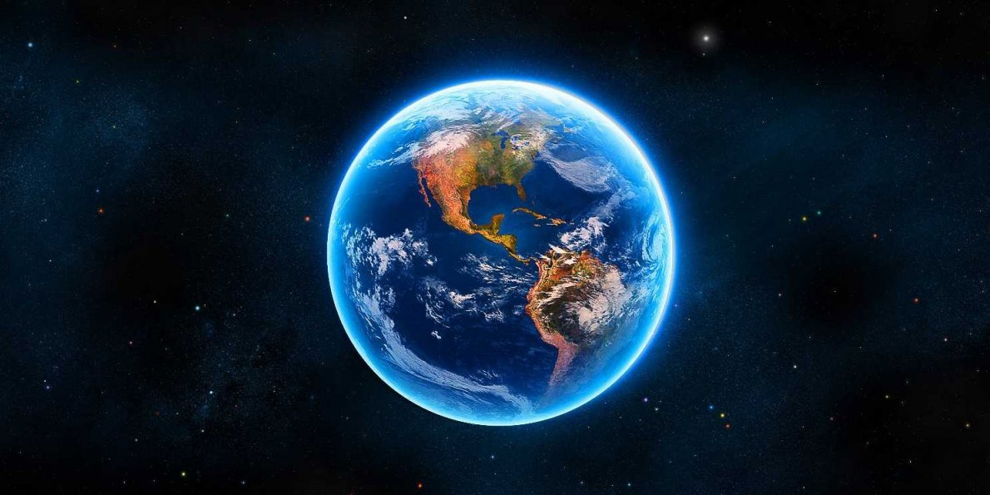
The Living Earth

Slide 2
Brainstorm:
What are the differences between biological events and geological events?

Slide 3
How old do you think the earth is?
How many years ago do you think life started on earth?
Notes:
4.5 billion years
3.8 billion years ago (prokaryotes)

Slide 4
There are many ways to represent the same information in a timeline...

Slide 5
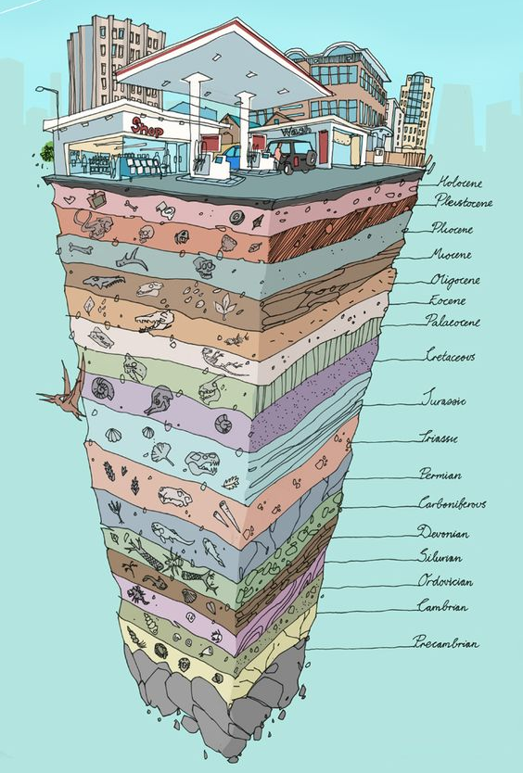
History of Earth broken up into chunks based on events within:
Era (biggest chunks)
Period
Epoch
Age (smallest chunks)

Slide 6
History of all fossils dated on Earth:

Slide 7
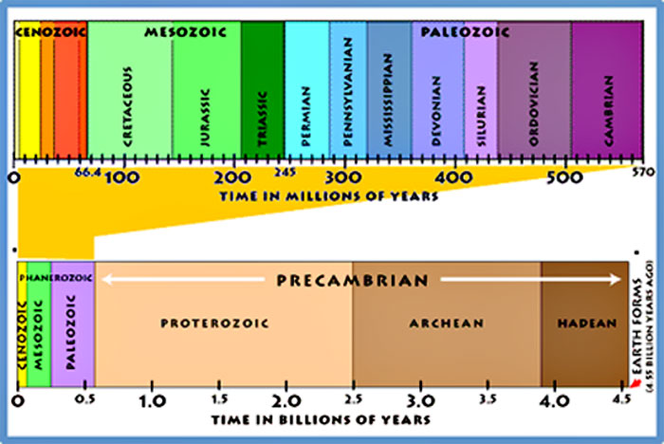

Slide 8
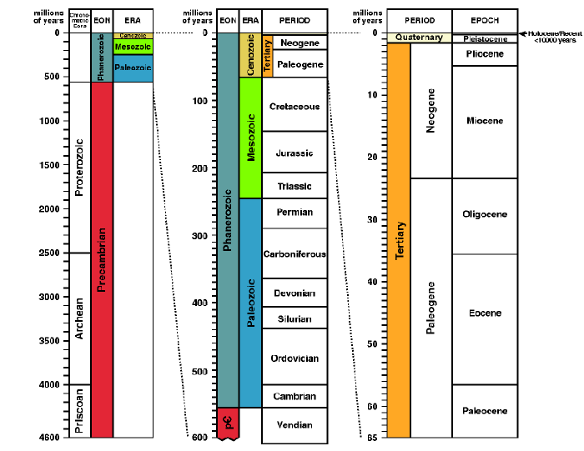

Slide 9
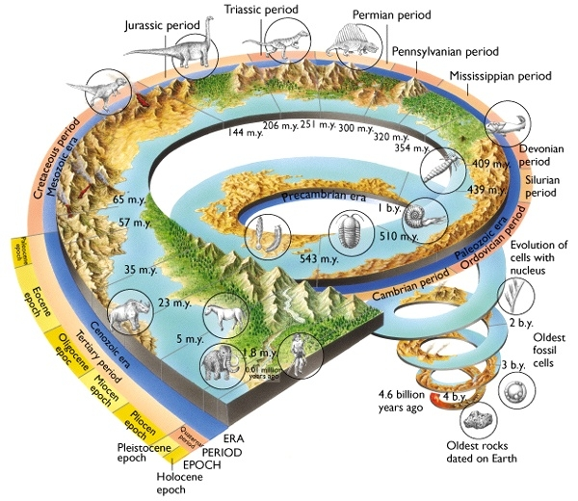

Slide 10
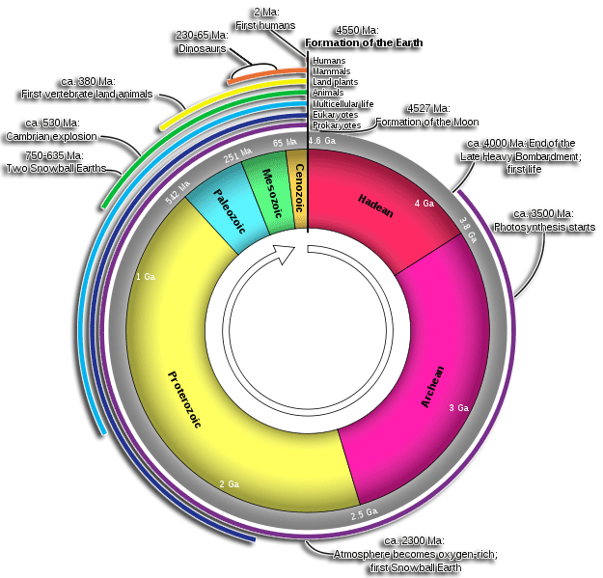

Slide 12
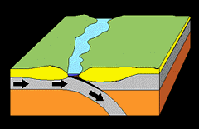

Slide 13
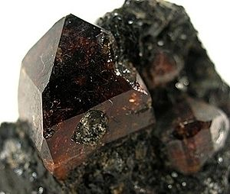
How do we know how old the Earth is?
Based on very old and stable zircon crystals from Australia we have dated that the Earth is at least 4.374 billion years old. But it could certainly be older. Scientists tend to agree that our little planet is around 4.54 billion years old—give or take a few hundred million.
Notes:
Based on the decay rate of the zircon (essentially bombard it with electrons).

Slide 14
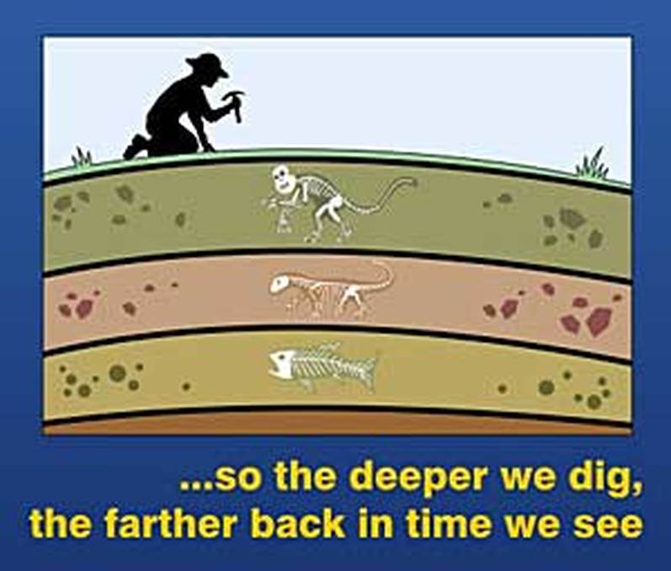
We can tell a lot about what conditions were in earth’s past by looking at rocks and fossils.

Slide 15
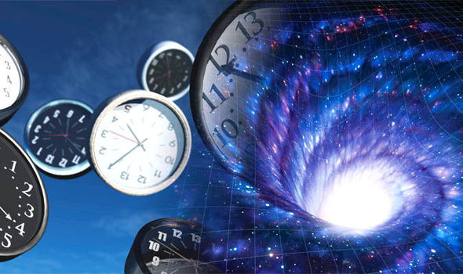
It’s very difficult to imagine what is considered “deep time” because it’s so vast.

Slide 16
...Now it’s your turn to make a timeline of the history* of life on Earth
*Putting every known fossil on a timeline would take a lifetime, which we don’t have today
Let’s just do some of the most important events...

Slide 17
Earth History wrap up tasks (page 4):
Look up the following time periods and explain why they have their names
(Wikipedia is fine):
Proterozoic Eon
Phanerozoic Eon
Paleozoic Era
Mesozoic Era
Cenozoic Era
Notes:
Proterozoic Eon (from 1st oxygen to right before complex life
Phanerozoic: Abundant plant and animal life
Paleozoic era: Start of biggest diversity of life
Mesozoic era: age of reptiles
Cenozoic; “new life” - up until present day

Slide 18
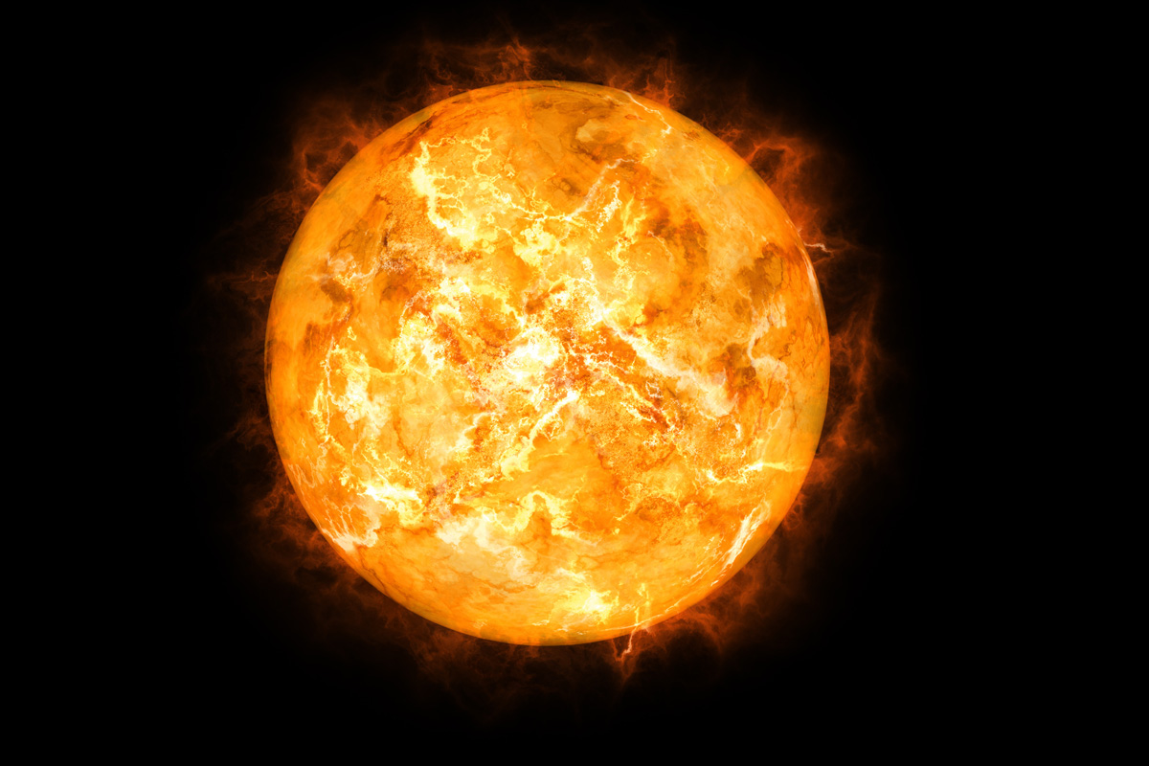
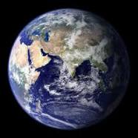
Based on the life of our star (the sun), earth will be around for another 5 billion years. Write a paragraph (individually) about what changes you predict for earth and the life on it during the next 5 billion years.

Slide 19
Additional information…….

Slide 20
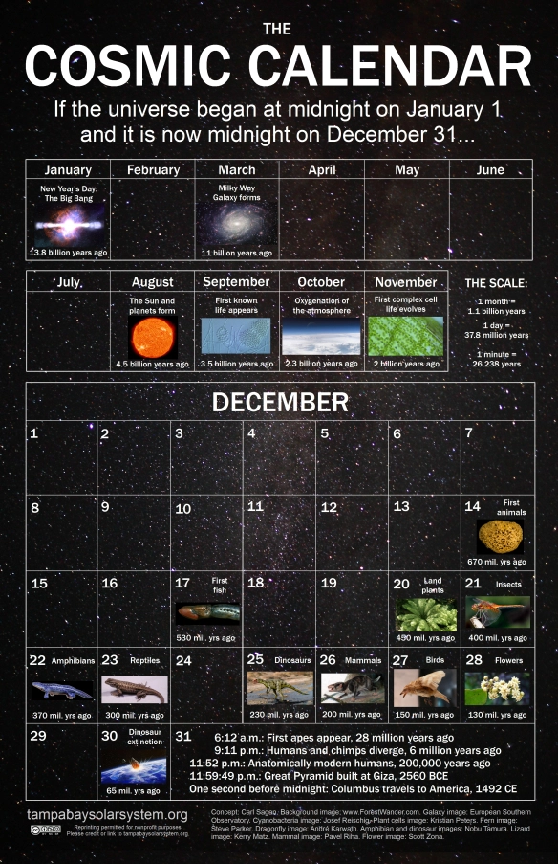
Comparing Earth’s Geologic Time to a Year Calendar
It’s an analogy so that humans can better grasp the lengths of time truly involved

Slide 21
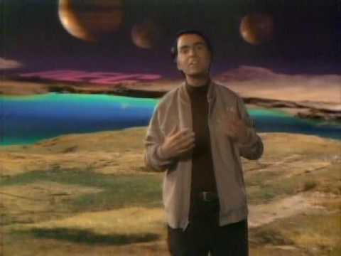
Cosmos:
Universe’s Year Calendar
6min
How did we calculate the age of the universe?
Knowing the current speeds and distances to galaxies, coupled with the rate at which the universe is accelerating, allows us to calculate how long it took for them to reach their current locations. The answer is about 14 billion years. The second method involves measuring the ages of the oldest star clusters.

Slide 22
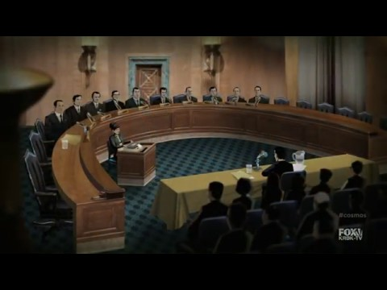
Cosmos
S1E7
Start 2:22
9 min
Or 13 min

Slide 23
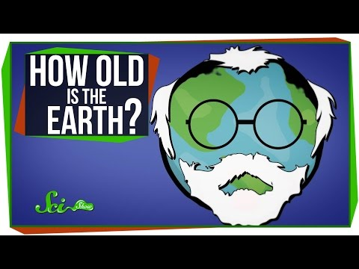
2:20min
EQ:
How old is the Earth & how do we know?

Slide 24
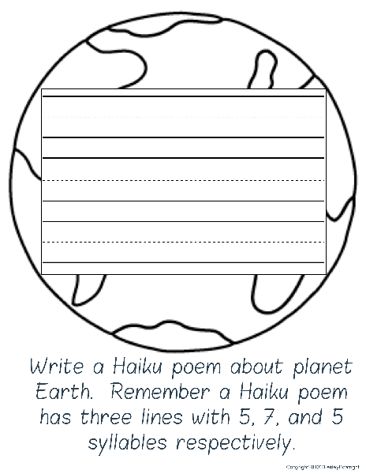

Slide 25
