Slide 1
DNA (“Close Read”)

Slide 2
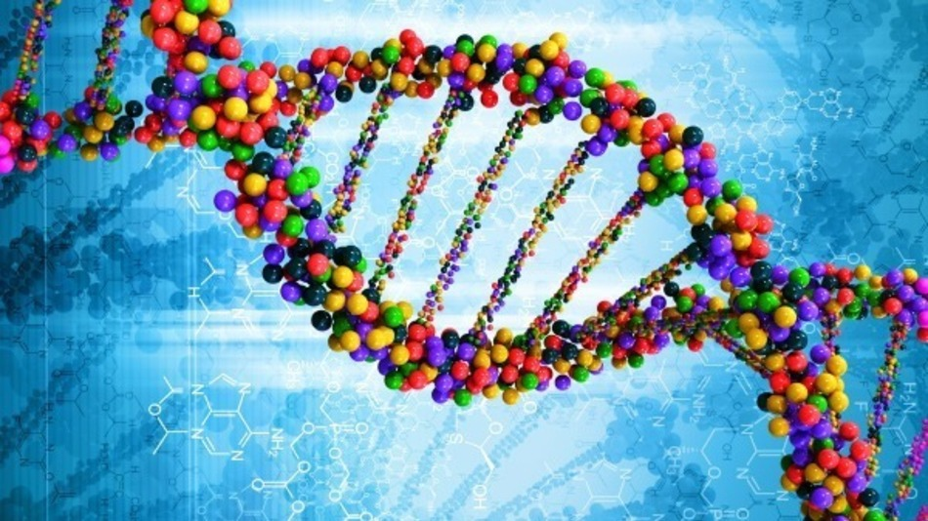
What is DNA?
Macromolecule called Deoxyribonucleic Acid
Instructions for making each species (and individual) unique

Slide 3
1. Where is DNA found?

Slide 4
2. DNA is the recipe to make: PROTEINS

Slide 5
3. Mitochondrial DNA:
Why do we only inherit mitochondrial DNA from our mother?

Slide 6
4. What is DNA made of?
Nucleotides:

Slide 7
5. What does DNA do?
Paraphrase/Summarize in your own words
What is an example of something specific that your body needs to do?

Slide 8
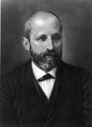
Who discovered DNA? 6. Why is the structure important?
Frederich Miescher was the first to isolate DNA
Determined the Structure

Slide 9
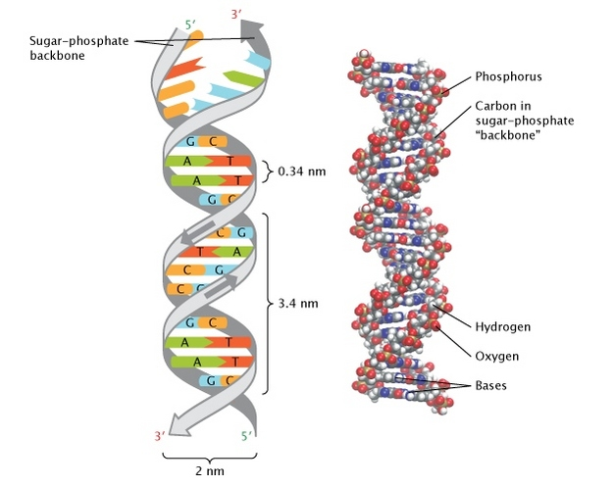
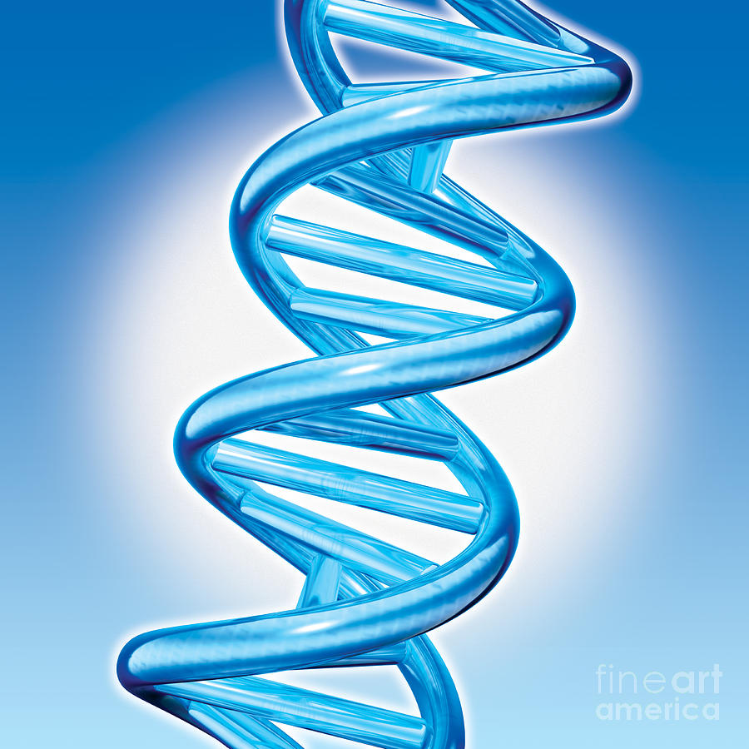
What is the DNA Double Helix? 7. (What are two advantages of DNA’s double-helix shape)?

