Slide 1
Deoxyribonucleic acid
DNA

Slide 2
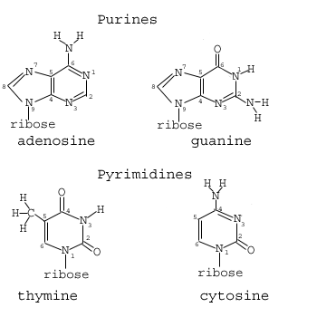
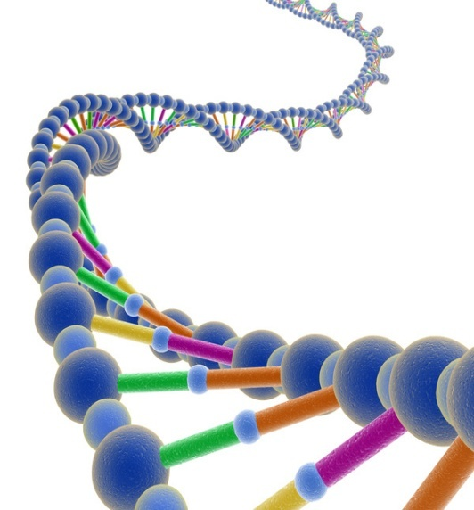
Double Helix (twisted ladder)
4 Nitrogenous bases
Adenine – Thymine
Cytosine – Guanine
Bonded to sides of
alternating sugar and
phosphate.

Slide 3
Nucleic Acids
A group of macromolecules that store and transmit genetic information
Made of smaller repeating subunits called: Nucleotides.
Nucleotides are made of one of each component of DNA (or RNA): A phosphate, a ribose sugar and a nitrogen base.

Slide 4
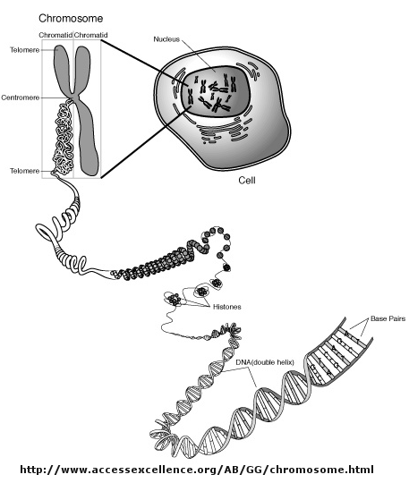
What does it do?

Slide 5
DNA is the recipe for making Proteins
Involved in nearly every body function
Each cell contains 10,000 different proteins
Made of amino acids according to DNA instructions (the recipe).
Protein Function:
Structure
Transport
Cell communication (hormones)
Speed up chemical reaction (enzymes)
Control cell growth

