Slide 1
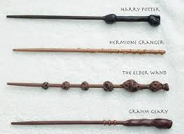
Warm-up (write on ½ sheet)
Muggles lack the ability to do magic. This is a dominant trait whereas the power for witch-craft and wizardry is recessive. In the same population, Brown hair color is dominant and orange hair is recessive. Determine the results of a cross between a Heterozygous muggle with orange hair and a wizard with homozygous brown hair.
1. Parent genotypes 2. Show Work 3. Phenotype ratios

