Slide 1
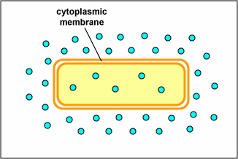
B
A
Which direction will the Oxygen move?

