Slide 1
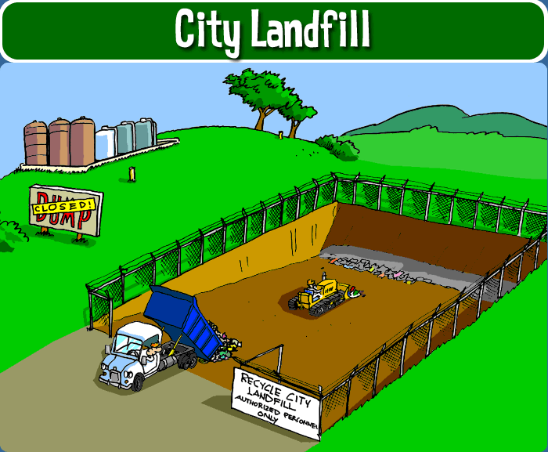
Design a Landfill
A well designed landfill should not leak too much but if it is sealed completely, materials will not decompose. Your task is to use available materials to design a landfill.
Materials: Clay, Parafilm, Plastic wrap, Tape, NaOH (sodium hydroxide), Distilled water, Phenolpthalein

Slide 2
