Slide 1
“WHO STOLE MY OSTRICH EGG!?”
Essential Question: Can you design a test to determine who the culprit is?

Slide 2
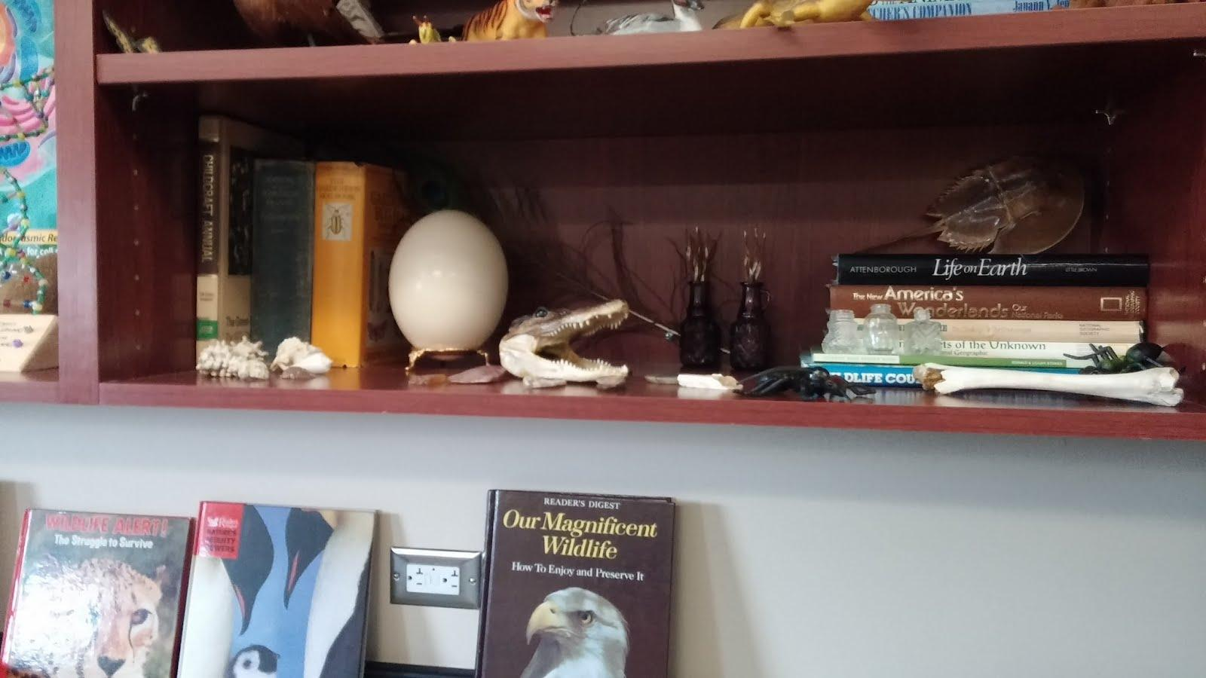
IT’S MISSING!

Slide 3
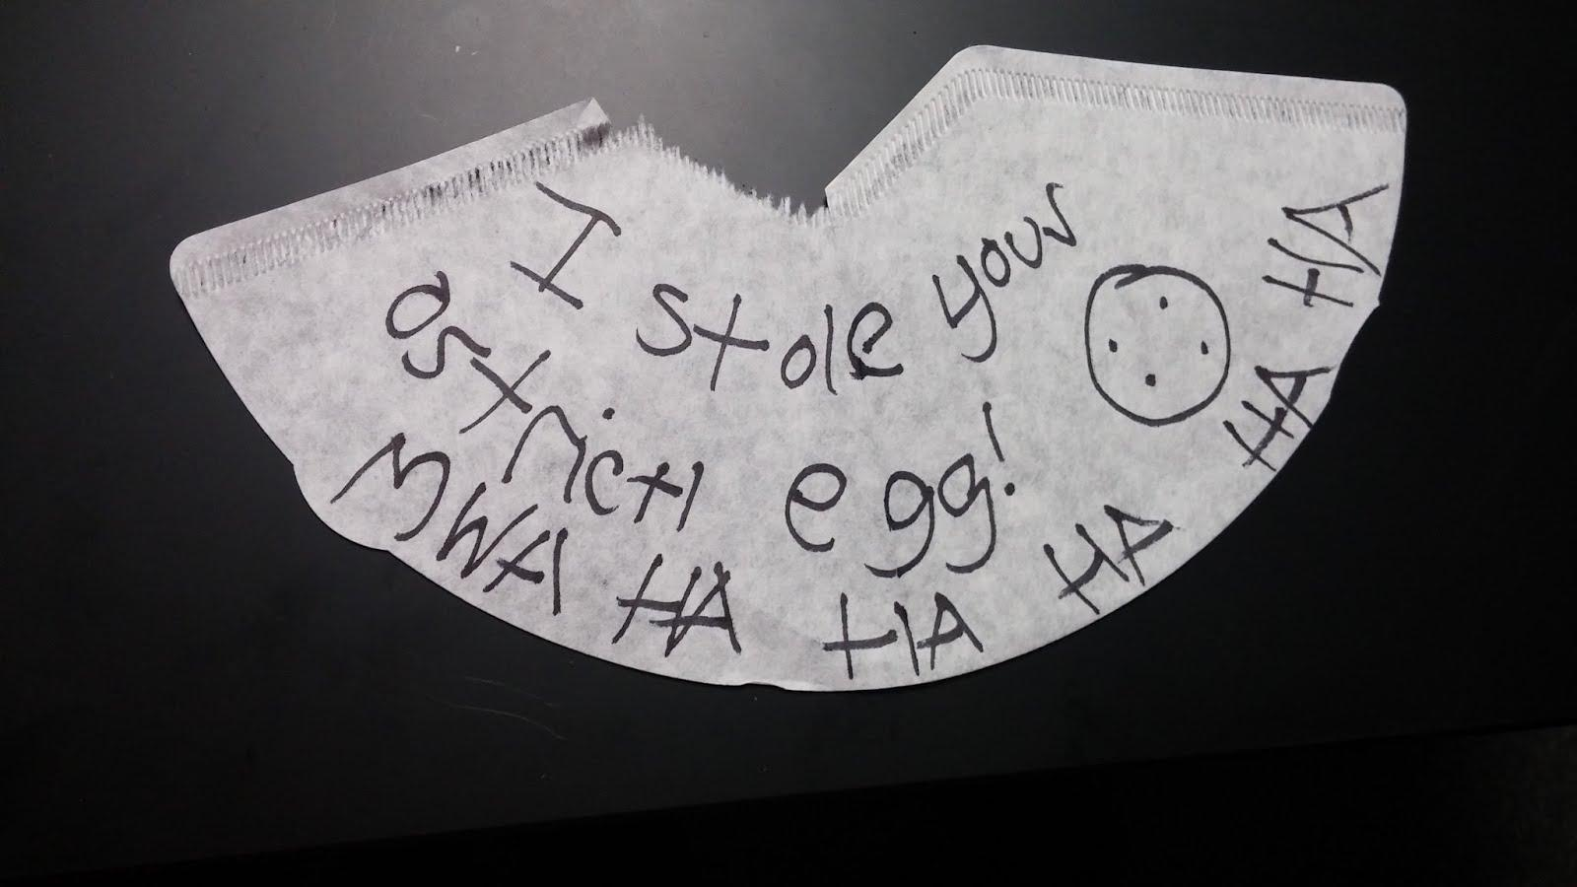
Exhibit A: A NOTE!

Slide 4
Observation Reports (What we know)
Someone used their security code to enter the building.
Based on the code numbers, we know that three biology teachers were in the building over the weekend.
One of them used a black marker to write the note and many of the science teachers LOVE using a certain type of marker.
The coffee filter was taken from the science workroom, where we all have our coffee.
Based on that evidence….these are the suspects:

Slide 5
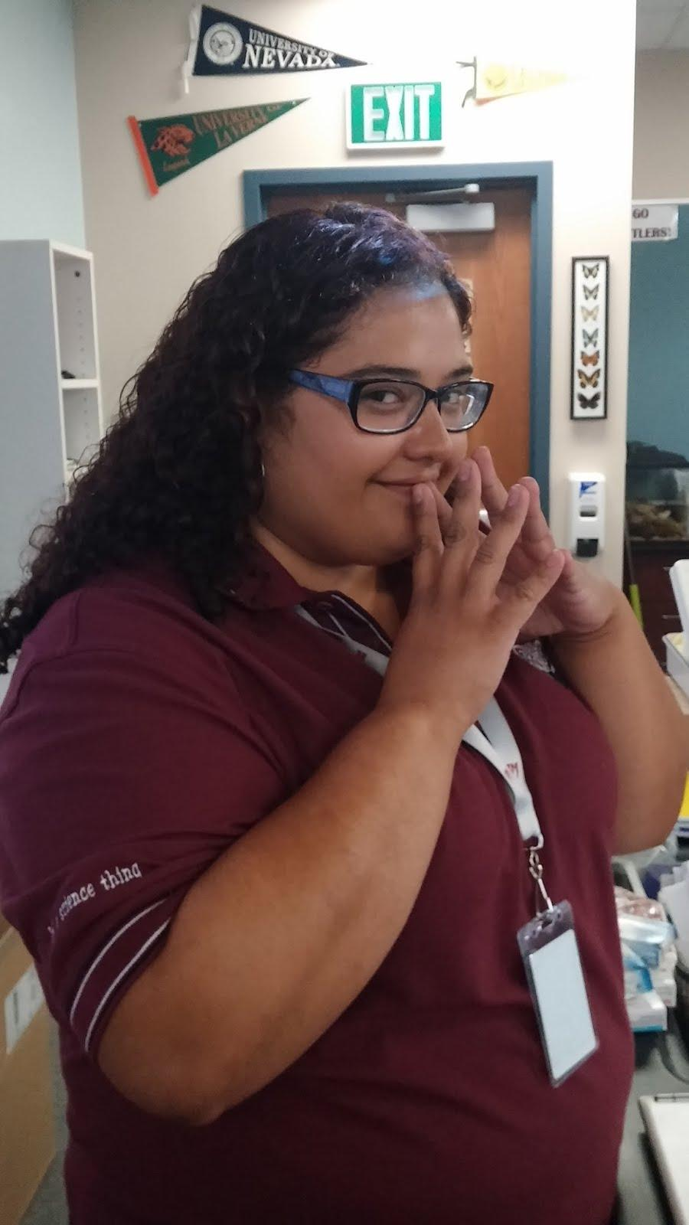
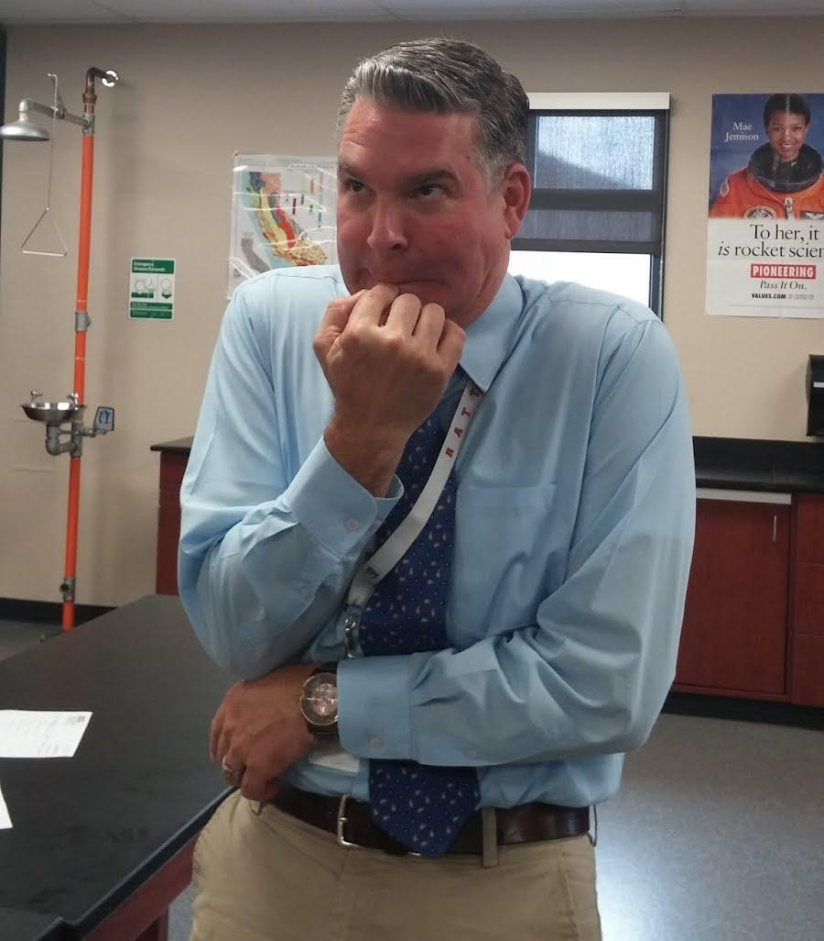
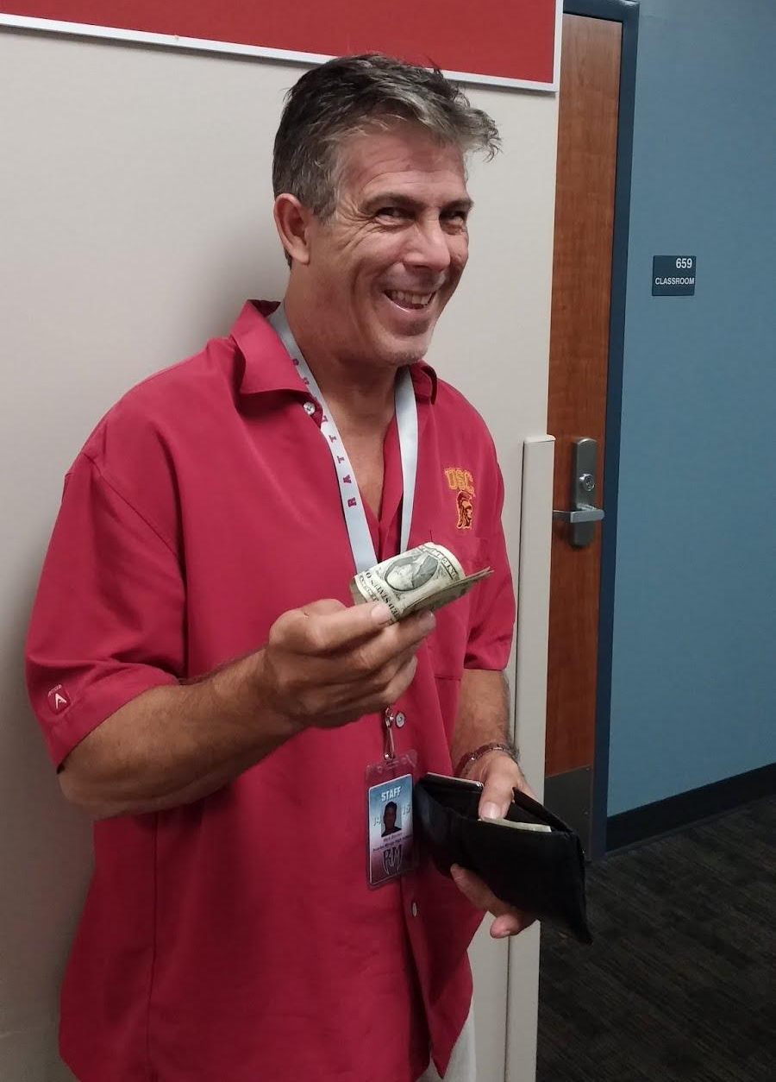
SUSPECTS:
Jorge Jimenez: Permanent Marker “He’s a lawyer, he’s always right”
Yvette Mocete: Crayola Marker “Doesn’t like to take things too seriously”
Mark Borden: Vis a Vis “It’s all about style.”

Slide 6
YOUR “FAMILY’S” JOB!
Design with your “family” an experiment using the supplies on the tray to figure out who stole the egg.
Set up and run your experiment.
Take notes and pictures (you can use the chromebooks) as you’re conducting the experiment!

Slide 7
Each Family has four roles:
Leader: Directs the group and communicates with the teacher if there are questions.
Note-taker: Takes notes during the experiment on what materials are being used, observations on what’s happening, and procedures.
Materials: Gathers supplies and cleans up materials.
Tech Guru: In charge of using the chromebook to take pictures as the experiment is being conducted.

Slide 8
Police Report
On your observation paper, write the roles of each member at the top. Include your table number.
Note-taker writes all the procedures and observations on the paper.
At the end of your experiment, write who you think stole the egg and what evidence you used to come to this conclusion.

Slide 9
Restrictions for your experiment:
You may use the materials on your trays but you don’t have to use all of the materials. If there is something that you think will help your experiment, your leader can ask the teacher.
You can use the rubbing alcohol on the front table (limit to 100 ml).
Water is unlimited.
You only have the period to complete the experiment.

Slide 10
Tech Gurus!
Get your chromebook from the chromebook cart and go see Mrs. Robles for instructions on how to take pictures using the chromebook!

Slide 11
Clean Up
Save all your evidence strips in the plastic baggy.
Any UNUSED alcohol needs to be placed back into the container.
Cups need to be rinsed!
The beaker, markers, paper clips, and clean cups stay on your tray.
Turn in your Police Report and Evidence bag (with your table number) to the turn in box for your period!

