Slide 1
Claim, Evidence and Reasoning
(Title of page 6)
25 August 2016

Slide 2
Page 4,
25 August 2016
Unit/Topic:
Introduction to Biology
Essential Question:
How do we use evidence to support claims?
Reminders: Characteristics of Life Quiz on Tuesday

Slide 3
Warm-up
Answer Questions using complete sentences!
You don’t have to write down the question.
What is evidence?
How could evidence be important to science and the study of biology?

Slide 4
Page 4:
Writing an Explanation
In science, information needs to be explained.
Explanations have three parts:
Claim
Evidence
Reasoning

Slide 5
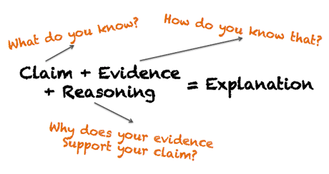

Slide 6
Example:
Claim: Thanos stole Ms. Robles’ puma skull.
Evidence: When drops of alcohol were dripped onto the marker samples, the color from the permanent marker matched the color from the marker found on the note.
Reasoning: Since the permanent marker color and the marker color from the note matched when alcohol was poured on them, it meant that Thanos stole the puma skull because he uses a permanent marker.

Slide 7
Example:
Warm water makes the sponge capsules open faster than cool water.

Slide 8
Add to glossary:
Claim:
a statement that gives an answer or conclusion to a question or problem.

Slide 9
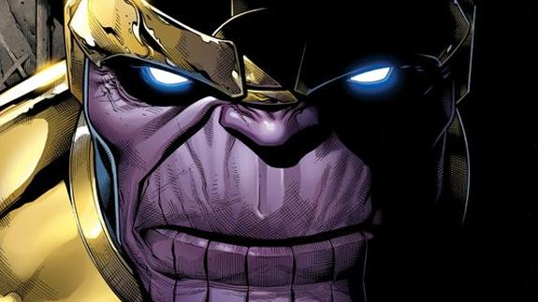
Example
Claim: Thanos stole Ms. Robles’ puma skull.

Slide 10
Add to glossary:
Evidence:
Scientific data (observations, measurements or results from an experiment) that can support the claim.

Slide 11
Example:
According to our results, it took 6 minutes for the sponge in heated water to open and 25 minutes for the sponge in room temperature water to open.

Slide 12
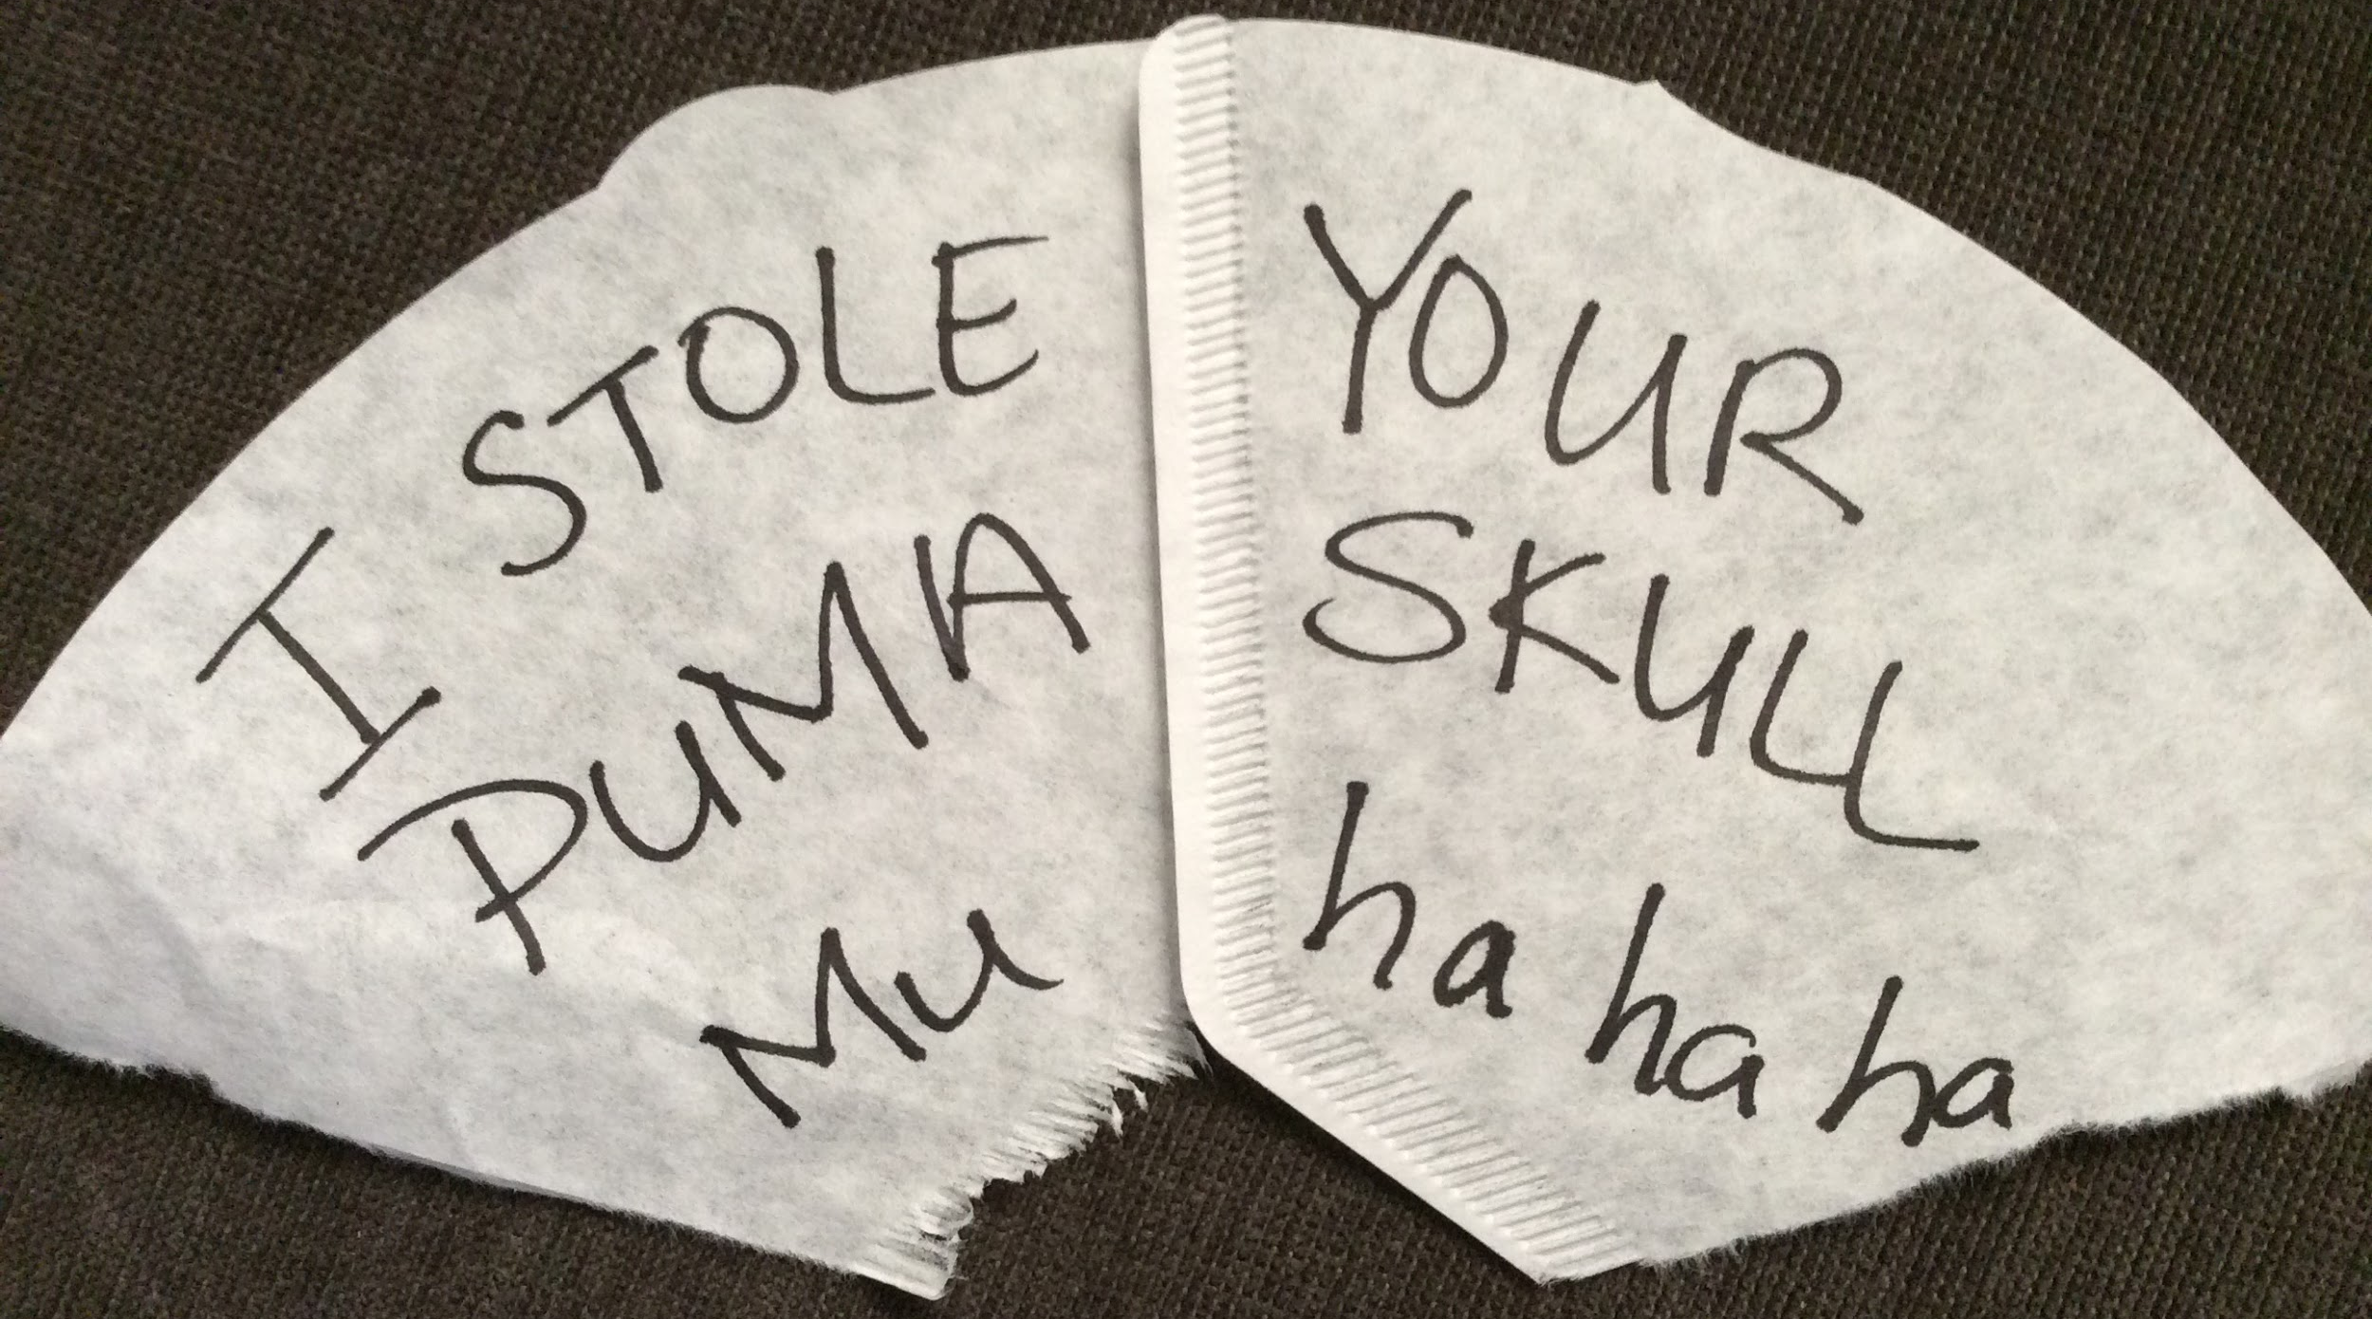
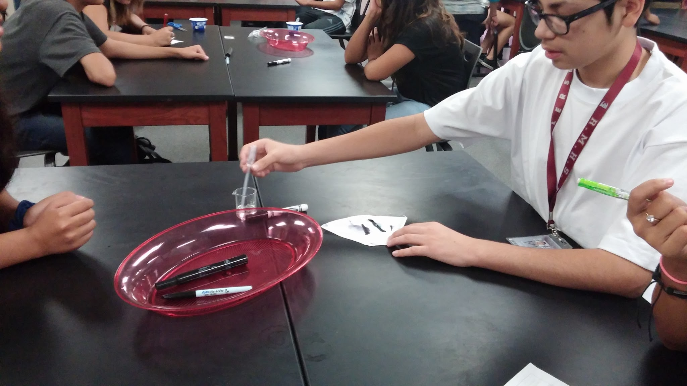
Example:
When drops of alcohol were dripped onto the marker samples, the color from the permanent marker matched the color from the marker found on the note.

Slide 13
Add to glossary:
Reasoning:
Explains why the evidence supports the claim by providing a logical connection between the two.

Slide 14
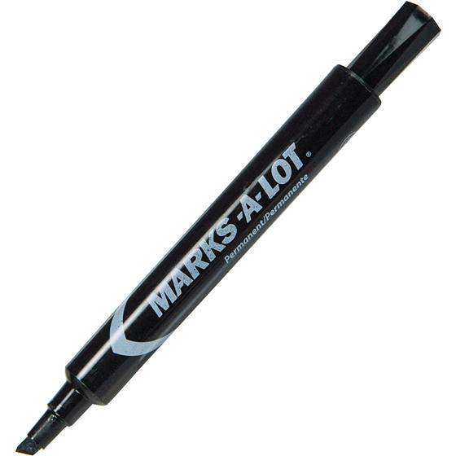
Example:
Since the permanent marker color and the marker color from the note matched when alcohol was poured on them, it meant that Thanos stole the puma skull because he uses a permanant marker.

Slide 15
Since the sponge capsule that
was heated opened faster and this was consistent with other results found in the class, our original claim was supported.

Slide 16
Add to glossary!
Biology: The study of
organisms.
Organisms: Any living or once living thing.

Slide 17
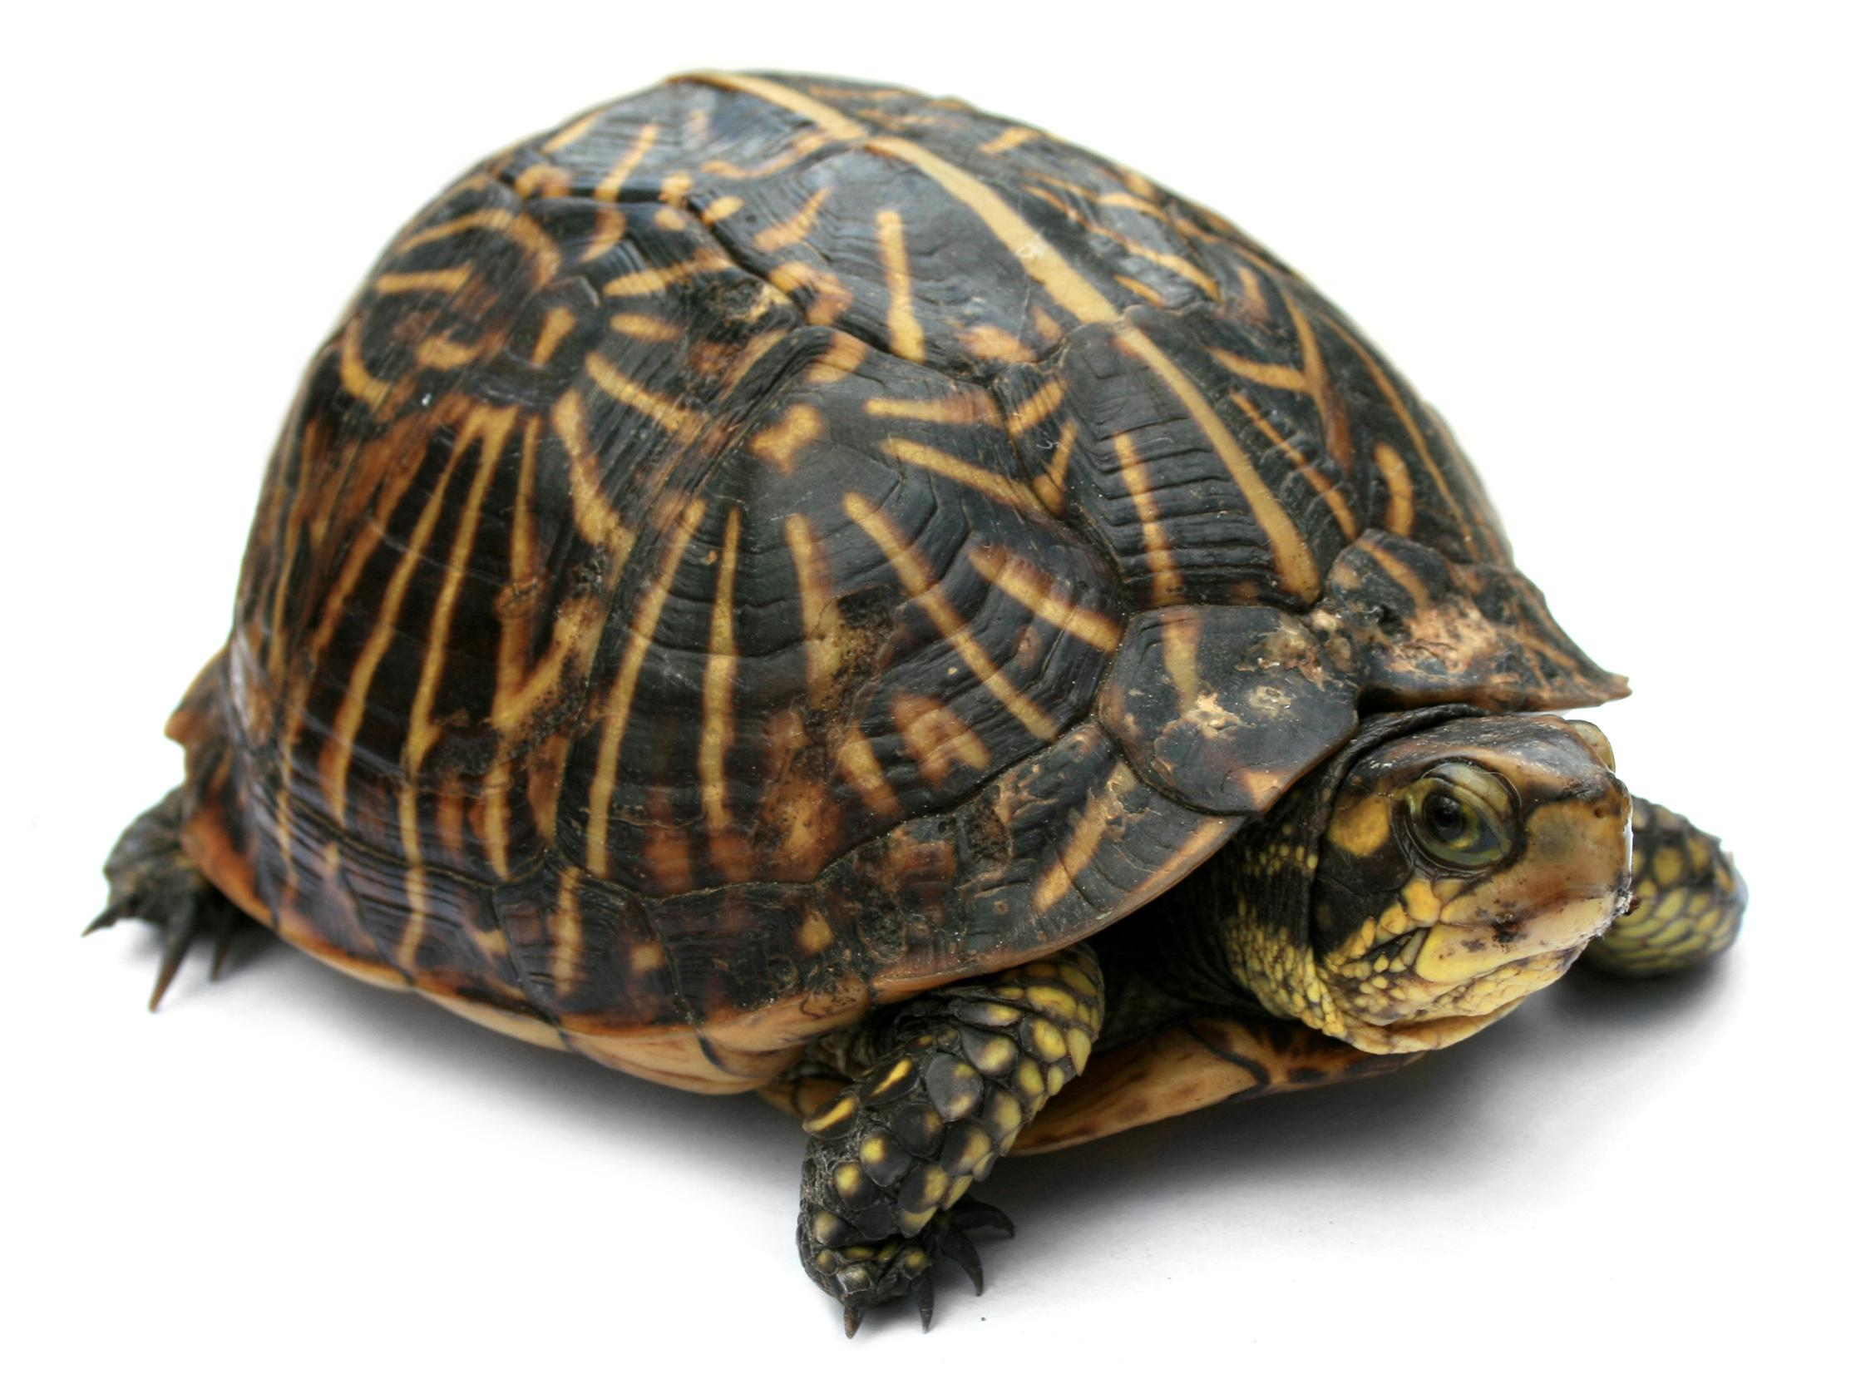
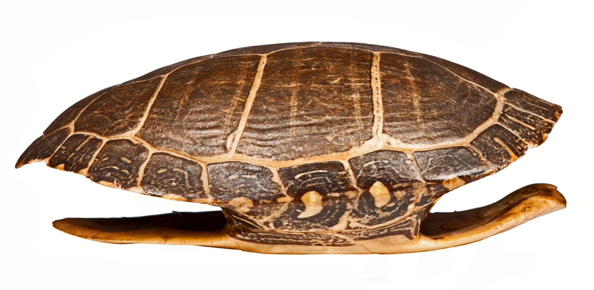
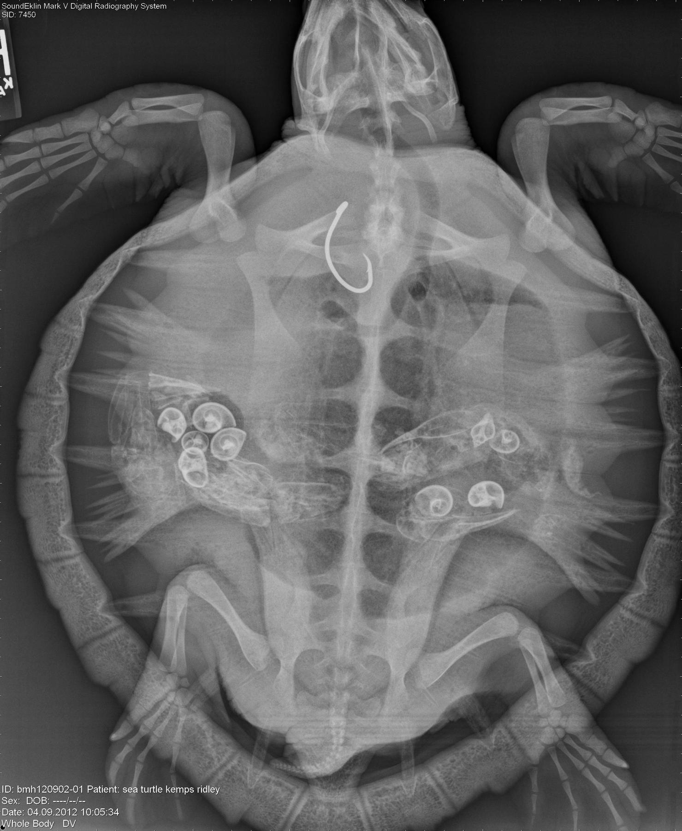
Practicing with Scientific Explanation
Where did the turtle shell come from?

Slide 18
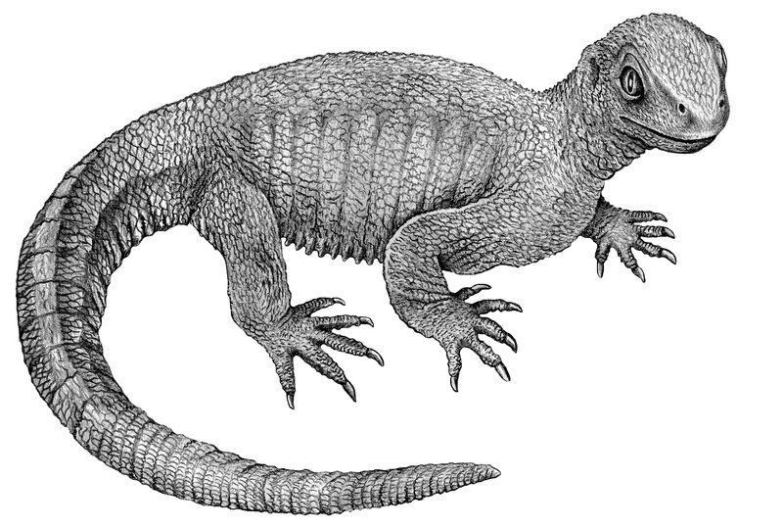
And it has to do with this guy!
Ancestor of the turtle!

Slide 19
At the top of your article...
Write the essential question: What is the claim, evidence, and reasoning of this article?
Number the paragraphs
(9 total/10 if you count the caption)

Slide 20
Step 1:
Read all the way through without marking anything on the paper!

Slide 21
Step 2:
Read again and circle words that you don’t understand.

Slide 22
Step 3:
Underline and put a “C” next to the scientist’s claim
Underline and put an “E” next to the scientist’s evidence
Underline and put an “R” next to the scientist’s reasoning.

Slide 23
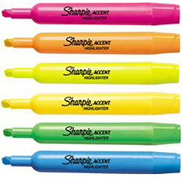
Bring out the highlighters!
You will need three different colors. If you don’t have your own, you will have to share mine or use a colored pen or pencil.

Slide 24
Page 6:
Article Reflection
Answering the Essential Question:
What is the author’s claim in this article?
What evidence did scientist see when looking at the prehistoric reptile?
How did scientists know that those structures meant that the reptile was an early ancestor to the turtle?

