Slide 1
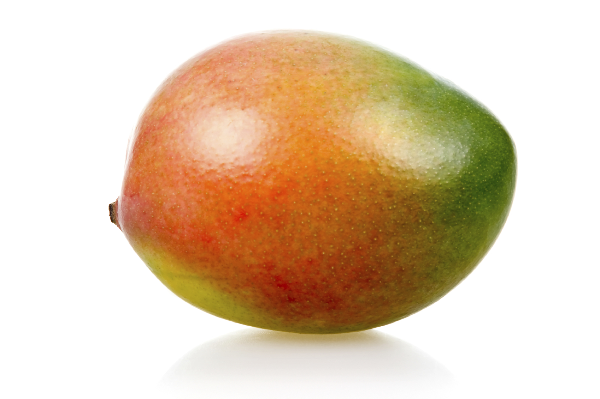
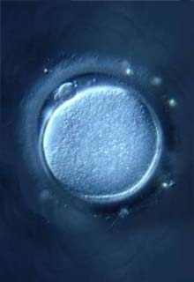
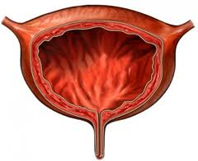
Pretend that this is the quiz: Would you get an “A”? U can get it
1) Are egg cells haploid or diploid?
2) Are cells of your big toe haploid or diploid?
3) Are the cells of your bladder haploid or diploid?
4) Are somatic cells haploid or diploid?
5) Are gametes haploid or diploid?
6) If a mango has 40 chromosomes in the cells of its peel, how many chromosomes does it have in it’s pollen?

