Slide 1
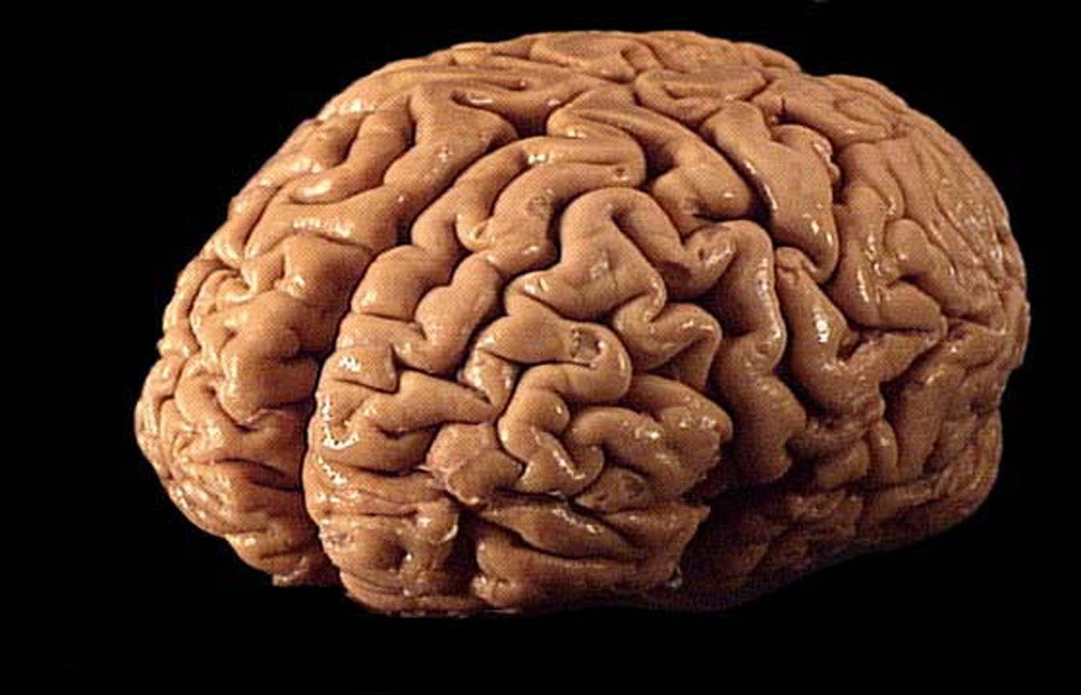
Practice Quiz:
1) Are sperm cells haploid or diploid?
2) Are cells of your tongue haploid or diploid?
3) Are the cells of your brain haploid or diploid?
4) Are somatic cells haploid or diploid?
5) Are gametes haploid or diploid?
6) If Smurfette has 22 chromosomes in her egg cells, how many chromosomes does she have in her skin cells?

