Slide 1
The Characteristics of Life

Slide 2
Essential Question:
What characteristics distinguish living organisms from non-living matter?

Slide 3
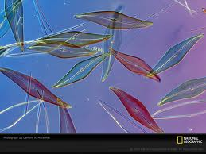
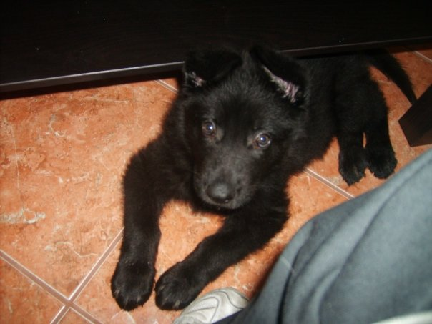
Characteristics of Life
1. Made of cells
Cell = Basic unit of all life
Unicellular vs. Multicellular

Slide 4
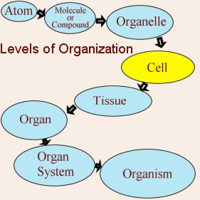
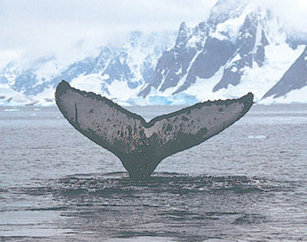
Characteristics of Life
2. Displays Organization
Each organized structure has a function

Slide 5
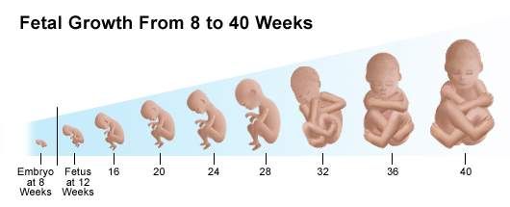
Characteristics of Life
3. Grows and Develops

Slide 6
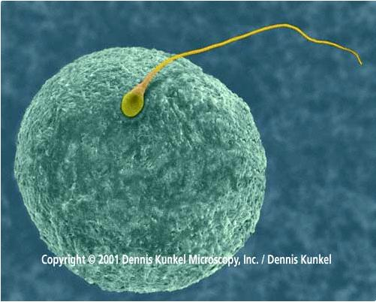
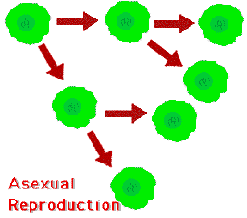
Characteristics of Life
Reproduces
Asexual vs. Sexual

Slide 7
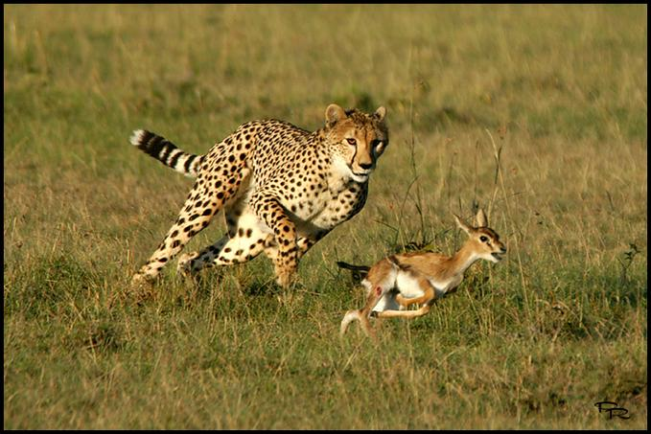
Characteristics of Life
5. Responds to Stimuli

Slide 8
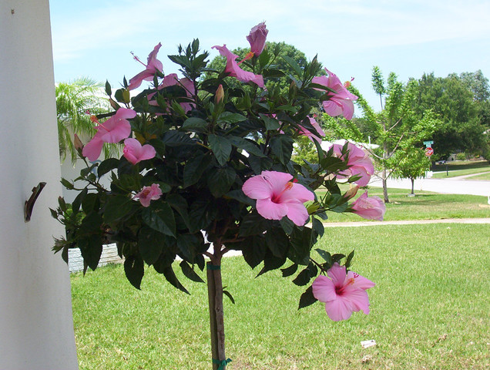
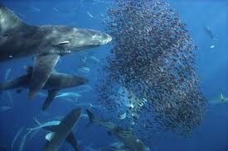
Characteristics of Life
6. Requires Energy
-Obtaining and using or making

Slide 9
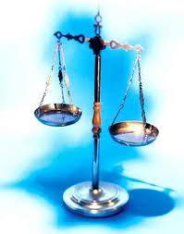
Characteristics of Life
7. Maintains Homeostasis- an internal balance
Food Intake
Temperature
Water Content

Slide 10
Characteristics of Life
8. Adaptations evolve over time

