Slide 1
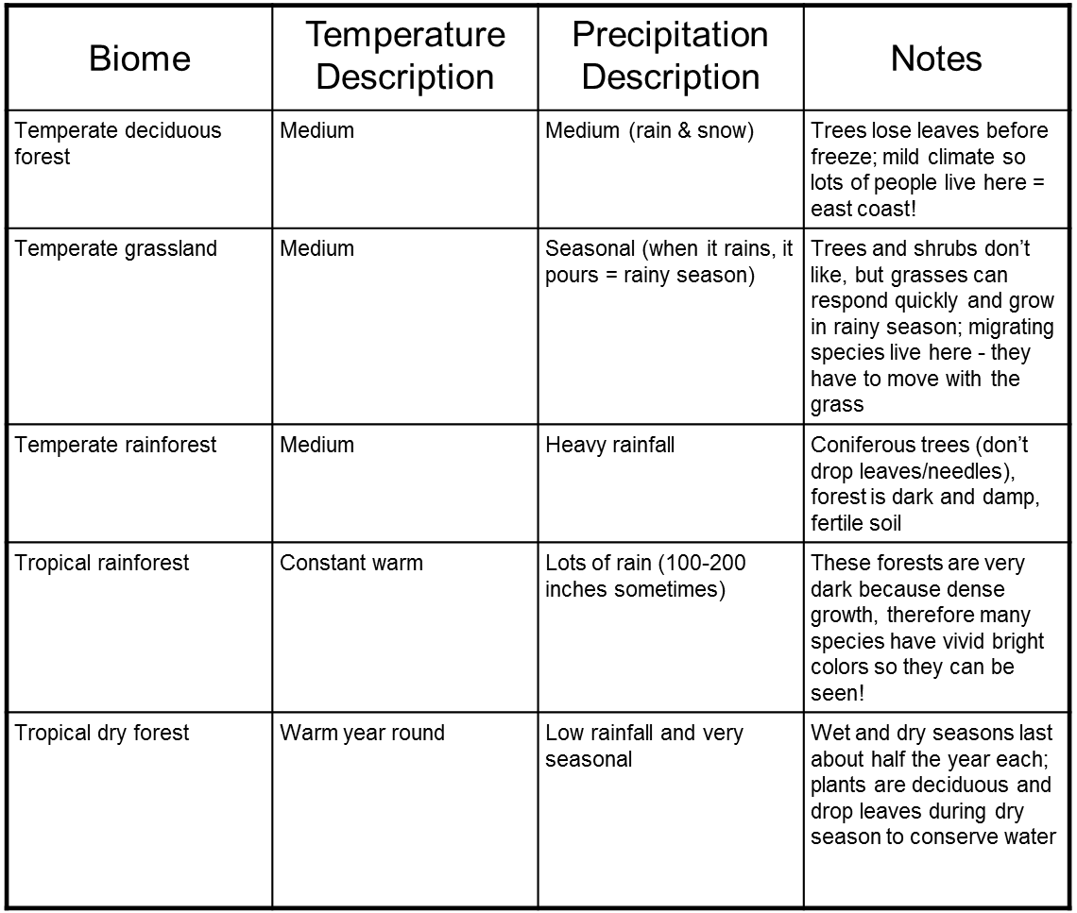
(Temp. seasonal forest)s*

Slide 2
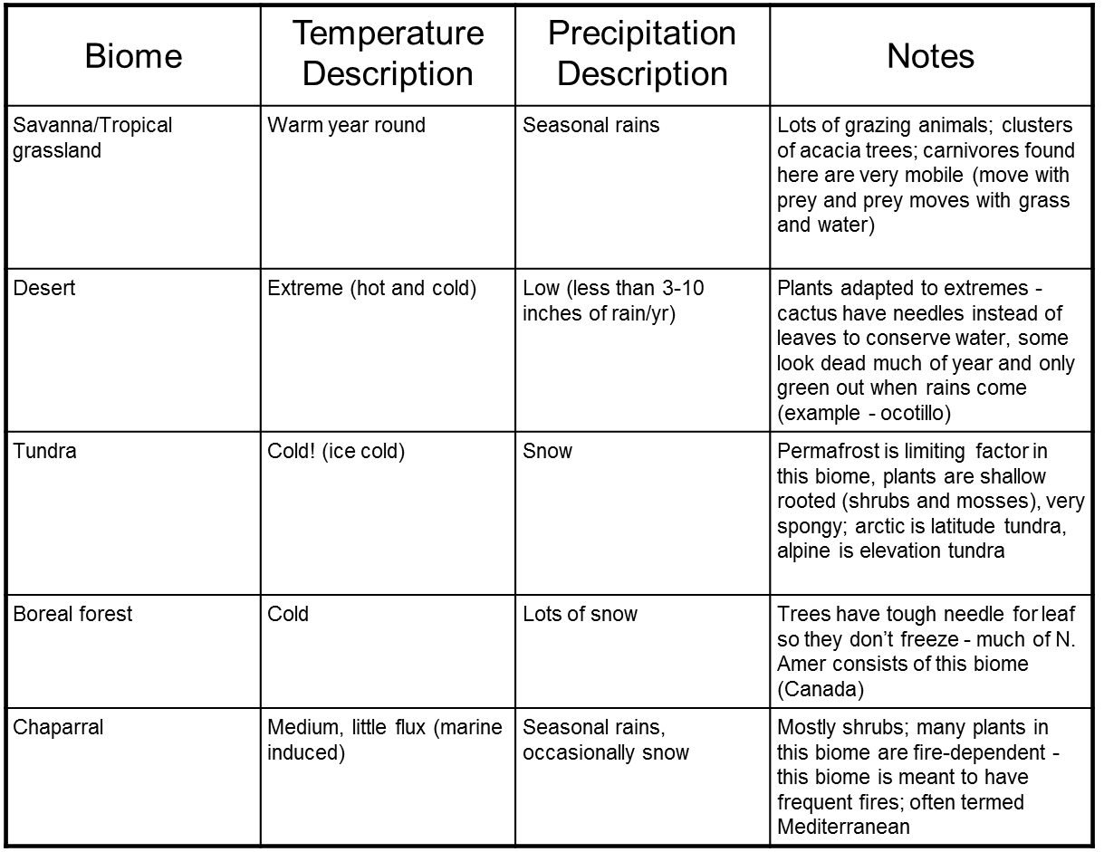
(Taiga)*
(Shrubland)*

Slide 3
Notes:
Seasonal forests

Slide 4
Human Impacts on the deciduous forest (seasonal forests)
Much of it cleared for farming
Periodic logging
High population (East coast and Europe especially).

Slide 5
Notes:
Prairies or steppes

Slide 6
Human Impacts on temperate grasslands
Most moist grasslands of the world have been converted to agriculture, since the rich soil is good for growing cultivated grasses such as corn and wheat.
Drier grasslands have been converted to graze cattle, sheep and goats.
Only fragmented grasslands remain

Slide 9
Human Impacts on temperate rainforest
At least half have been logged
Most of remaining is scheduled for logging
Small patches are protected for endangered species

Slide 11
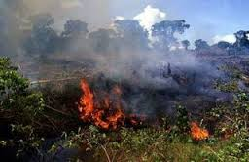
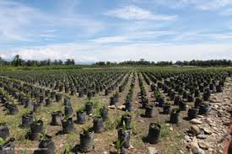
Human Impacts on tropical rainforest
Intense logging pressure
Intense agricultural pressure
Notes:
Slash and burn common because soil isn’t great because nutrients are tied up in the biomass. Farming only good for a couple years and then have to move on.

Slide 13
Human Impacts on tropical dry forest
High human population
Harvesting of wood for buildings and fuel.
Farming
Grazing

Slide 14
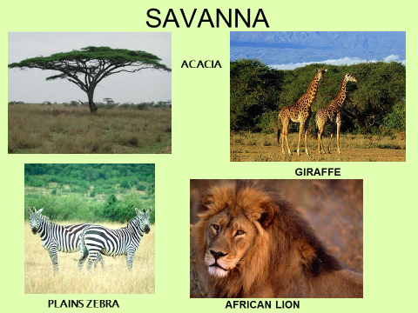

Slide 15
Human Impacts on the savanna
Heavily impacted by agriculture in the more moist areas (fertile soil)
Grazing in the drier areas

Slide 17
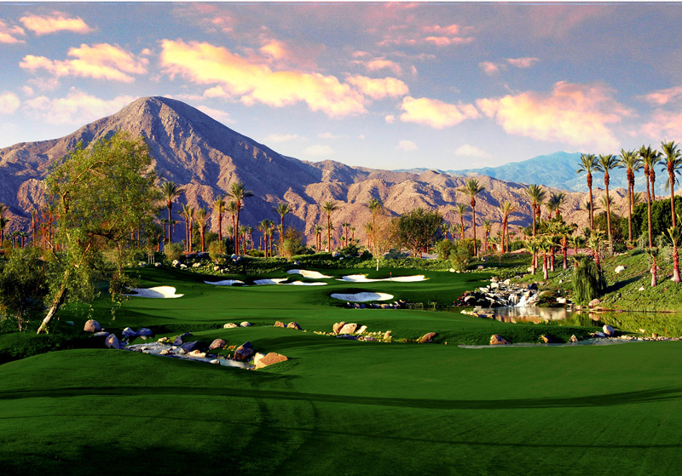
Human Impacts on the desert
Modern technology allows for the transport of water to the desert resulting in cities and some agriculture

Slide 19
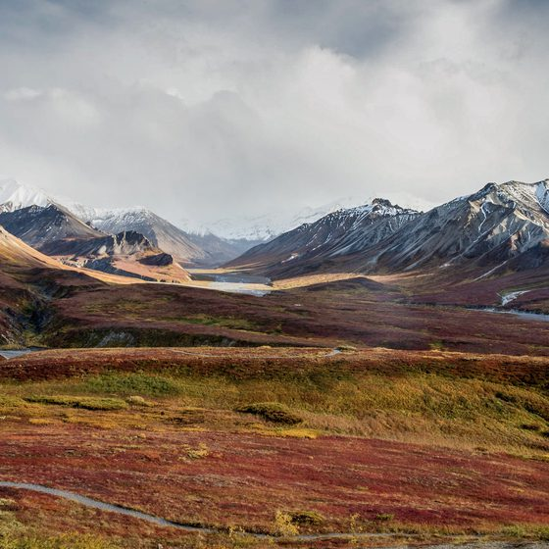
Human Impacts on the tundra
Few people live here
Natives rely on subsistence hunting
Impacts are slow to heal because of short growing season
Climate change (warming) is melting tundra (and releasing methane gas).
QUICK READ
(“Tundra Threats article)

Slide 20
Notes:
Also Taiga, Northern Coniferous Forest

Slide 21
Human Impacts on the boreal (taiga) forest
Population density is low so there has been less of an impact here
Logging is common
Some reindeer herding
Natives rely on subsistence hunting

Slide 23
Human Impacts on chaparral (scrublands)
Very little left undisturbed
Agriculture
Moderate climate leads to high population (cities).

Slide 24
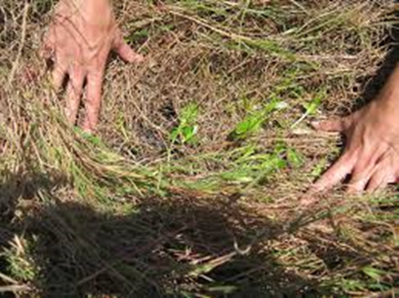
Fire ecology
Forests, savannas and chaparral biomes especially need natural fires to be maintained:
In savannas/grasslands:
Fire destroys invasive species that compete for resources
Fire removes cover and allows sunlight penetration
Fire helps the seeds of native grasses to germinate
Fire enhances cycling of
nutrients back into the soil.

Slide 25
Fire ecology continued
In chaparral (scrublands):
Fire removes brush, reducing competition for resources
Helps plants that require fire or lack of brush cover to germinate
Enhance cycling of nutrients

Slide 26
