Slide 1
Chapter 1 Review

Slide 2
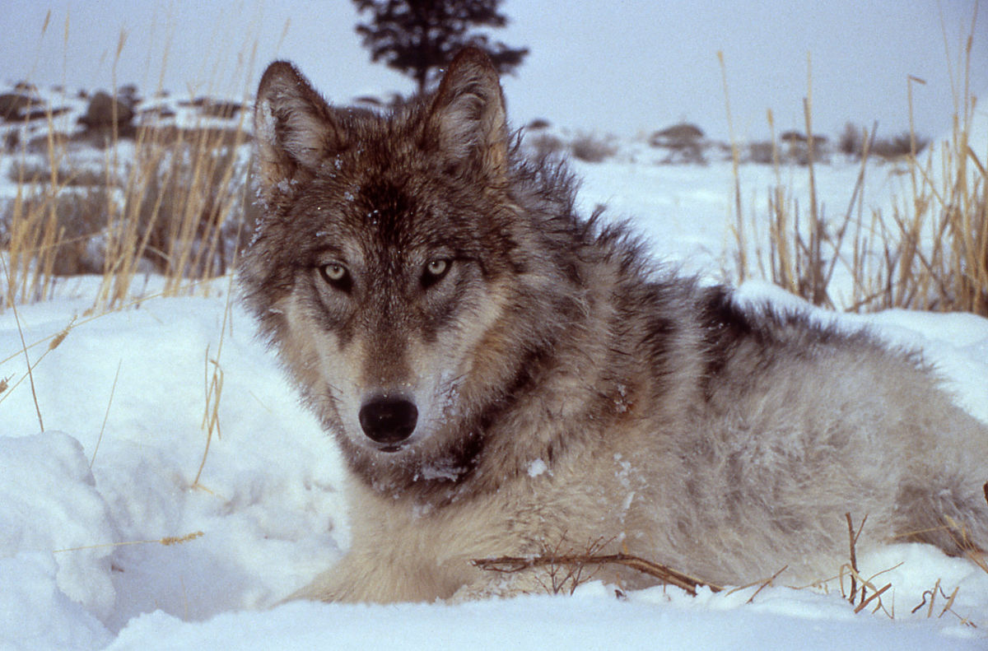
Be sure to know consequences of wolves in Yellowstone.

Slide 3
Which of the following would NOT be considered an ecosystem service?
Pollination D. Photosynthesis
Erosion control E. Farming
Water filtration
Notes:
Think of putting a dollar value on it

Slide 4
What is sustainability in terms of environmental science?
Notes:
Development that meets the needs of the present without compromising the ability of future generations to meet their own needs

Slide 5
What is globalization?
2. What is one negative effect of globalization?

Slide 6
Which of these would NOT be an example of a human health issue caused by environmental exposure:
Asthma caused by air pollution
Lung disease caused by mining
Malaria spread by mosquitos
Genetic hemophilia
Heat stroke

