Slide 1
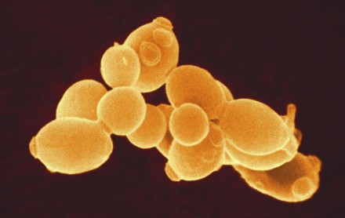
Cellular Respiration Demo
On page 21:
1. Hypothesis: If the yeast cells break down sugar (do cellular respiration), they will release _______ and the balloon will ________________.
a. What is the purpose of cellular respiration?
b. What is the main product of cellular respiration?
c. What is the main “waste” product of cellular respiration?
2. Results:
3. Conclusion Statement:

