Slide 1
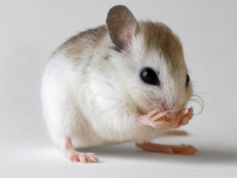
Cells Cells reprogrammed in Living Mice
Work with a partner, number the paragraphs and answer the following questions in complete sentences:
1) Who is the author? Do you think they know what they’re writing about? How do you know? (include where you got the information).
2) Who are the experts in this article? Circle the experts and highlight the evidence that supports your choice.
3) For the experts you highlighted, would you trust their information? Why?
4) According to the author, why are stem cells important? Use info from the article to support your answer (reference the paragraphs)
5) What is the relationship between mitosis and tumors?

