Slide 1
Warm-up
Add to page 10: Summarize the cell notes and add a level 2 or level 3 question.
Add to page 11: Summarize your animal cell vs. plant cell double-bubble

Slide 2
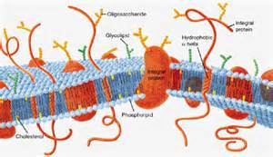
Cell (plasma) membrane article:
Read
Number paragraphs
Read again
Mark “?” for confusing ideas
Circle confusing words
Mark “!” for interesting or new information

Slide 3
Article Analysis (p.12):
Essential Question: “What materials need to pass through the cell membrane and how is it designed to allow passage?”
Why do you think the cell membrane is called the fluid mosaic model?
What is the cell membrane made out of?
Summarize the article (including answering the Essential Question).

